Slide 2
Good morning Year 5!
Firstly, I would like to say well done for creating such a fantastic sports day. You were all amazing and made it so much fun - thank you!
I will be on Dojo all day so please send me any work or messages and I will get back to you as soon as possible.
I am looking forward to seeing you all again soon!

Slide 3


To wake up your brain, have a go at the following task:
Try and get as close as you can to the target number using these six numbers:
75
10
25
7
3
5
Target number: 446
You can only use the number once.
Only plus, minus, times and divide are allowed.

Slide 4
Arithmetic

Slide 5
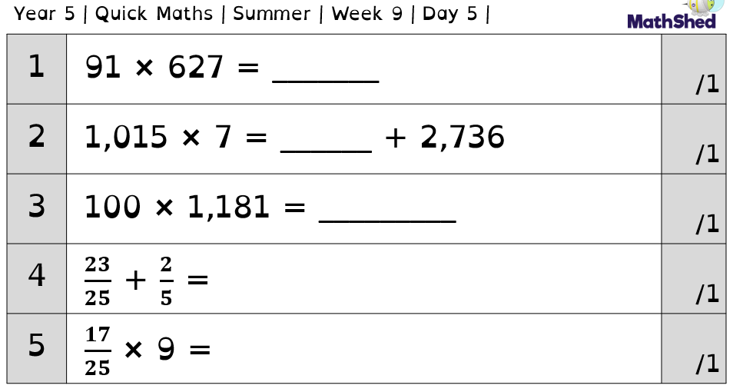
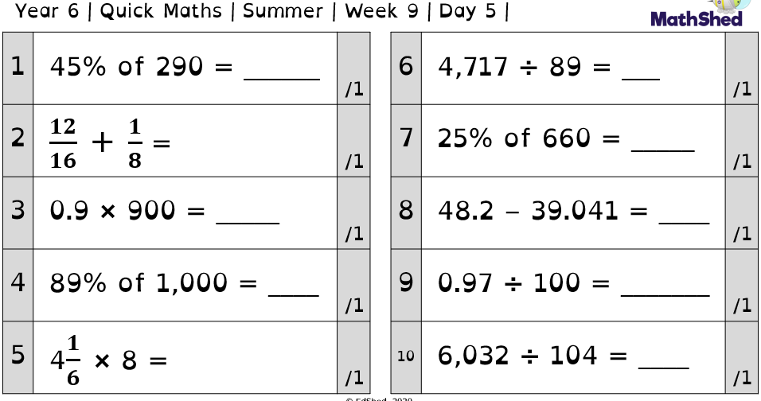

Slide 6
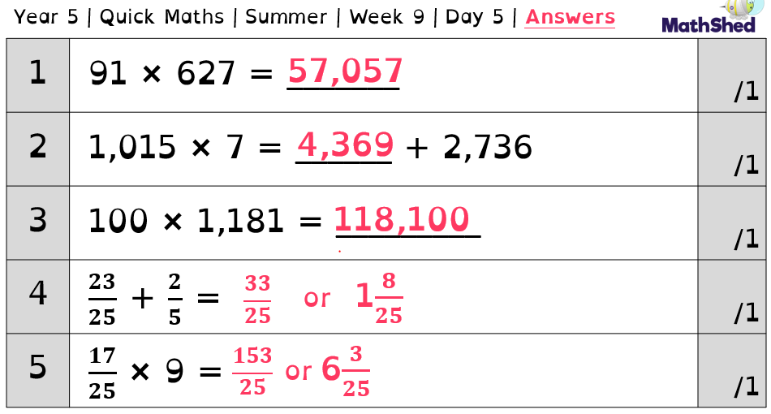
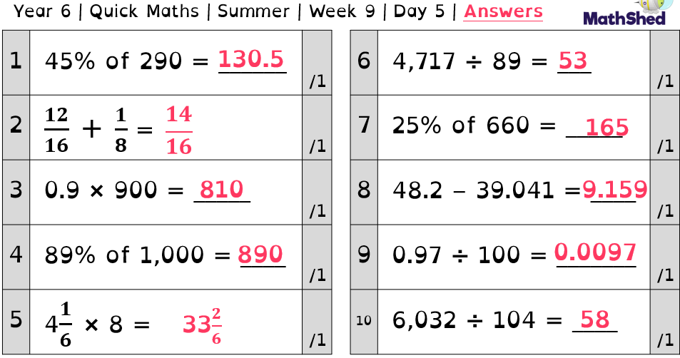

Slide 7
Maths
- Quadrilaterals

Slide 8
Quadrilaterals

Slide 9
What Is a Quadrilateral?
a 2D shape
a 4-sided
shape
has 4 interior angles that add up to 360°
all of its sides are straight

Slide 10
Square
Do you know what the properties of a square are?
All sides are of equal length.
Opposite sides are parallel.
All interior angles are equal.
If the interior angles of a quadrilateral add up to 360°, what must each interior angle of a square be?
Each angle is a right angle of 90°.

Slide 11
Rectangle
Do you know what the properties of a rectangle are?
Opposite sides are parallel and of equal length.
Every angle is a right angle (90°).

Slide 12
Rhombus
Do you know what the properties
of a rhombus are?
All 4 sides are of equal length.
Diagonally opposite angles are equal.
2 angles are acute and 2 are obtuse.
Opposite sides are parallel.
What other name could be given to a rhombus?
A parallelogram.

Slide 13
Parallelogram
Do you know what the properties of a parallelogram are?
It has 2 pairs of equal parallel sides.
Diagonally opposite angles are equal.
2 angles are acute and 2 are obtuse.
A rhombus is a type of parallelogram. Which property means that not all parallelograms are rhombuses?
In a rhombus, all of the sides are equal.

Slide 14
Trapezium
Do you know what the properties of a trapezium are?
Has 1 pair of parallel sides.

Slide 15
Kite
Do you know what the properties of a kite are?
Has 2 pairs of equal, adjacent sides.
1 pair of opposite angle are equal.

Slide 16
Which is the odd one out? Explain your choice.
Name each shape.

Slide 17
Which is the odd one out? Explain your choice.
Example answer:
The pentagon is the odd one out as all of the others are quadrilaterals.
Name each shape.
trapezium
parallelogram
rectangle
square
pentagon
rhombus

Slide 18
Draw lines to match the true statements to the shape.
It is a rectangle
It has 5 right angles
It has 3 sides
It has equal sides
It has 4 sides

Slide 19
Draw lines to match the true statements to the shape.
It is a rectangle
It has 5 right angles
It has 3 sides
It has equal sides
It has 4 sides

Slide 20
Fill in the blanks to describe the shape.
This shape has ______ sides.
It has ______ right angles.
It has ______ pair of parallel sides.

Slide 21
Fill in the blanks to describe the shape.
This shape has ______ sides.
It has ______ right angles.
It has ______ pair of parallel sides.
4
0
1

Slide 22
Draw the shape using the description below.
The shape has:
4 sides
4 right angles
What shape have you drawn?

Slide 23
Draw the shape using the description below.
The shape has:
4 sides
4 right angles
What shape have you drawn?

Slide 24
Circle the quadrilaterals.

Slide 25
Circle the quadrilaterals.

Slide 26
Tina is thinking of a shape. It has:
4 equal length sides
No right angles
What shape could Tina be thinking of? Give all possible answers.

Slide 27
Tina is thinking of a shape. It has:
4 equal length sides
No right angles
What shape could Tina be thinking of? Give all possible answers.
Tina could be thinking of a rhombus.

Slide 28
What Am I?
My adjacent sides are of equal length and I have 1 pair of equal angles. What am I?
I have 1 pair of parallel lines. What am I?
I have 4 right angles but my sides are not all equal. What am I?
All of my sides are equal and I have 2 acute angles. What am I?
All of my sides and angles are equal. What am I?
I am a square.
I am a rhombus.
I am a trapezium.
I am a rectangle.
I am a kite.

Slide 29
Video link for more support: https://vimeo.com/549255278

Slide 30
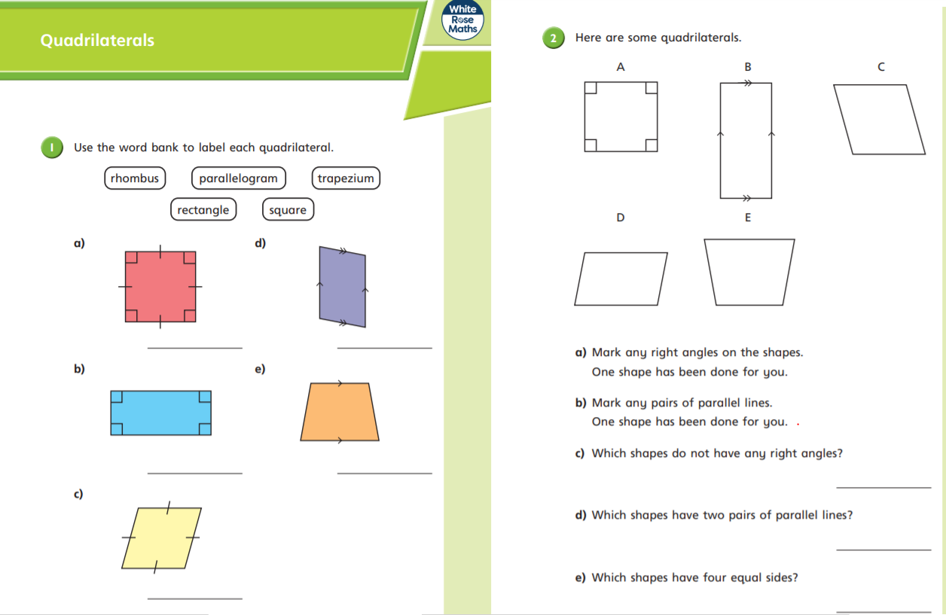
Now, use your knowledge to answer the following questions:
(Full sheet also available on Dojo.)

Slide 31
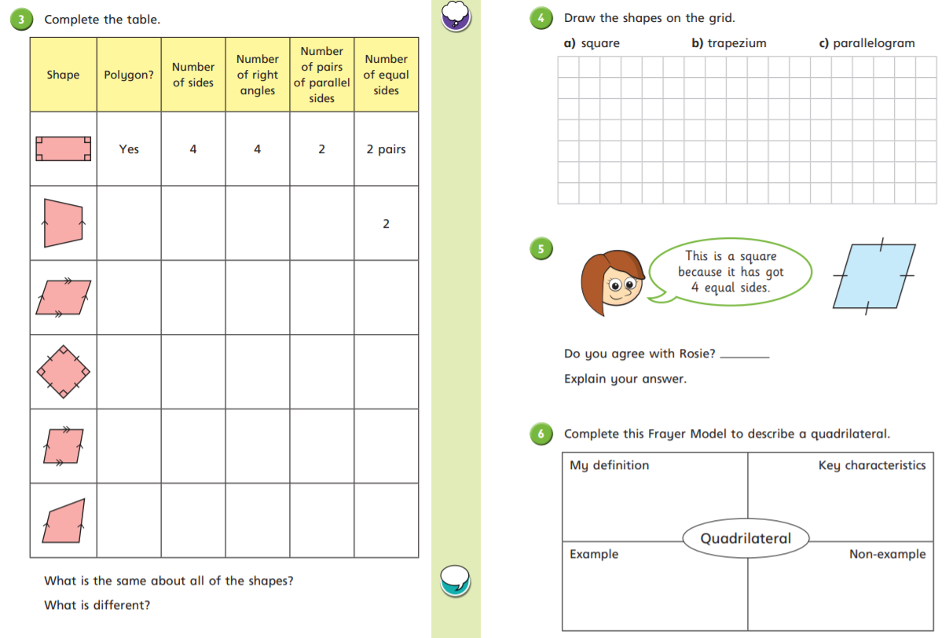

Slide 32
GPS Starter

Slide 33
Yesterday, we looked at when to use the homophones ‘here’ and ‘hear’.
Use your knowledge to complete the sentences on the following page.
Then, create a poster for our GPS wall showing the difference between the two.

Slide 34
Tuesday 29th June 2021
Writing Warm up— Homophones— Here/hear
Why? Miss Cooper has seen us mixing up the homophones in our work.
Complete the sentences using hear/here.
I _________________________ you are going to space.
Did you _________________________ about the sacrifice to the gods?
I can _________________________ the countdown.
I _________________________ a strange rumbling sound coming from the rocket.
Our space suits are right _________________________
Can you come _________________________?
I _________________________ an alien coming!

Slide 35
Writing
- Features of a newspaper report

Slide 36
I can identify the key features of a newspaper report.

Slide 37
Newspapers have a range of features that attract the reader.
Before we look at some examples, jot down as many features as you can!

Slide 38

Headline!
Newspapers use headlines to grab your attention. Headlines try to tell the story in as few words as possible;
Watery weather washes out Wales!
Driverless car ploughs through busy junction!’

Slide 39


The 5 WS
WHAT?
WHERE?
WHY?
WHO?
WHEN?

Slide 40


“QUOTES”
Quotes tell us what has been said and who said it. They can help to tell the story by giving the reader the opinions of the people involved.
Eg. Class teacher for Year 3 and 4, Mrs Johns said “They are a lovely class of children and I really like teaching them.”
“It was the scariest moment of my life!” the 28 year old home owner told us.
“They’re lucky to be alive!” said Sam Fenton, (35) Chief Fire Officer for Greater Manchester Fire Service.

Slide 41

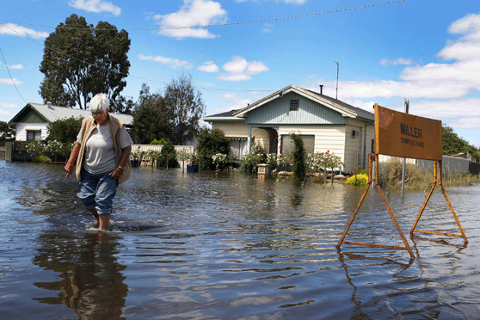
Photographs & Captions
Photos and captions help to tell the story by giving readers a snapshot of what happened, where it happened or who it happened to.
What do you think a report using this picture would be about?
#
Photos also need a caption underneath them. A caption is a short sentence explaining what is happening in the photograph. What would the caption be for this picture?

Slide 42
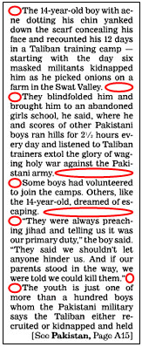
PARAGRAPHS
Paragraphs help the reader clearly understand the information.
Parents are working longer hours than ever before. They may have to stay late at work or continue working after they get home. A quarter of parents said that in an average week they spend less than an hour with
their children, although almost half would like to spend more time together as a family.
Thomson Holidays want to
work with kids across the country
on a Family Charter. The Charter
will involve parents and kids
identifying the promises and
rules that every family member
should make to make sure they
spend proper time together,
whether it’s at home or on
holiday. We want you to vote
for rules for family holidays and
breaks that everyone in the
family must follow. For example,
no mobile phones during
mealtimes or promising to play a
game together once a day.
A new all-party parliamentary group report called Giving Britain a break, which is supported by the Family Holiday Association and Thomson Holidays, says that families..

Slide 43
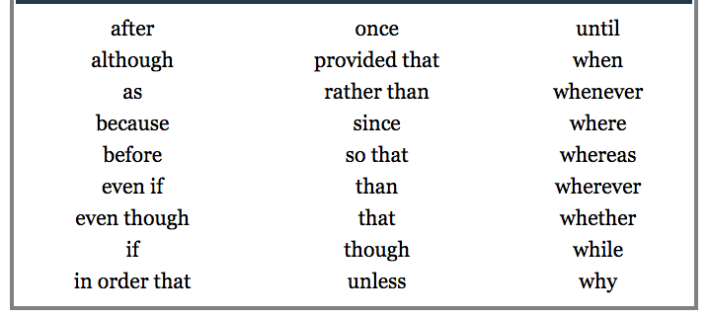
Conjunctions are used to link paragraphs.

Slide 44
What tense is a newspaper report written in?
How do you know?

Slide 45
What person is a newspaper report written in?
How do you know?

Slide 46
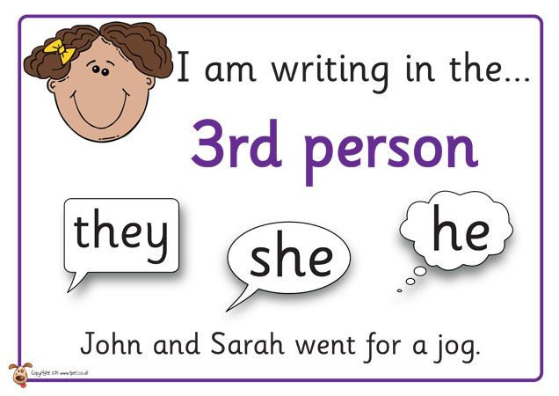
Past tense (we are reporting something that has happened)
3rd person (a reporter writes about someone else)

Slide 47
What should be in...
an introductory paragraph?
a concluding paragraph?

Slide 48

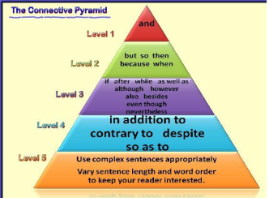

FEATURES
Headline!
5 W’s (can you find
one of each W)
Quotes
Photographs & captions
Paragraphs
Conjunctions
Past tense
Introductory paragraph
Concluding paragraph
Facts and factual language
Subject specific vocabulary
3rd person

Slide 49
Tuesday 29th June 2021
I can identify the key features of a newspaper report.
Can you find one example of each feature we have covered today in the text? Label each of these to show where they are.
Challenge: Write a sentence for each to explain why these are used/helpful.

Slide 50
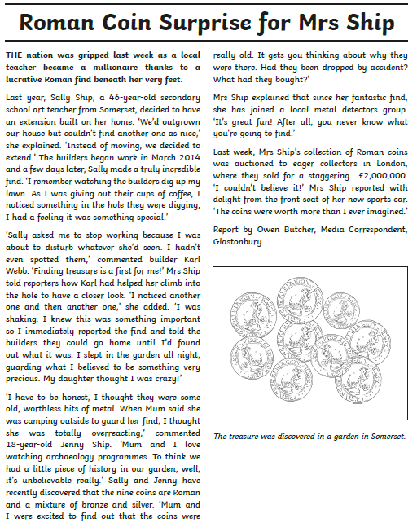
- e.g.
- Headline
- Past tense
- Who
- What
- Where
- When
- Why
- Quote
- Picture
- Intro
- Conclusion
- Caption
- 3rd person
- subject specific vocabulary
who

Slide 51
Reading

Slide 52
Spend at least 20 minutes reading a book of your choice.
Which book did you choose?

Slide 53
Spelling
- ship suffix

Slide 54
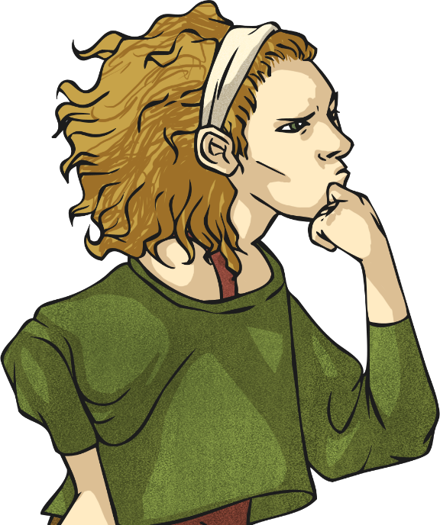
This week, we are going to look at adding the suffix –ship to root words to create nouns.
Let’s start by seeing how many nouns you can think of that end in the suffix –ship…
For example:
member + ship = membership

Slide 55
You have 3 minutes to think of as many –ship suffix words as you can.
How many words can you think of?
e.g. membership
ownership
partnership
dictatorship
championship
craftsmanship
fellowship
apprenticeship
citizenship
sponsorship
Finished

Slide 56
Aztecs

Slide 57
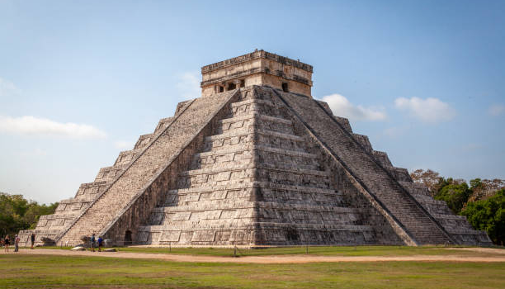
The Aztecs were master builders. They built temple-pyramids to worship their gods. These were tall structures with platforms and stairways running up one side. The series of platforms started wide at the base and gradually got narrower as they reached the top. The taller the temple, the more valued it was, as the Aztecs believed they were closer to the gods.
Have a go at creating your own
Aztec temple. Choose what
materials you will use to make
it. You may decide to build this
in your garden or using items
inside your house! (Have a look
on the following page for some
inspiration).
Please take a picture of this!

Slide 58
