Slide 1
Work ethic!! It’s time to get down to business
Today’s assembly is about your work ethic at home and how this should be.

Slide 2
You are currently learning from home because of a global pandemic, you are at home to stay safe and to make sure your family is safe as well. However the fact that you are at home does not mean that you are on a holiday.
You need to be continuing to learn whilst you are there. We teachers are still providing you with lessons that we expect you to complete each day and to send evidence of as well.
You send this to the email mrthurlby@Oxenhope.Bradford.sch.uk or when classdojo is up and running you can post it on there.

Slide 3
The work you produce should be of the same standard that you would be producing in school. Here are some examples of work that I have received that is of that standard.

Slide 4
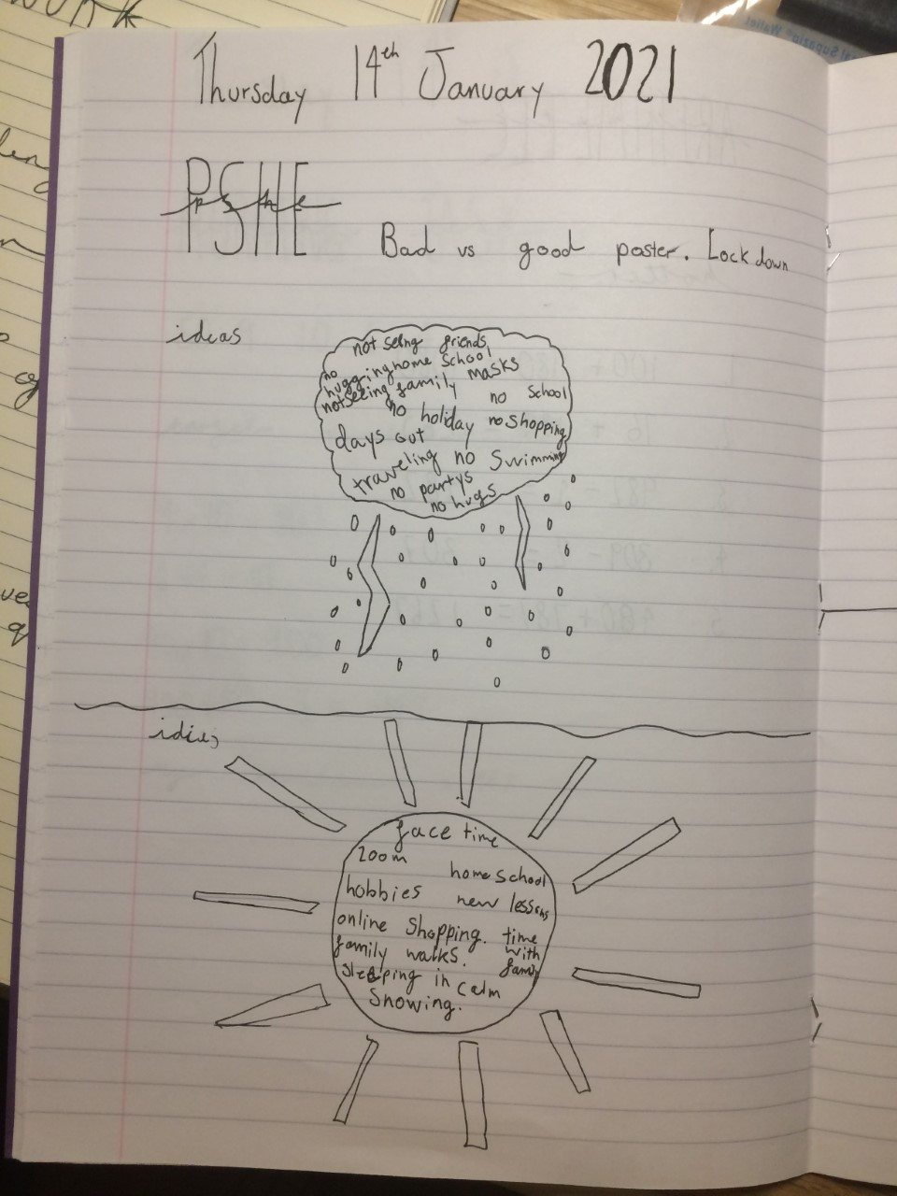

Slide 5
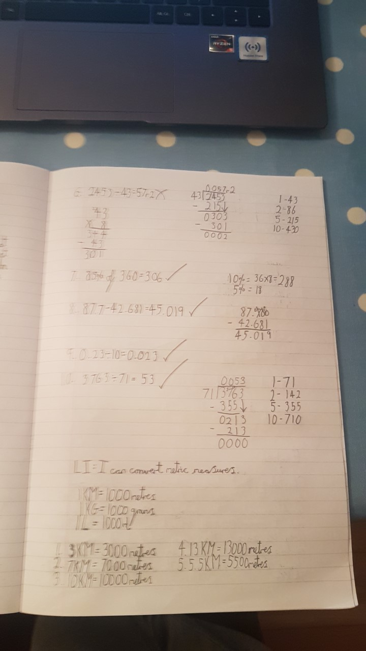

Slide 6
The amount of work you should be doing each day is 4 hours. If you are completing the work that has been set on the home learning page, you will easily do this amount. Below is a timetable of what is happening in school. The children there are doing the same lessons you are and they are expected to work hard, so you should as well.
Monday | Tuesday | Wednesday | Thursday | Friday
Morning activity 8:40-9:05 | Morning activity 8:40-9:05 | Morning activity 8:40-9:05 | Morning activity 8:40-9:05 | Morning activity 8:40-9:05
Arithmetic 9:05-9:40 | Arithmetic 9:05-9:40 | Arithmetic 9:05-9:40 | Arithmetic 9:05-9:25 | Ttrockstars 9:05- 9:40
Maths main lesson 9:40-10:30 | Maths main lesson 9:40-10:30 | Maths main lesson 9:40-10:30 | Maths main lesson 9:25-10:00 | Mathletics/EdShed 9:40-10:30
Break 10:30-11:00 | Break 10:30-11:00 | Break 10:30-11:00 | PSHE 10:00- 10:30 | Break 10:30-11:00
English 11:00-11:50 | English 11:00-11:50 | English 11:00-11:50 | Break 10:30-11:00 | English 11:00-11:50
Guided reading 11:50-12:30 | Independent reading 11:50-12:30 | Guided reading 11:50-12:30 | English 11:00-11:50 | Guided reading 11:50-12:30
Lunch 12:30-13:30 | Lunch 12:30-13:30 | Lunch 12:30-13:30 | Independent reading 11:50-12:30 | Lunch 12:30-13:30
Spellings 13:30-13:50 | Spellings 13:30-13:50 | Spellings 13:30-13:50 | Lunch 12:30-13:30 | Spellings 13:30-13:50
PE 13:50-15:00 | Science 13:50-15:00 | Outdoor learning 13:50-15:00 | Spellings 13:30-13:50 | Topic 13:50-15:00
Sharing a class book.15:00-15:10 | Sharing a class book.15:00-15:10 | Sharing a class book.15:00-15:10 | RE 13:50-15:00 | Sharing a class book.15:00-15:10
 |  |  | Sharing a class book.15:00-15:10
Total hours learning=290 minutes or 4 hours and 50minutes | Total hours learning=290 minutes or 4 hours and 50minutes | Total hours learning=290 minutes or 4 hours and 50minutes | Total hours learning=290 minutes or 4 hours and 50minutes | Total hours learning=290 minutes or 4 hours and 50minutes

Slide 7
Why is it important?
It is important to keep learning to give yourselves the best possible start to secondary school as you can. The harder you work now during lockdown the easier it will be for you when you come back into school.
A good education will help you to achieve all that you want to in your long term goals.

Slide 8
Parents
At this time a lot of your parents are working from home. Having spoken to them I know that they want to help you with your learning everyday but unfortunately they can not do this at your beck and call.
It is important to be patient if you are needing assistance with your work. You can always email me for some support and I will provide it when I can.
You are the oldest children in school and knowing a lot of you, you crave independence. This is your chance to prove to your parents that you can work in a mature and independent way looking at the home learning that has been provided.

Slide 9
Tips for staying on task
I know that the home learning is different to being at school and can be tricky. So here are some tips and tricks to help.
Create a timetable for your learning and stick to it. You could use the one I have shown you and learn along with us at school. Set smart targets.
Talk to your parents about setting up a reward chart, which allows you a treat at the end of the week if you have worked exceptionally hard.
Take regular breaks in between activities, complete one task then take a 10 minute break.
Get a good nights sleep and eat well. This will help with your concentration and effort level.

Slide 10
The last thing I would like to say to you is that your mental health is very important and so is your safety.
I know that you will do me proud and that we will all up our effort towards home learning. I am looking forward to seeing the work that you are producing.

