Slide 1
Tuesday 2nd February 2021 Week 5

Slide 2
Good morning!
Have a go at the following task:
Try to make the longest word you can using these letters:
C: Can you make a full sentence using the words you made. Extra C: Can you include a conjunction to extend your sentence using only the letters above?
H T R O M I E E S N
W V B C

Slide 3
Arithmetic

Slide 4
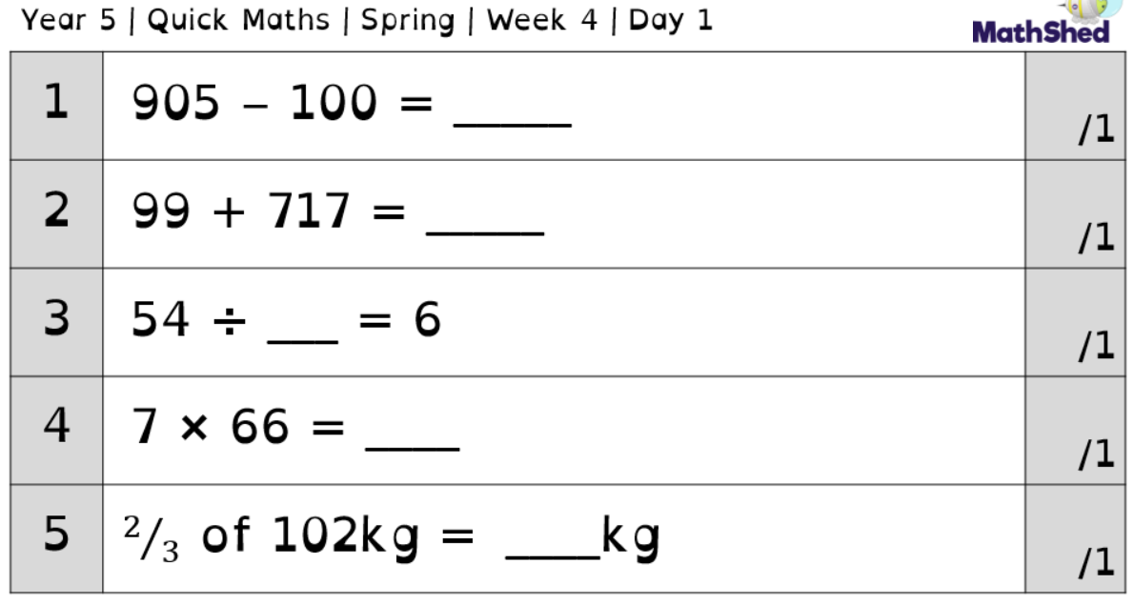
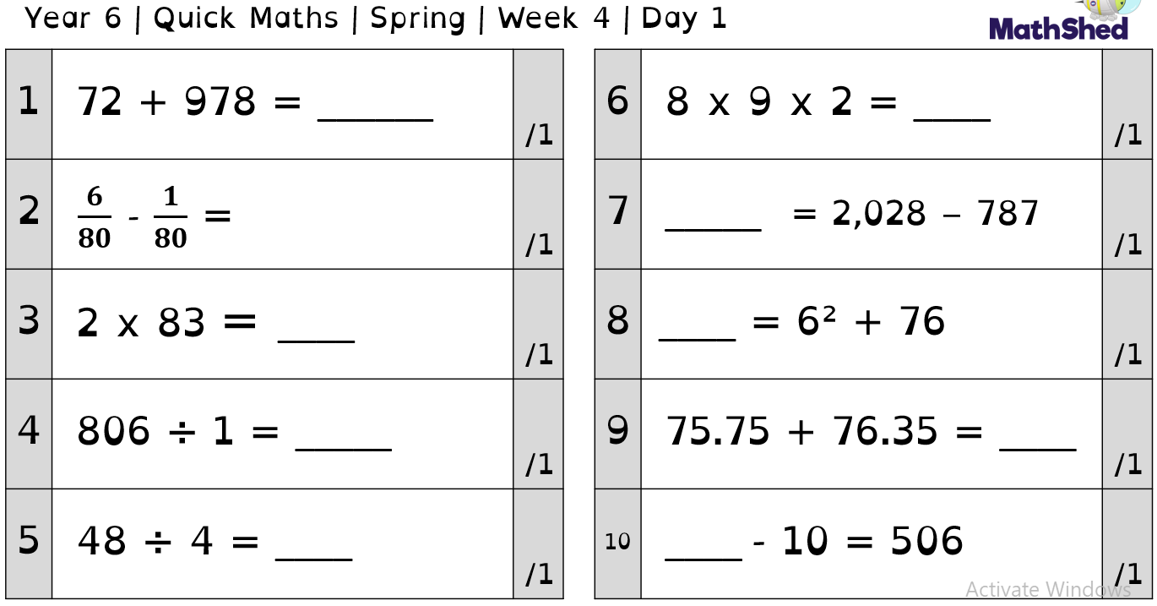

Slide 5
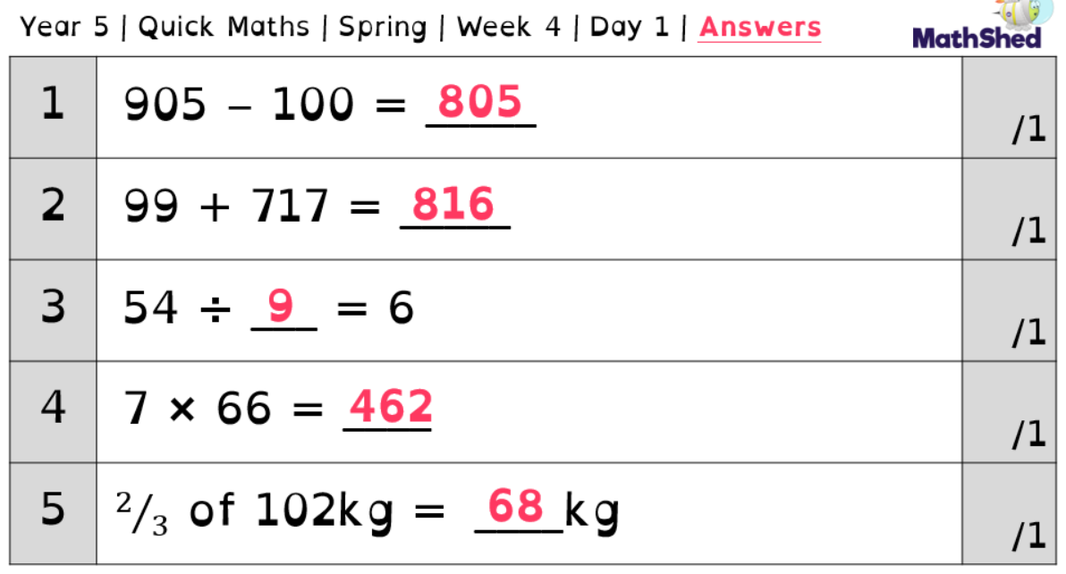

Slide 6
Today we are going to focus on question 9 on year 6.
The question asks us 75.75 + 76.35 =
When we have looked at the answer, it is 152.1.. but how?
For this, we need to use the column method of addition.

Slide 7
First, put the two values into columns, ensuring that the decimal is in the same place in both.
75.75
+ 76.35
Now, complete the addition as you would with a 4digit number, just putting the decimal in the same place below.
75.75
+ 76.35
152.10

Slide 8
Now, try the following questions:
57.91 + 22.04 =
23.66 + 18.14 =
16.44 + 37.35 =
87.57 + 14.56 =

Slide 9
Maths area of triangles, yesterday was just half of it.

Slide 10
Yesterday we began looking at the area of triangles using squared paper.
We were able to calculate the area of the triangles by counting the squares. Some of the squares were fractions of a whole square and we needed to add them together to create whole squares.
We used estimates to do this.

Slide 11
Today we are going to look at a new method for calculating the area of a triangle.
Looking at the two shapes below we can see that the area of the square is 25cm² and the area of the triangle is 12.5cm^{2.}
If you overlapped the two shapes you would see the triangle is half the size of the square and two of them would fit together to make the square.
We can use this to help us to find the area of a triangle.

Slide 12
If you remember from last week the formula for working out the area of a rectangle or square was length x width.
We can use this to work out the area of a triangle.
We can do length x width then half the answer(divide by 2).
The reason we can do this is because as I said on the previous slide two triangles would fit into the square.

Slide 13
Let me show you the method if you look at the triangle you can see it has a width of 5 cm and a height of 5 cm(so does the square). We multiply them together to get 25cm² (this is the area of the square)
Then we halve this to give us 12.5cm² this is the area of the triangle.

Slide 14
Use the formula width x height divided by 2, to answer the questions below.

Slide 15
Whitney is telling us something really important to remember when working out the area of a triangle. We need to be looking at the height of the triangle and the base. She has told us to ignore the diagonal line and she would be correct. We need to make sure we are using the correct lines to help us work out the area.

Slide 16
Remembering what Whitney said complete these questions.
Challenge yourself and complete question 6 and 7 on the sheet labelled Tuesday maths.

Slide 17
English
- Wagoll

Slide 18
Today in English we are going to look at a WAGOLL.
Look through the writing and highlight the techniques for creating suspense, the next slide will remind you of the things you are looking for.

Slide 19
Suspense techniques.
Short sentences
Ellipsis
Showing not telling (characters emotions)
Adventurous vocabulary
Detailed description of the setting
Similes and metaphors.
Can you think of anymore.
Read or listen to the Wagoll and see if you can identify the techniques above.

Slide 20
Challenge
Have a go at editing parts of the WAGOLL, making improvements to it.
Think carefully about what you have changed and explain why.

Slide 21
Independent reading

Slide 22
Fact web
Choose a non-fiction book (e.g. animal, space or history related, or even Word Records).
Write the topic of your book in the middle of your page.
Can you add as many facts/as much information as possible round the outside?

Slide 23
Spelling

Slide 24
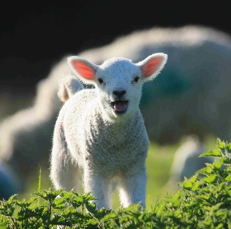
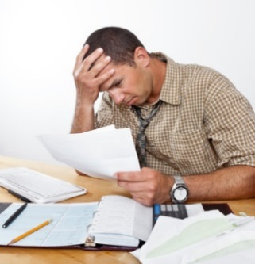
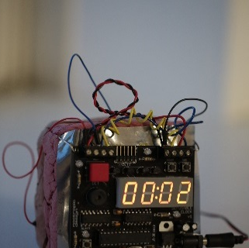
A silent b sometimes occurs after m or before t.
lamb
thumb
debt
bomb
What other words do you know with a silent b?
Flick through some examples on the next page!

Slide 25
A silent b sometimes occurs after m or before t.
lamb
thumb
debt
bomb
What other words do you know with a silent b?
numb
comb
tomb
climb
lamb
dumb
doubt
debt
crumb
womb
aplomb
succumb
bomb
thumb

Slide 26
What words do you know with a silent h?
Flick through some examples on the next page!

Slide 27
What words do you know with a silent h?
rhubarb
ghost
monarch
chrome
whisky
rhyme
orchid
archaeology
Sikh
vehicle
hour
spaghetti
echo
white
technology
whisk
stomach
chaos
ache
chemist
exhausting
honest

Slide 28
Put some of these words into your own sentences.
C: How many of these words containing the silent letters b and h can you get into the same sentence?

Slide 29
Science
- David Attenborough documentary

Slide 30
Today we are going to continue making our own documentary in the style of David Attenborough!
Using your non-chronological report from last week, put together a presentation to share facts about your chosen safari animal.
You could record this and send it in. (Some of you may even want to attempt it in full Attenborough style and speak as he does!)
You could watch one of his documentaries for inspiration.
If you finished your documentary last week, show your understanding of evolution and inheritance by completing the activities on the following pages. (You may need to research some bits of information !)

Slide 31
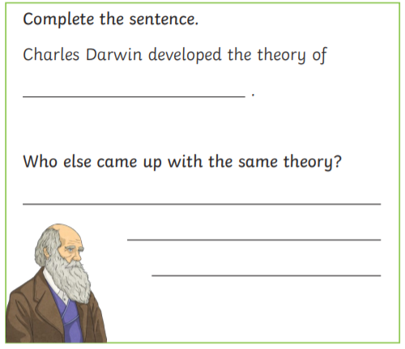

Slide 32
