Slide 1
Thursday 4th February 2021 Week 5

Slide 2
Good morning! To wake up your brain, have a go at the following task:

Slide 3
Arithmetic

Slide 4
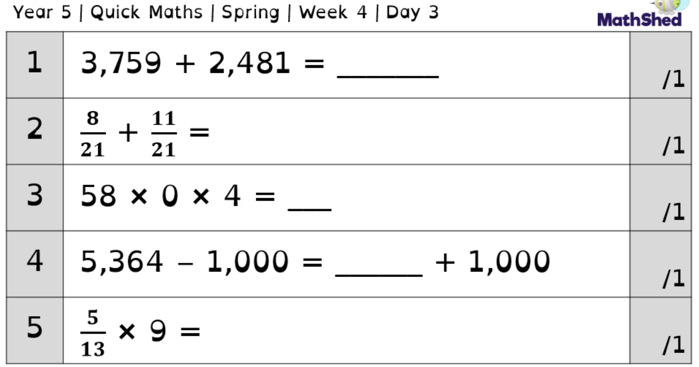
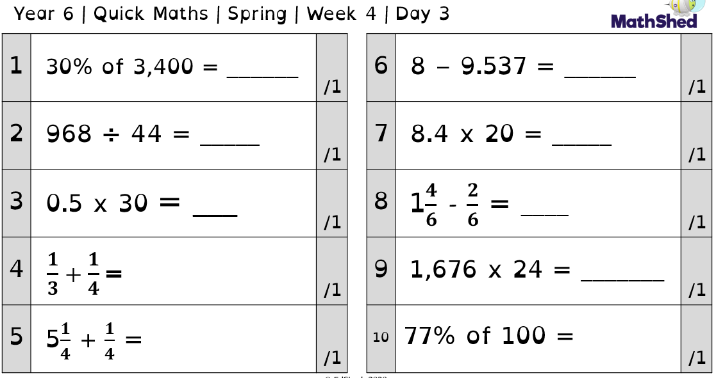

Slide 5
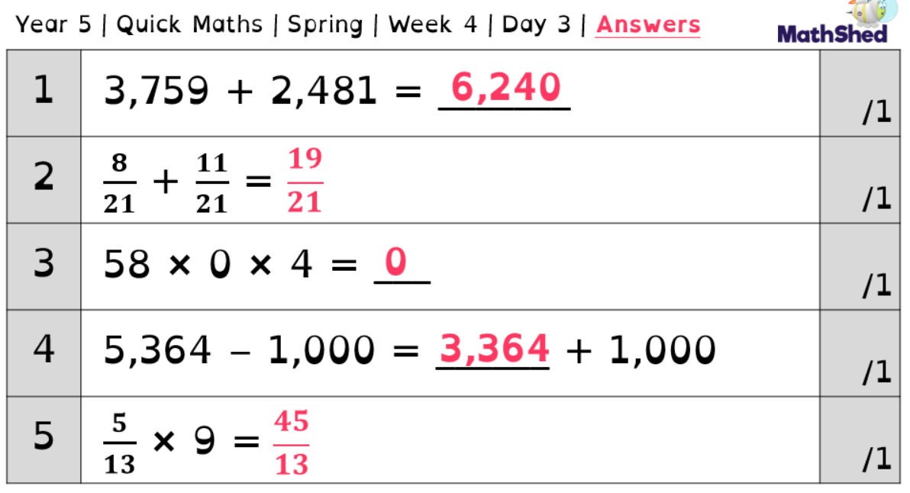
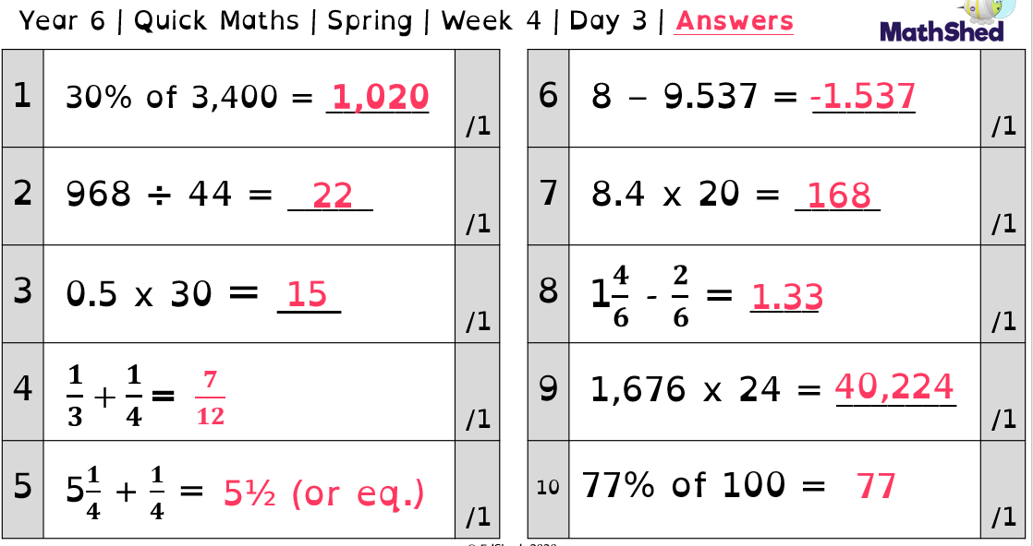

Slide 6
Today we are going to focus on question 7 of the year 6 sheet.
This question focuses on multiplying a decimal by a multiple of 10.
8.4 x 20 = 168
There are a few ways of tackling this sort of question.

Slide 7
Method 1
First, multiply 8.4 by 2
So, 2 x 4 = 8
Then, 2 x 8 = 16
Put the decimal point back in the same place as above.
8.4
X 2
16.8
Now, multiply your answer by 10 (using the method we looked at yesterday) as you have only multiplied by 2 so far, not 20. 16.8 x 10 = 168

Slide 8
Method 2
First, multiply 8.4 by 10 by moving it 1 space to the left.
8.4 x 10 = 84
Now, put your answer into the column method and multiply it by 2 as we have only multiplied by 10 so far.
So, 2 x 4 = 8
Then, 2 x 8 = 16
84
X 2
168

Slide 9
Method 3
First, remove the decimal to make 84.
8.4 - 84
Now, multiply 84 by 20, which makes 1680.
Finally, divide your answer by 10.
1680 ÷ 10 = 168.

Slide 10
Now, have a go at the following:
1.) 6.2 x 20 =
2.) 3.1 x 30 =
3.) 2.7 x 50 =
4.) 4.6 x 40 =

Slide 11
Maths
- Applying our knowledge of area and perimeter.

Slide 12
Over the past couple of days we have been looking at the area and perimeter of squares, rectangles, triangles and parallelograms.
Today we are going to be applying what we have learnt to the end of unit sheet (like we do in class!).
The sheet is available on the next 2 slides, on the home learning page and on Class Dojo.

Slide 14
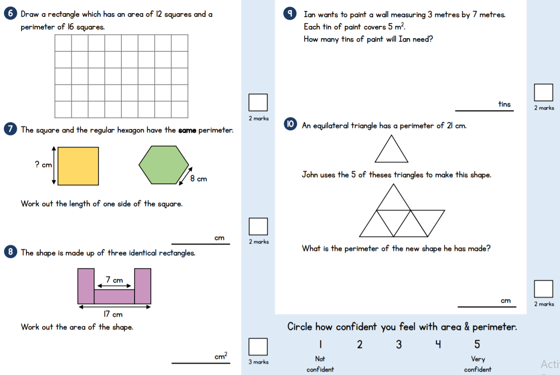

Slide 15
PSHE

Slide 16
Over the past few weeks we have been looking at how we can keep our mental health strong through the latest lockdown.
Today we are going to be looking at how we can help others look after their mental health.

Slide 17
First, think about who is important to you.
Make a spider diagram of who you care for the most and why.
Think about how they help you and why they help you.

Slide 18
During the current lockdown it is important to help others.
We have thought about the people who are important to us and why they are. Now lets think about how we can help them.
One of the people most of us said were important are our parents.
Think about 5 ways we can help our parents at this time.

Slide 19
Main activity.
Create a poster that shows how we can help others during this time.
Remember to include how we can help them and why this would help.

Slide 20
English
- Drafting part 2

Slide 21
Today we are going to continue writing our narratives.
We are going to write the resolution and the ending.
First, read through your draft from yesterday so you remember where you reached in the story.
Use your plan to write each paragraph, thinking carefully about the work you did last week to build tension and suspense within a story.
Think carefully about the GPS techniques and skills you need to include e.g. Fronted adverbials, expanded noun phrases, complex sentences, a variety of conjunctions, brackets, relative clauses and ellipsis.

Slide 22
Reading - characters

Slide 23
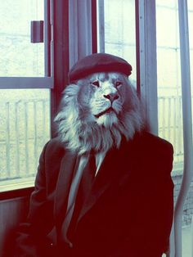
If this is the front cover, write the blurb for the book (the short outline on the back ).
OR
If this is a the main character in the book, write a short description of him!
Why is he wearing these clothes?

Slide 24
Spelling

Slide 25
Today we are going to look at some different silent letters!

Slide 26
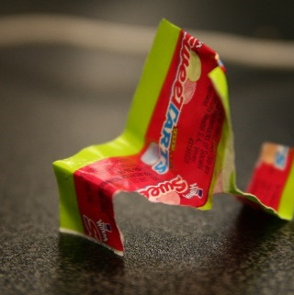
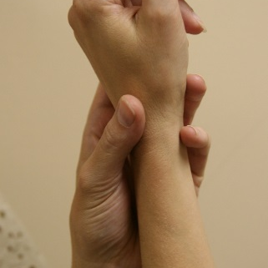
A silent w often goes before r.
wrapper
wrestle
wrist
wreck
What other words do you know with a silent w?
Flick through some examples on the next page!

Slide 27
A silent w often goes before r.
wrapper
wrestle
wrist
wreck
What other words do you know with a silent w?
wrong
wrinkle
wriggle
wrote
write

Slide 28
What words do you know with a silent u?
Flick through some examples on the next page!

Slide 29
What words do you know with a silent u?
baguette
built
silhouette
guitar
guest
circuit
guilty
buoy
guess
guinea pig
disguise
dialogue
colleague
tongue

Slide 30
Put some of these words into your own sentences.
C: How many of these words containing the silent letters w and u can you get into the same sentence?

Slide 31
RE
- Pentecost

Slide 32
Unit 2.6 Kingdom of God
When Jesus left, what was the impact of Pentecost?

Slide 33
Complete the table to give examples of rules a good or bad leader might enforce.
Good King or Queen | Bad King or Queen

Slide 34
Give some examples for each:
If you were King or Queen, what rules would you enforce?
If Jesus was king, what do you think he would want people to do? (Consider your prior learning in RE and collective worship!)

Slide 35
Today we are going to be thinking about ‘The Kingdom of God’. Have a go at answering the following questions:
Is the Kingdom of God a place?
Where is it?
Who is the leader of this Kingdom?
Who is part of the Kingdom?
How can someone be part of it?

Slide 37
Think back through all the learning we have done about Jesus’ life. https://www.youtube.com/watch?v=2fK3ZS9T3as
Create an emotion graph (as we have done in English lessons before) of six key moments in the story, thinking about how the disciples would feel at each point. The events are labelled on the bottom of the graph.
On each of the events A-D, mark how the disciples would feel. Leave E for now.
Next, add a key word next to each letter on the following page to describe exactly how they would be feeling and explain why. E.g. A - Distraught because...

Slide 38
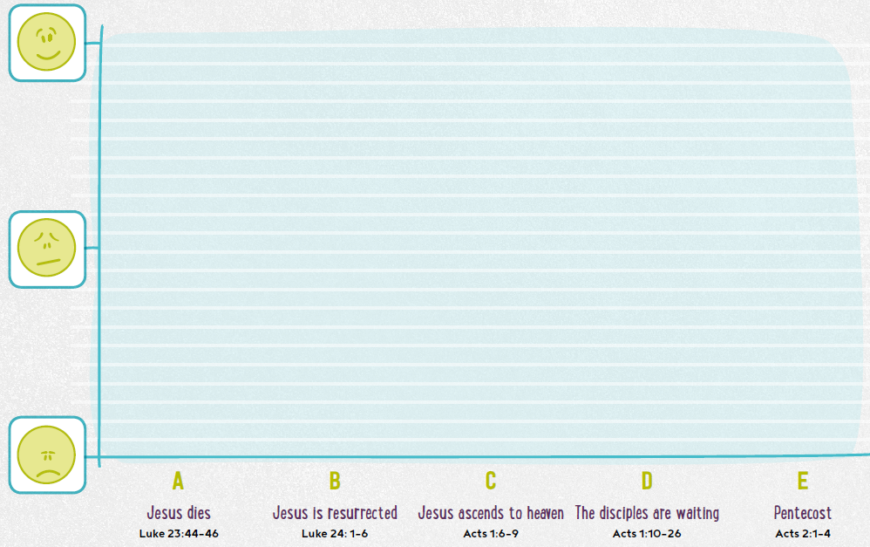
A graph to show how the disciples felt during various events in Jesus’ life.

Slide 39
A - The disciples might feel ____________ because _________________________ _________________________________________________________________
B - The disciples might feel ____________ because _________________________
_________________________________________________________________
C - The disciples might feel ____________ because _________________________
_________________________________________________________________
D (Remember, at this point Jesus had ascended to heaven and told the disciples to wait in Jerusalem for the Holy Spirit to come baptise them, giving them to the power to tell people all over Earth about Jesus.) - The disciples might feel ____________ because __________________________ _________________________________________________________________

Slide 40
Now, we are going to learn about what happened next.
Watch the following video to learn about The Pentecost.
https://www.youtube.com/watch?v=OMQKy1Mx49M
Finally, add an extra mark on the graph for E and complete the sentence:
E - The disciples may have felt _____________ because ______________________
__________________________________________________________________

Slide 41
Computing
- Coding

Slide 42
This week we are going to spend some time looking at coding.
Coding is the process of using a programming language to get a computer to behave how you want it to. Every line of code tells the computer to do something. A document full of lines of code is called a script. Each script is designed to carry out a job.

Slide 43
Use the following website to practice coding. There are loads of activities to choose from such as Minecraft, Star Wars and Moana!
https://hourofcode.com/uk/learn

