Slide 1
Monday 1st February 2021 Week 5
Good morning year 6, I hope you are all well and continuing to stay safe.
This week we will be moving our learning forwards in maths continuing the work around area, we will also be writing our suspense story.
If you would like there is an extra maths sheet for you to complete on the home learning page that will help to consolidate your learning from last week.

Slide 2
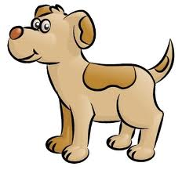
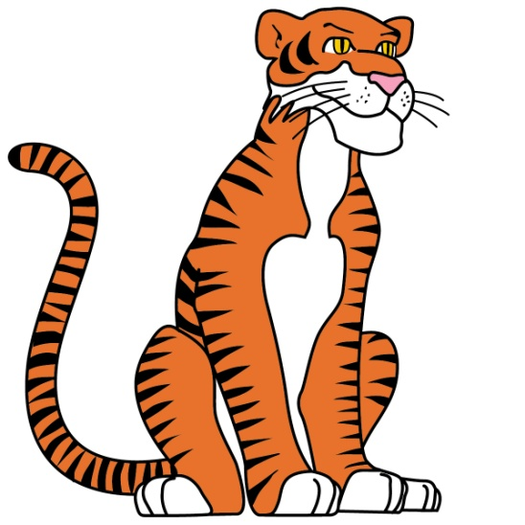
Good morning!
Have a go at the following task:
If you could be an animal what would you be and why?

Slide 3
Arithmetic

Slide 4
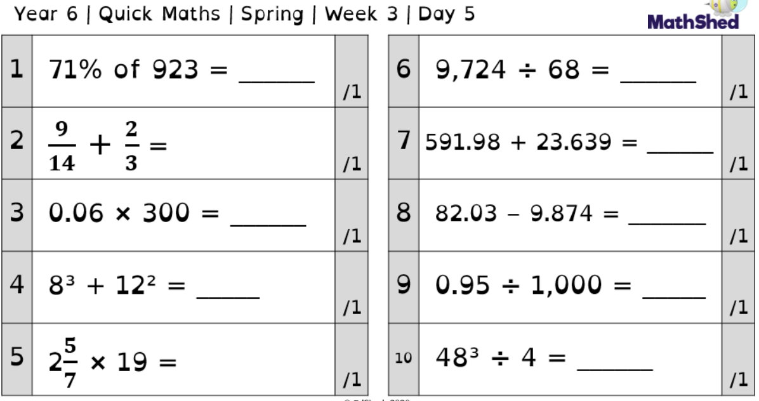

Slide 5
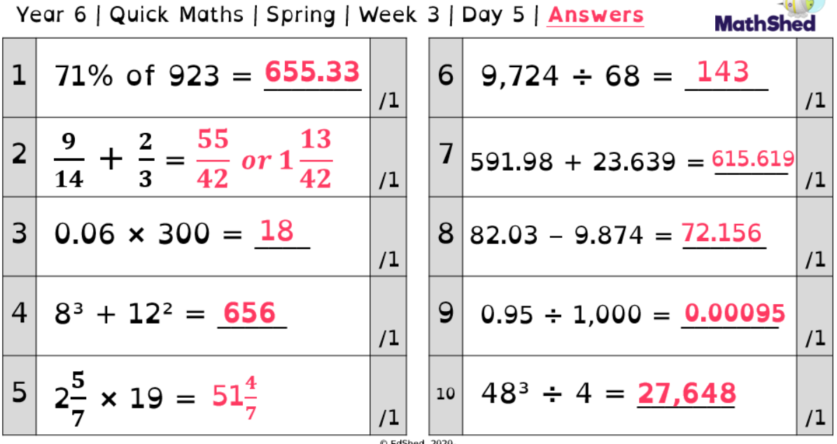

Slide 6
Today we are going to focus on year 5 question 5.
We are trying to multiply a fraction by a whole number
7/13 x 5 =
From the answers you can see the answer is 35/13, but how did we get this?

Slide 7
When multiplying fractions by a whole number, first we keep the denominator the same so
/13
Next, we multiply the numerator by the whole number so 7 x 5 = 35. This becomes the numerator in our answer.
35/13.
You may then choose to convert this to a mixed number fraction (2 9/13).

Slide 8
Have a go at the following:
¾ x 8 =
9/13 x 3 =
5/11 x 9 =
6/18 x 6 =
12/25 x 5 =
C: Can you convert them into mixed number fractions?

Slide 9
Maths- Area of a triangle

Slide 10
Today in Maths we are going to continue our learning around area. We will be looking at ways in which we can find the area of a triangle.

Slide 11
When given squares…
When we are given squares, just like when working out the area of rectangles we can count the squares.
What you will notice is that some squares are not complete so we can not count them as a full square.
We need to add these part squares together to make a whole.
Look at the diagram to the side you can see that it has 6 full squares and 4 half squares.
What do you think we need to do with the half squares?

Slide 12
When given squares…
That’s right we need to add them together. When you have added the 4 half squares together you would get 2 whole squares.
Once you have done that you can add them to the other 4 whole squares we have. So in this case the area would be 8cm².
Have a go at doing this with the questions on the next slide.
BE CAREFUL, sometimes the parts of squares will not be perfectly half so we will have to estimate.

Slide 15
Now complete the rest of the sheet given to you on the home learning page. Remember when we are counting squares sometimes the parts will not be perfect fractions so we will have to estimate.

Slide 16
English - planning

Slide 17
Today, we are going to plan our narratives using the image from last week.
Use the story mountain on the following page to record your ideas.

Slide 18
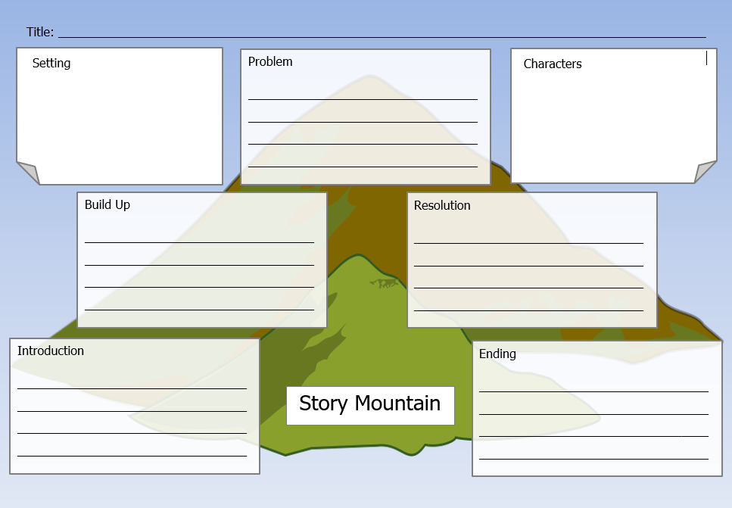

Slide 19
Reading - Prediction

Slide 20
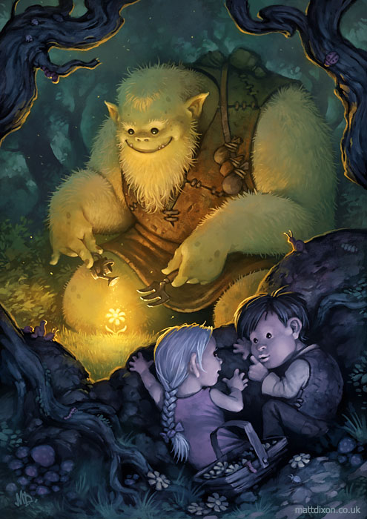
Today we are going to use details from the picture to make predictions (Polly).
Make sure you explain why you chose your answer - what part of the picture made you think this?
What is the ogre doing? Why?
Why is there a glowing light over the flower? Where is it coming from?
What do you think is in the pouches on the ogre’s bag strap?
Why were the children in the woods?
Does he know that they are watching him?
Do the children want him to know that they’re there?

Slide 21
Spelling

Slide 22
This week in spelling we are going to recap the use of silent letters.
What are silent letters?

Slide 23
Some letters in words do not make a sound, they are silent.
Silent letters are letters that you can't hear when you say the word, but that are there when you write the word.
There are silent letters in some English words because over hundreds of years we have changed how we pronounce these words, but have kept the spelling.
The spelling tells us how the word used to be pronounced.
For example: knock. In the past, people used to say the word with the k sounded out at the beginning! That would sound very strange to us today!

Slide 24
Sometimes we can forget to include letters when they can’t be heard in words or if they are difficult to hear.
One way to remember the spelling of words with silent letters is to stress the silent letter when you say the word to yourself.
Break the word up and decide how you say it to yourself, to help you remember the spelling.
For example: Wednesday has a silent d. You could remember how to spell it by saying Wed-nes-day.
Choose some words with silent letters and try breaking them up in this way, to help you remember how to spell the word correctly with the silent letter.

Slide 25
Can You Find the Silent Letters in These Words?
knife
wrapper
wrong
write
gnome
wreck
crumb
lamb
knuckle
know

Slide 26
Can You Find the Silent Letters in These Words?
knife
knife
wrapper
wrapper
wrong
wrong
write
write
gnome
gnome
wreck
wreck
crumb
crumb
lamb
lamb
knuckle
knuckle
know
know

Slide 27
What words do you know with a silent c?

Slide 28
What words do you know with a silent c?
scissors
scene
scent
science
acquire
descend
scenic
disciple
miscellaneous
fascinate
obscene
resuscitate
scenario
conscious
abscess

Slide 29
PE
- Games

Slide 30
Why not create a circuit in your garden and have a go at some of these fitness challenges?
Record your scores as you could try to beat them next week!

Slide 31
