Slide 1
Friday 5th February 2021 Week 5

Slide 2
Good morning!
Have a go at the following task:
How would you balance these 6 weights?
5kg, 11kg, 29kg, 19kg,
7kg and 23kg

Slide 3
TTrockstars

Slide 4
This week you are going to have some set time on Ttrockstars to help practise your timetables.
Spend the next 20 minutes in the garage or maybe you can challenge your friends or even your teacher.

Slide 5
Mathletics

Slide 6
Now we are going to be working on Mathletics.
Complete the tasks set for you on area and perimeter and then play live to compete against your friends.

Slide 7
English
- Editing and re-drafting

Slide 8
Now you have finished your narrative its time to edit and improve. This is a key skill in KS2!
First, read through to ensure you have used accurate punctuation. Does every sentence start with a capital and have closing punctuation? (e.g. full stops, exclamation marks or ellipsis.)
Think carefully about the GPS techniques you should be using in your work e.g.
A range of conjunctions
Fronted adverbials
Expanded noun phrases
Brackets
Relative clauses
Finally, check your spellings. Are there any words you are unsure of?
Although we often edit and improve our work in class, the following video may help you:
https://classroom.thenational.academy/lessons/to-edit-a-non-chronological-report-c9j3ac?activity=video&step=1

Slide 9
Independent reading

Slide 10
Today, just take some time to read a book you enjoy!

Slide 11
Spelling

Slide 12
Today we are going to continue looking at silent letters!

Slide 13
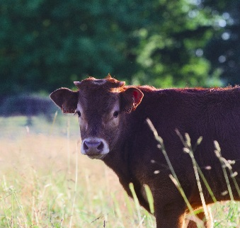
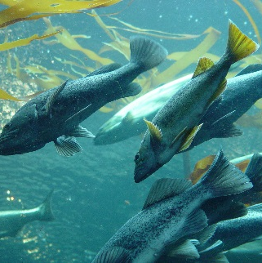
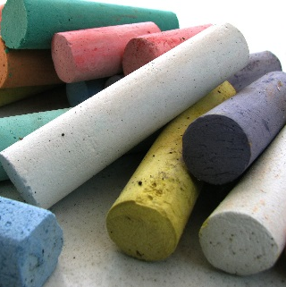
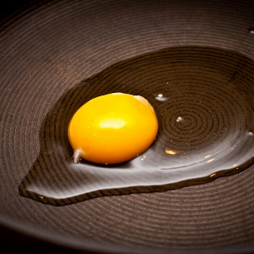
A silent l follows vowels a, o and u.
calf
salmon
chalk
yolk
What other words do you know with a silent l?
Flick through some examples on the next page!

Slide 14
A silent l follows vowels a, o and u.
calf
salmon
chalk
yolk
What other words do you know with a silent l?
calf
yolk
folk
chalk
talk
walk
half
calm
palm

Slide 15
What words do you know with a silent n?
Flick through some examples on the next page!

Slide 16
What words do you know with a silent n?
autumn
column
condemn
hymn
solemn

Slide 17
Can you think of any other silent letters we have not looked at this week?

Slide 18
Art - adaptation

Slide 19
Do you notice anything special in the following photos?
(Some are easier than others!)

Slide 20
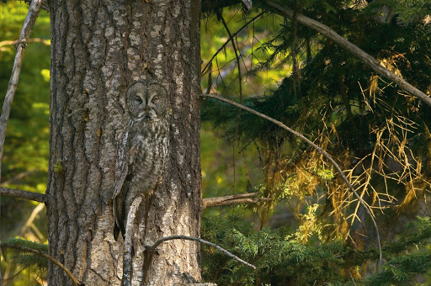

Slide 21
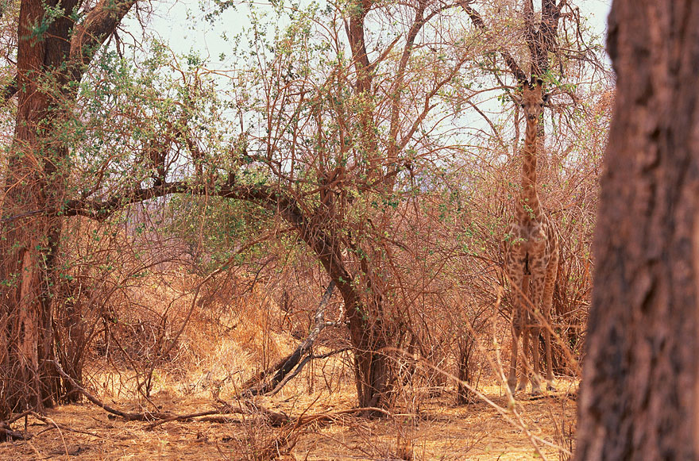

Slide 22
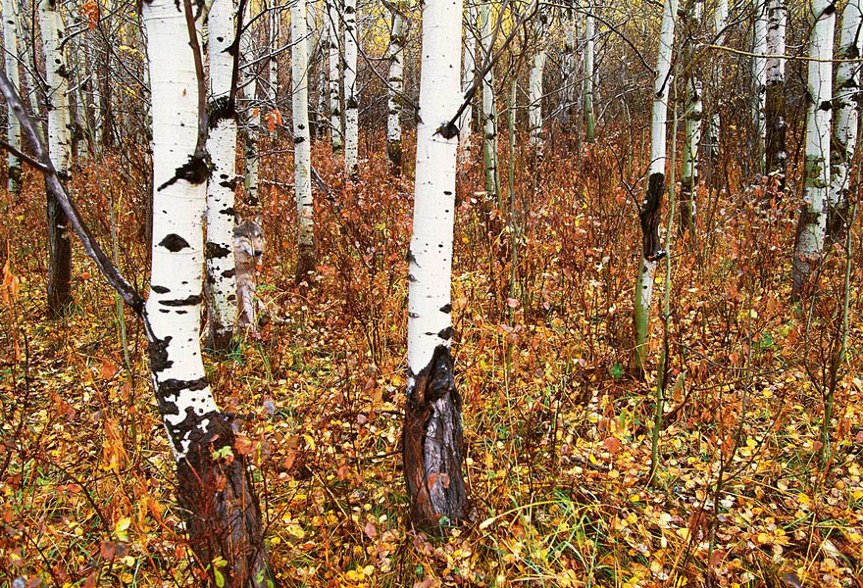

Slide 23
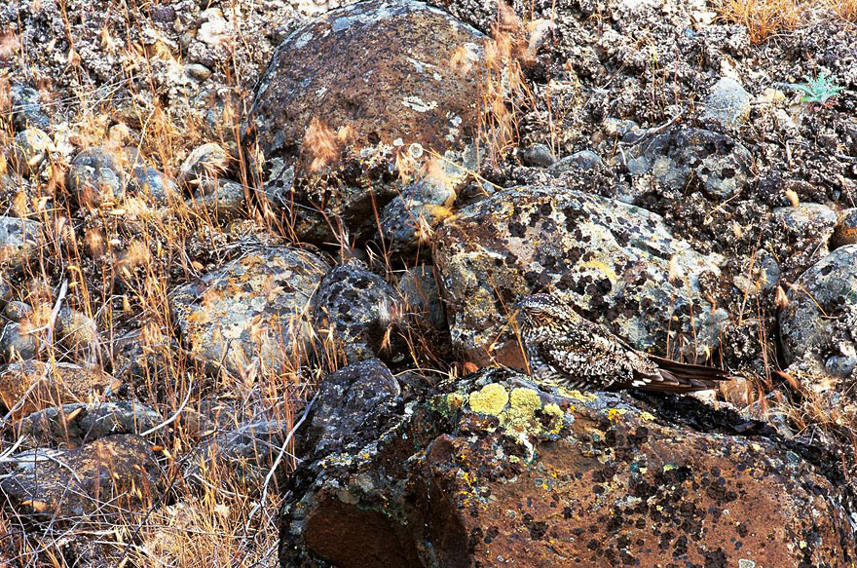

Slide 24
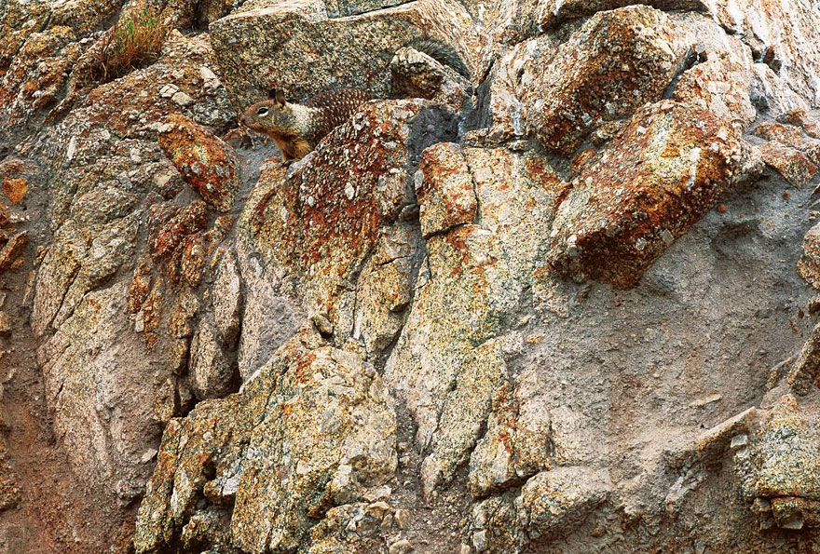

Slide 25
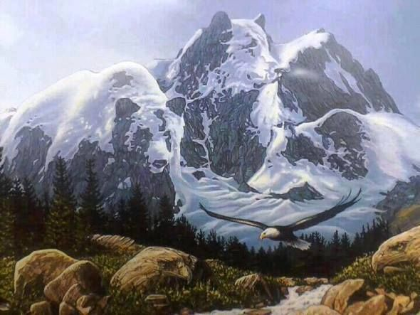

Slide 26
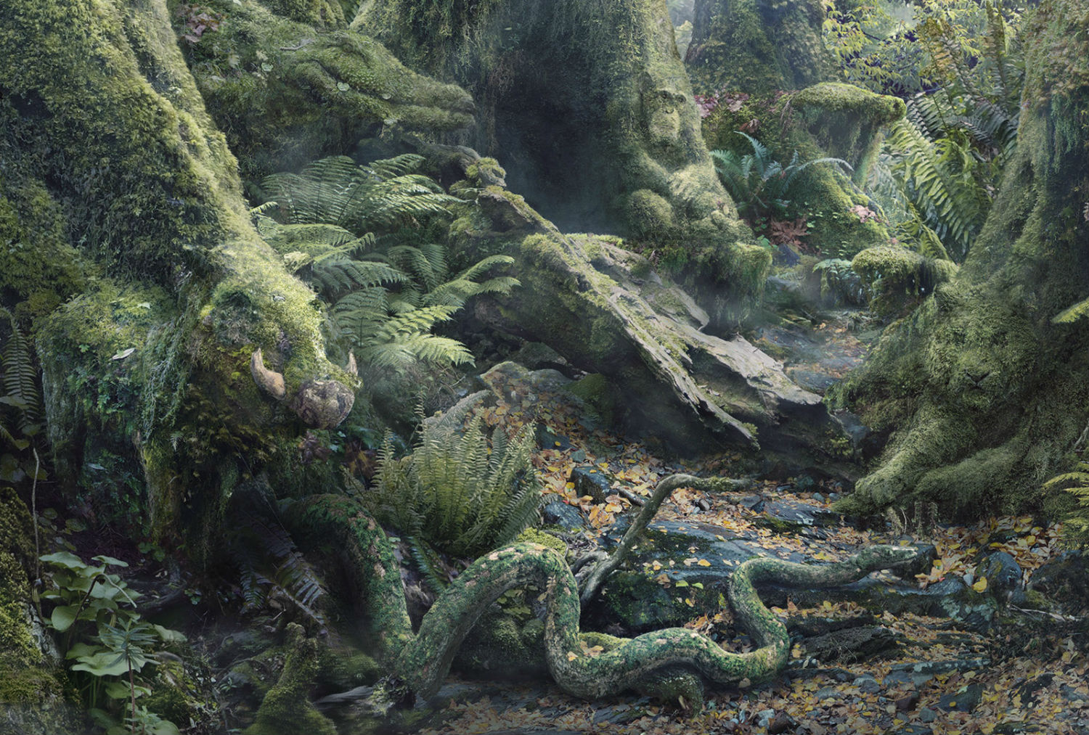

Slide 27
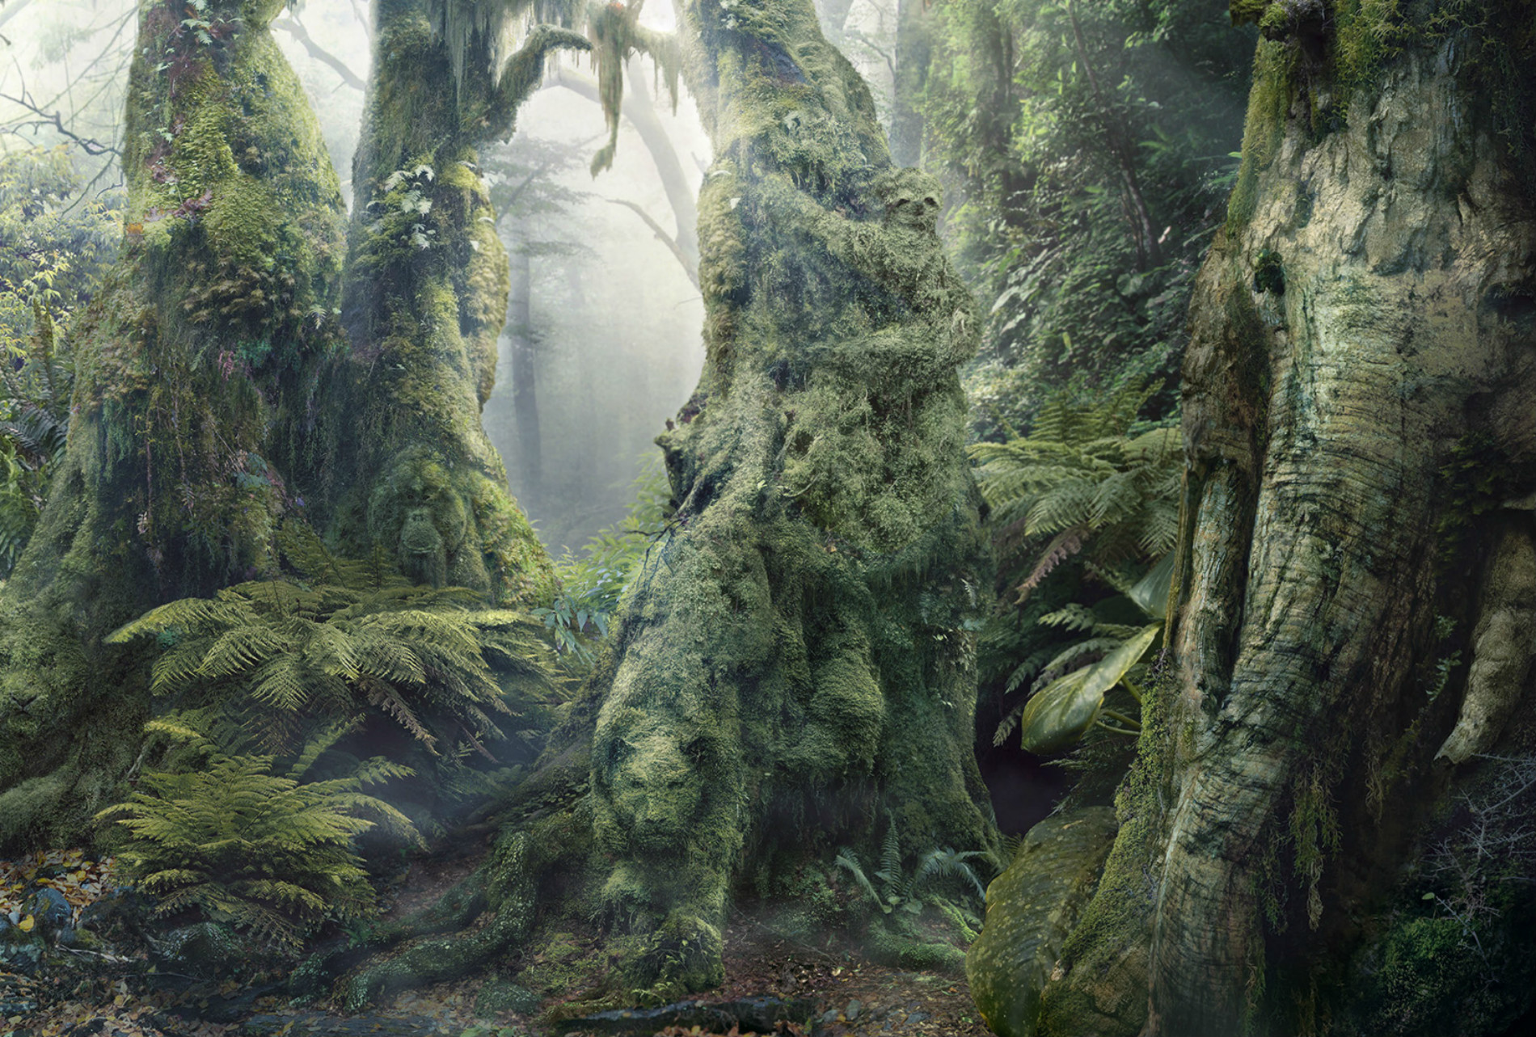

Slide 28
Over the last few weeks we have looked at adaptation and inheritance in science. Our art this week will be focused on a major part of adaptation…
Camouflage.
This is an animals ability to blend into its environment. It does this to hide from predators and prey. This gives it an advantage when hunting or hiding.

Slide 29
Today we are going to have a go at drawing our own ‘hidden animal’ art.
Think about the following questions:
Which type of habitat will you choose?
Which animals are you going to include?
What colours will help your animals camouflage into the picture?
Which order will you draw your picture in? (e.g. animals, then surroundings?)

