Slide 1


Slide 3


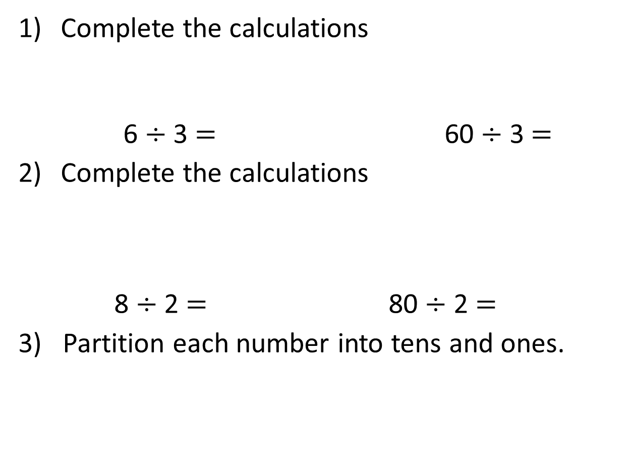
Complete the calculations
6 $÷$ 3 $=$ 60 $÷$ 3 $=$
Complete the calculations
8 $÷$ 2 $=$ 80 $÷$ 2 $=$
3) Partition each number into tens and ones.
24
42
48

Slide 4
Complete the calculations
6 $÷$ 3 $=$ 60 $÷$ 3 $=$
Complete the calculations
8 $÷$ 2 $=$ 80 $÷$ 2 $=$
3) Partition each number into tens and ones.
2
20
4
40
24
42
48
20
4
40
2
40
8

Slide 6




There are 4 counters in each group.
But your counters have different values. The value of each group must be equal too.

Slide 7
39 ÷ 3 =
13
Tens | Ones

Slide 8

84 ÷ 4 =
21
Have a think
Tens | Ones

Slide 9

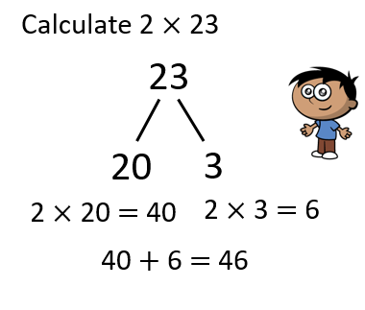
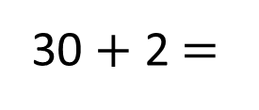
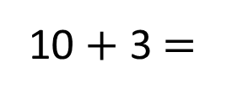
39 ÷ 3 =
13
96 ÷ 3 =
32
39
96
Have a think
30
9
90
6
÷ 3
÷ 3
÷ 3
÷ 3
10
3
30
2
10 + 3 $=$
13
30 + 2 $=$
32

Slide 10
Have a go at questions
1 - 6 on the worksheet

Slide 11


66
66
Have a think
60
6
60
6
÷ 2
÷ 2
÷ 3
÷ 3
30
3
20
2
30 + 3 =
33
20 + 2 =
22

Slide 12




Ron and Jack each have a packet of sweets.
There are 18 sweets in each packet.
They want to share the sweets equally with Mo.
How many sweets will each boy have?
Have a think

Slide 13
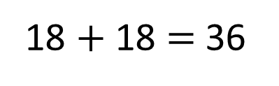
Ron and Jack each have a packet of sweets.
There are 18 sweets in each packet.
They want to share the sweets equally with Mo.
How many sweets will each boy have?
18 $+$ 18 $=$ 36
36
Each boy will have 12 sweets.
30
6
÷ 3
÷ 3
10
2
10 + 2 =
12

Slide 14
Have a go at the rest of the questions on the worksheet

