Slide 1
Wednesday 13th January 2021 Week 2

Slide 2
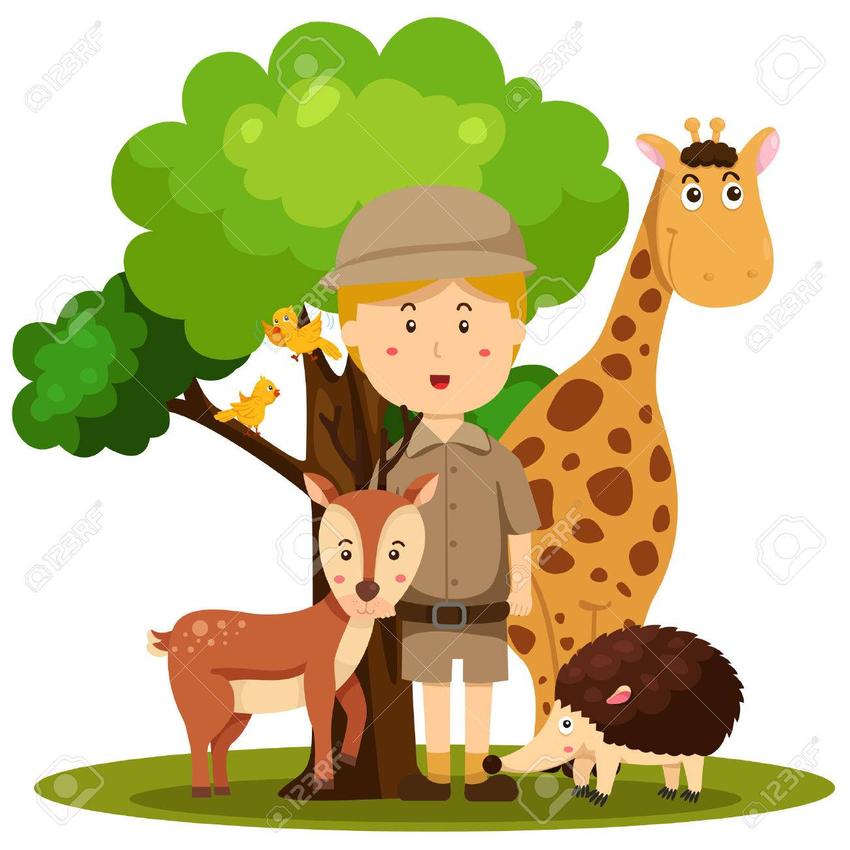
Good morning!
Have a go at the following task:
You walk into class and instead of your teacher you find a zookeeper sitting in the chair. He tells you that you can ask three questions.
What three questions would you ask him and why?

Slide 3
Arithmetic

Slide 4
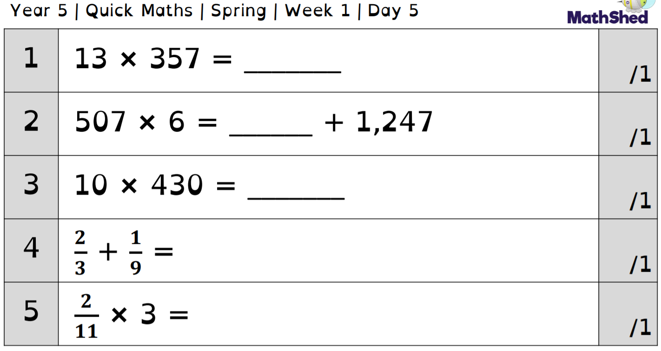
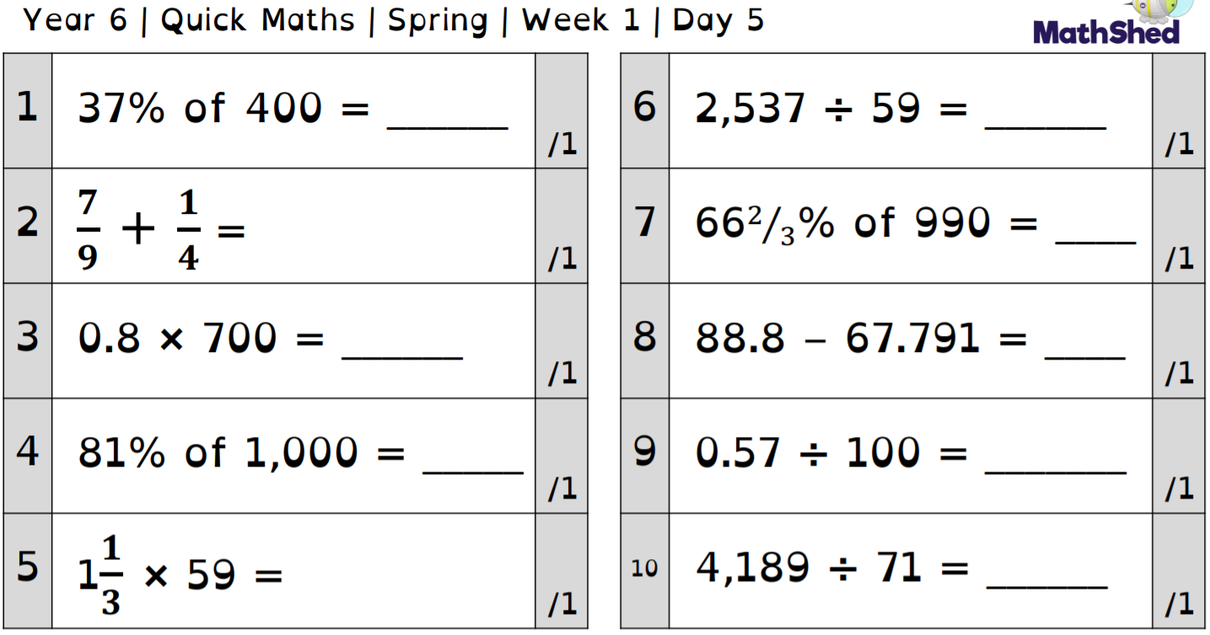
1. Use the column method - don’t forget the 0!
2. Calculate the left hand side - use this for the right!

Slide 5
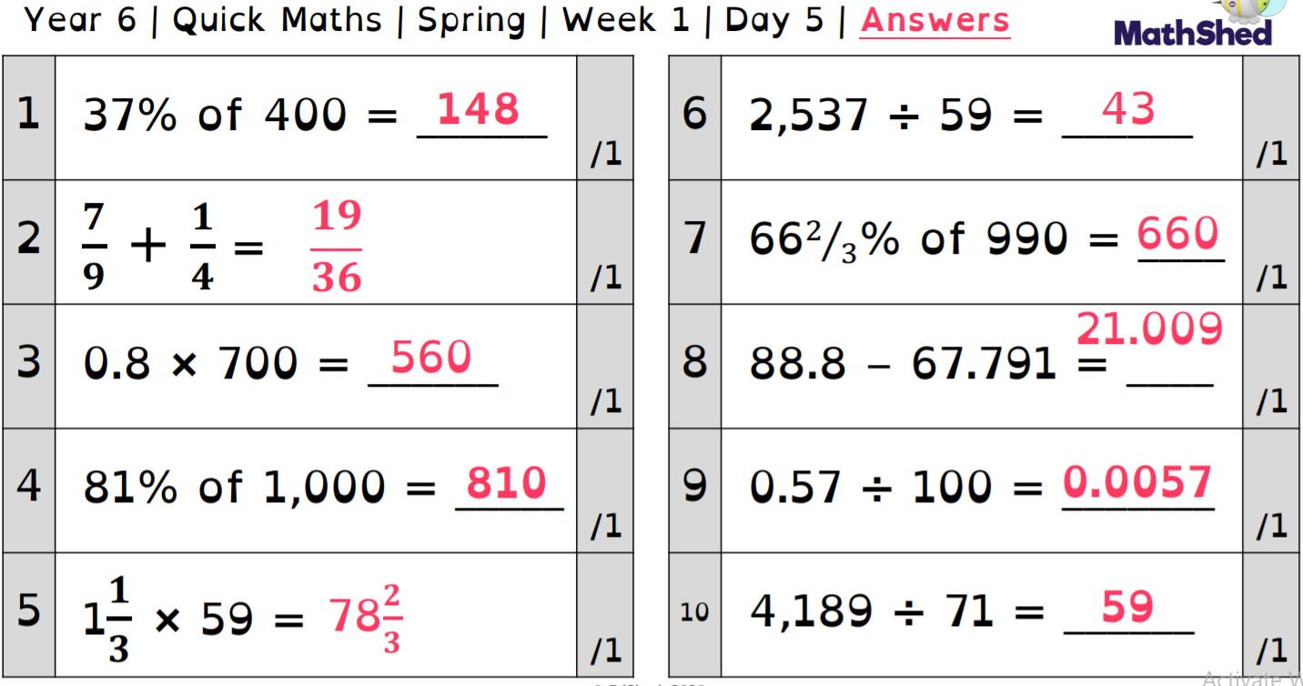

Slide 6
Maths -
Converting measure problem solving

Slide 7
13.1.21 I can use converting measure in problem solving.

Slide 8
Vocabulary
Converting – Change the form or character of something
Units – A quantity chosen as a standard e.g. a unit of measurement
Measurement – The size, length or amount of something
Mass - Weight

Slide 9
10mm = 1cm
100cm = 1m
1000m = 1km
1000g = 1kg
1000ml = 1l
Key Facts Recap
1cm = 10mm
1m = 100cm
1km = 1000m
1kg = 1000g
1l = 1000ml

Slide 10
÷ 10
10mm
1cm
x 10
÷ 100
100cm
1m
x 100

Slide 11
÷ 1000
1000ml
1000g
1000m
1l
1kg
1km
x 1000

Slide 12
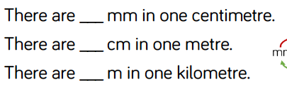
Practice:
Convert 5.67km into metres
Convert 8900mm into metres

Slide 13
Practice 2:
What’s the same and what’s different about km and kg?

Slide 14
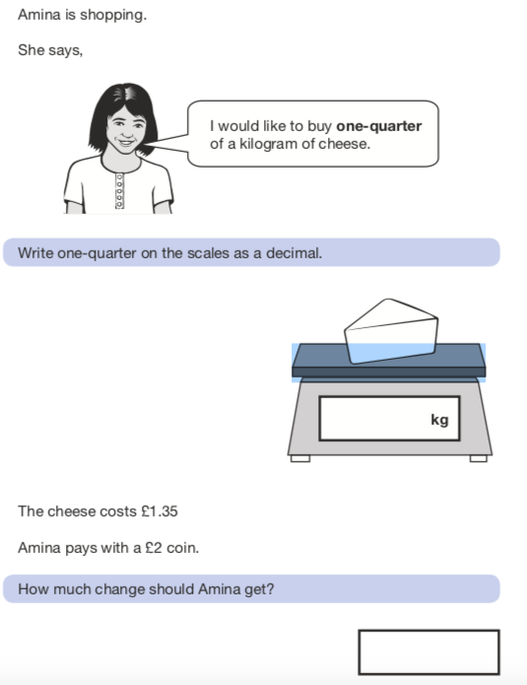
Application

Slide 15
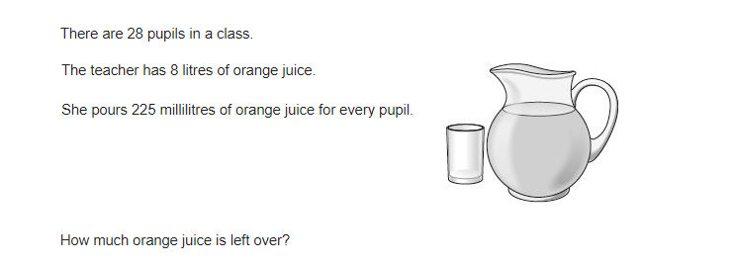
Application

Slide 16
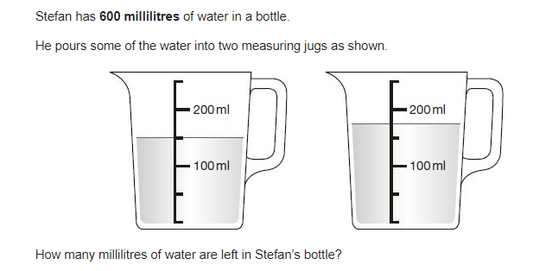
Application

Slide 17
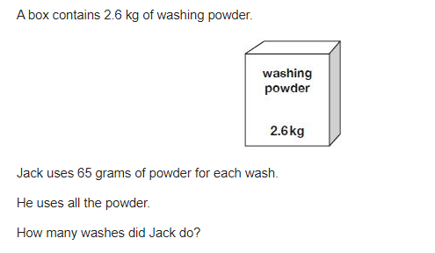
Application

Slide 18
Click the links below for more problem solving activities.
https://classroom.thenational.academy/lessons/solving-problems-involving-converting-between-units-of-metric-mass-69h66e
https://classroom.thenational.academy/lessons/solving-problems-involving-converting-between-metric-units-of-length-cmwk6c

Slide 19
English
- Subject specific vocabulary

Slide 20
Today we are going to look into using subject specific vocabulary. We will generate some vocabulary based on our topic and use this to build informative sentences.
Watch the following video for support and to give you some ideas for your own work.
https://classroom.thenational.academy/lessons/to-develop-and-generate-subject-specific-vocabulary-6mtp4e?activity=video&step=1
Next, choose one of your favourite animals (this may be one you chose earlier in the week) and make a list of vocabulary surrounding them. It would be beneficial to choose a big cat as this will help your final report.

Slide 21
Independent reading

Slide 22
Today is your chance to read independently. Find a book that you know you will enjoy and read.
Once you have finished reading, write a short review of it for me. I am looking for a book to read to the pupils in school so may choose one based on your review!
Remember to include things like: what your book is about, what genre it is, whether it is fact or fiction, what you have read so far, whether you are liking it, what the characters are like, what you think might happen next.

Slide 23
Spelling

Slide 24
-sion spelling
Can you think of any words that end in -sion?
Give the rules you think apply to this ending.

Slide 25
-sion spelling
We usually use the suffix –sion when the base word ends in d/de
( explode - explosion)
Or, where the base word ends in s/de
(confuse - confusion)

Slide 26
Outdoor learning

Slide 27
In Oak Bubble we are going to going to go on a nature trail around the village.
This is because we are going to be helping create a sculpture trail.
Our task today is to follow the instructions given to us by Mrs Hartley, taking pictures of key landmarks to help to show people they are on the right track.
If you are at home, you could create a nature trail around your garden or your local area. Think about what key landmarks people might be interested in seeing. Make a map for people to follow, adding the key landmarks.

