Slide 1
Friday 15th January 2021 Week 2!

Slide 2
Good morning! To wake up your brain, have a go at the following task:
The security door to Mrs Jones’ office has a code of 5422.
The door can, in fact be opened by any combination of these numbers (e.g. 2425).
How many different combinations are there to open the door?

Slide 3
Mathletics/EdSHed

Slide 4
Today we are going to spend some time on Mathletics and TT Rockstars.
Complete the tasks set for and then go on play live to compete against your friends. Is there anyone else from school online who you could challenge?

Slide 5
English
Gathering information

Slide 6
Today we are going to research our chosen big cat. Remember our topic is African Safari, so consider which animals you could choose.
The video below has some ideas surrounding tigers - you could use this as a starting point and edit them for your own cat.
https://classroom.thenational.academy/lessons/to-learn-about-tigers-and-their-appearance-c5j3cc?activity=video&step=1
Use a range of sources to gather information. Record your information in note form, ready to write up next week.

Slide 7
Independent reading

Slide 8
Today you are going to carry on reading the book you chose the other day.
Once you have read enough, I would like you to create a comic strip depicting what has happened in the story so far.
If you have chosen a non-fiction piece, create an information poster that shows some of the information you have read.

Slide 9
Spelling

Slide 10
This week we have been learning about the sound shun and its suffixes that go with it.
-tion
-sion
-cian
On the next page is a sheet for you to complete. Fill it in with the correct spellings.

Slide 11
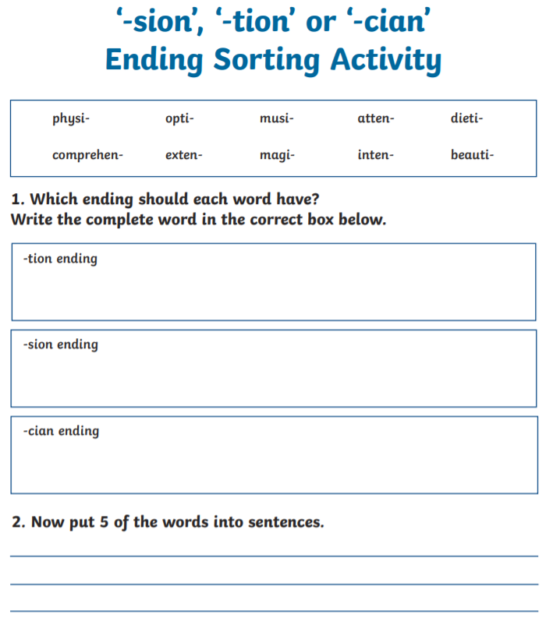

Slide 12
Topic
- Geography

Slide 13
Today we are going to look at some of the amazing safari spots in Africa!
We are going to locate and label these places on a blank map of Africa using an atlas (or the internet if you do not have one at home ☺).
Hot task: Use the ‘national park ideas’ page below to give you example safari spots. You will have to find which country each park is in by researching it online and then label it on your map. Can you find anywhere else people may go on safari?
Spicy task: Use the internet/books (or your own knowledge) to find some of the most popular safari destinations in Africa. Label these on your map, giving the National Park and the Country it is in. Can you find anywhere else people may go on safari?
C: Can you find where Miss Cooper went on safari (she took this photo at the entrance)?

Slide 14
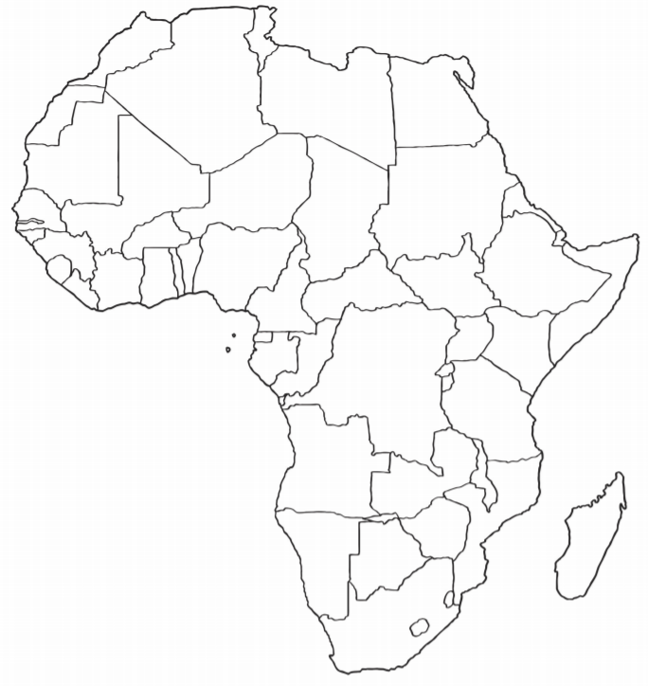

Slide 15
National Park ideas
Chobe National Park
Masai Mara National Reserve
Amber Mountain National Park
Serengeti National Park
Liwonde National Park
Etosha National Park
Nyungwe Forest
Kruger National Park
Lake Nakuru National Park
Ngorongoro Crater
Kidepo National Park
Mana Pools National Park

