Slide 1
spelling
Year 4.
21.1.21

Slide 2
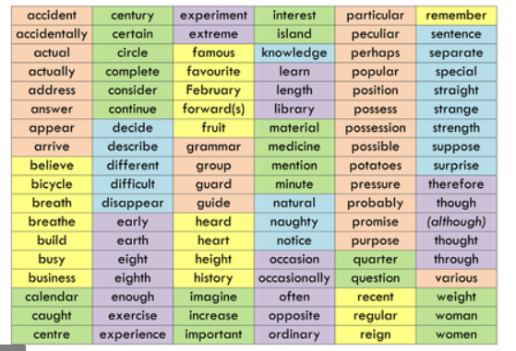

Slide 3
Choose your words
First, choose some words you want to work on this week.
bicycle, decide,
February, possession

Slide 4
Choose a method
Think of a way to help you learn these words.
bi – cycle dec – ide
Feb – ru – ary
poss – ess - ion

Slide 5
Use your method
Use your method to help you learn your chosen words.
bi – cycle dec – ide
Feb – ru – ary
poss – ess - ion

Slide 6
Put them in a sentence
Write your words in a sentence. Remember to think about all the ingredients a sentence needs as well as your spelling.
When I ride my bicycle, I always remember to wear my helmet so I am safe.
I might decide to buy a new Lego set if I get enough money for my birthday.
“Shall we go on holiday in February?” asked my mum excitedly.
I’m so fed up of my little sister breaking my possessions!

