Slide 1
Wednesday 13th January 2021
Remote learning
Year 3
Miss Hargreaves

Slide 2
English – character profiles
Over the next few weeks, we will be planning, editing and drafting our very own Greek myth. However, we have lots of things to look at before we do this! We have already explored some Greek Gods and now, we are going to look at some Greek mythical creatures!
Activity:
I would like you to choose 2 Greek mythical creatures from the next slide to research and create a character profile. (the character profile sheet will be on the website, but you may wish to be creative with this and present it in your own way)

Slide 3
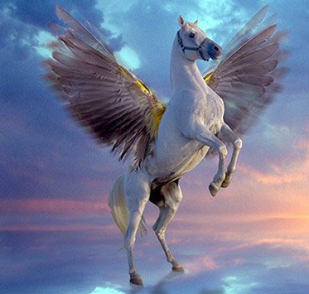
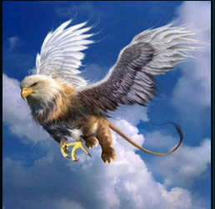
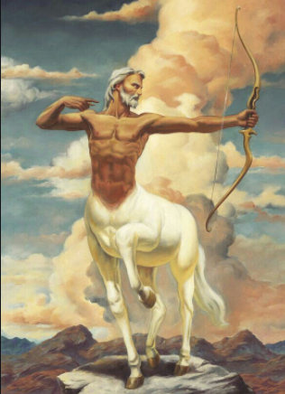
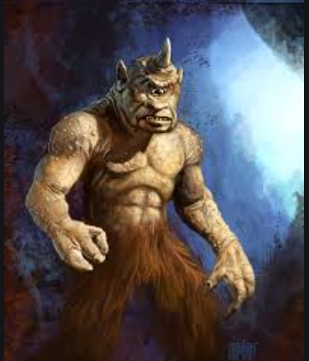
Pegasus
Griffin
Centaur
You can use these images to help you write about the characters appearance.
Remember, presentation is still important even though you are at home!
Cyclops

Slide 4
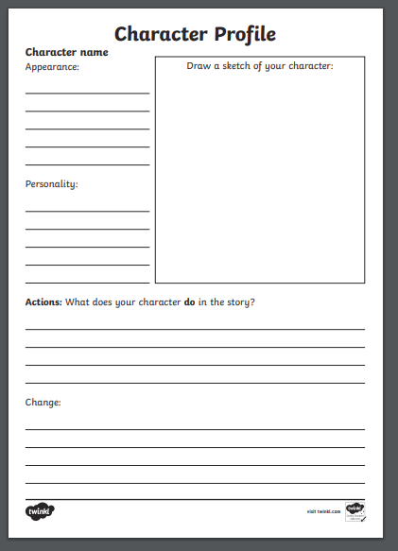
This sheet is available on the website for you to use.
You can either draw the creature you are looking at or, you can print it out and stick it in! ☺
Appearance → what do they look like? Use the images on the other page to help you
Personality → what are they like? Are they strong, mean, kind, evil, generous?
Actions → you may need to do a little bit more research on this and see what the mythical creature does.
Change → what would you change about this character and why.

Slide 5
Reading – independent (20 mins)
Today, I would like you to do some independent reading. This can be a book you enjoy reading.
I would like you to keep a record of any independent reading you do at home.
It needs to include:
* the date
* the book you are reading
* how many pages you have read (I have read from page 12 to page 29 today)
* a few sentences telling me what has happened in the book
* any bits you have really enjoyed or disliked

Slide 6
Phonics
If your child accesses phonics in Year 3 please look at the videos available on Youtube to support them with this at home and look at the phonics schedule on the website.
https://www.youtube.com/channel/UCo7fbLgY2oA_cFCIg9GdxtQ?fbclid=IwAR07QDNLAMqWrJXHBKMTYoOMF7dZQcOYfCeUEcsygVxBF5pDVeKm9plhy0c

Slide 7
GPS lesson on Oak Academy
Revising compound sentences
- Click the link
- English grammar units
https://classroom.thenational.academy/subjects-by-year/year-3
- Then click T1: sentence level objectives

Slide 8
Spelling
Todays spellings are:
can’t
Shouldn’t
Wouldn’t
These words are called contractions as they shorten two words into one.
Remember your apostrophe that replaces a letter
WORD OF THE DAY →
Humid – air that is full of water vapour
Can you write a sentence with this word in?
Can you learn the spelling?

Slide 9
R.E – Jesus and his first disciples
Watch this short Youtube video –
https://www.youtube.com/watch?v=UWiqXIn9tyg
Activity:
Draw a picture of your 3 favourite possessions or take a picture and stick these in a notebook.
Make a note of:
Would you give up these possessions? (challenge yourself by trying to explain each reason)
What is most important to you and why?

Slide 10
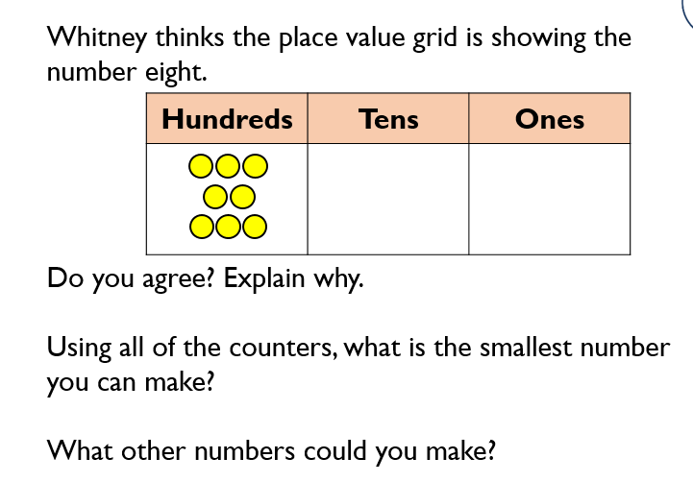
Maths - consolidate 2s 4s and 8s times tables
Activity 1:
Click the link below to watch a short video. Make sure you have a pencil and some paper ready as there are times when you have to pause the video and do some thinking.
https://whiterosemaths.com/homelearning/year-3/week-1-number-multiplication-division/
Activity 2:

