Slide 1
Tuesday 12th January 2021
Remote learning
Year 3
Miss Hargreaves

Slide 2
GPS: Oak Academy lesson
Exploring compound sentences
• Click the link
https://classroom.thenational.academy/subjects-by-year/year-3
• English grammar units
• Then click T1: sentence level objectives

Slide 3
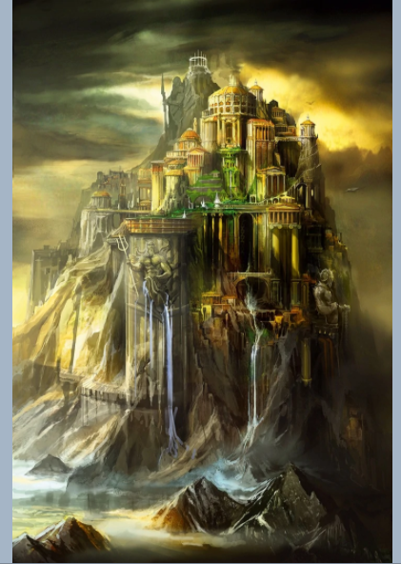
English – writing a setting description
Use your mind map from yesterdays lesson to now write some fantastic sentences for your setting description. Remember to write in full sentences, capital letters and full stops. Use your understanding of compound sentences from todays GPS lesson to help you, too.
Example:
The huge, rocky mountain stood proudly in the centre of Greece with water flowing gracefully down from the jagged cracks. The echoes of chatter fill the air from the grand meeting room where all 12 Greek Gods gathered.

Slide 4
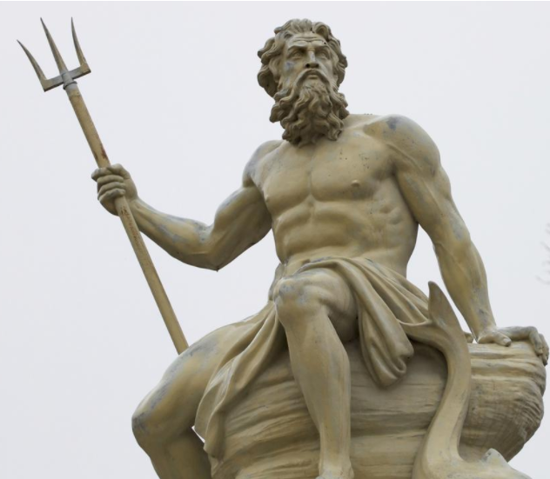
Reading – Greek myths.
Greek Mythology is a group of epic stories about Gods, Goddesses, heroes, creatures and the rituals of Ancient Greece.
Most of these stories were told by the Ancient Greeks to their families and friends over many generations. The stories often featured wars and heroic battles, frightening monsters, and also taught the importance of bravery, intelligence, fear, love, fun and right and wrong.
Many myths were based on the fact that Gods, like human men and women, could be punished or rewarded for their actions.
The Ancient Greeks used myths about Gods to help them understand things happening around them such as the forces of nature. There were sea gods, woodland gods, sky gods, underwater gods, half-gods and human heroes undertaking courageous or romantic adventures

Slide 5
Reading – Pandora’s box
Pandora finds a box and is told NOT to open it.
What do you think is going to be in the box?
Write a few ideas down so you can have a look back and see if you are right.
Use some of these sentence starters to help you.
I think that ….
I predict that …
Maybe …
Possibly …
Remember, there is no right or wrong answer it is your opinion.
Now you have done your prediction sentences, I would like you to read the Greek myth. This is available on the website as an eBook.

Slide 6
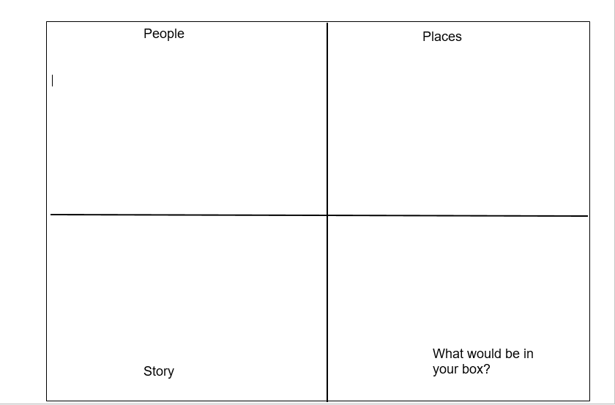
Reading – Pandora’s box
What an interesting story Pandora’s box is! It is one of my favourite Greek myths.
To demonstrate your understanding of this text, I would like you to fill out a ‘tell me grid’.
It is available on the website or you can split a pieced of paper into 4 sections with an adult to complete this.
People → Think about who is involved in the story and why they are important. What are their names?
Places → where does this take place?
Story → summarise the story into some key bullet points. No more than 10!
What would be in your box? → Think about what things frighten you? What would you keep hidden away in the box?

Slide 7
Phonics
If your child accesses phonics in Year 3 please look at the videos available on Youtube to support them with this at home and look at the phonics schedule on the website.
https://www.youtube.com/channel/UCo7fbLgY2oA_cFCIg9GdxtQ?fbclid=IwAR07QDNLAMqWrJXHBKMTYoOMF7dZQcOYfCeUEcsygVxBF5pDVeKm9plhy0c

Slide 8
Spelling
Spellings:
Recap the their, there and they’re homophones.
Can you remember the actions to help you?
Write 2 sentences with each word.
WORD OF THE DAY →
Petrified – extremely frightened and unable to move.
Can you use this in a sentence?

Slide 9
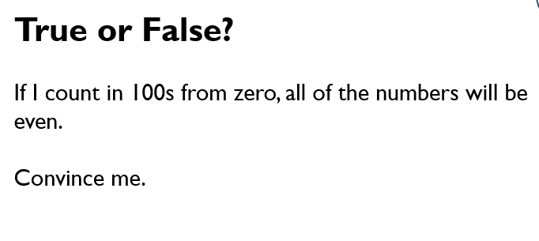
Maths: mathletics lesson
Challenge 1:
Mathletics lesson (repartition 2-digit number).
I will be checking the scores this evening, try and get 75% or more on this activity. Don’t give up! You can all do this ☺
Challenge 2: Problem solving/reasoning:

Slide 10
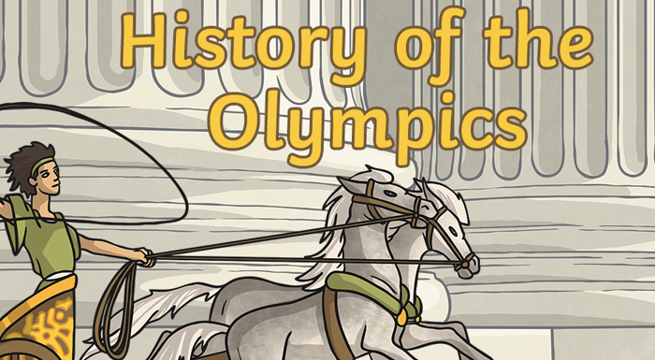
Topic – who made the Olympics?
Look at the PowerPoint on the website that explains all about the Ancient Olympics.
After looking at this information I would either like you to:
1) create an information leaflet explaining this to someone else
2) create a news report video pretending you are live at the first ever Olympic games – you will need to explain the rules, the events and who can attend.
I cant wait to see these! ☺

