Slide 1
Friday 15th January 2021
Miss Hargreaves
Year 3
Remote learning

Slide 2
Well done, Year 3! You have done your first week!
Phew!
Well done to you, your parents/carers or whoever is looking after you at home. You are all doing an amazing job and I am so proud of all the work you have been doing! ☺
I hope you have enjoyed some of the learning you have done this week, especially the work about The Greeks! We will be doing some more on this next week so I hope you are prepared.
Remember, I am always here if you need a chat about anything (even if it isn’t school related).
Stay safe and enjoy your weekend.
Love,
Miss Hargreaves

Slide 3
Morning activity!
This morning I would like you to go on TT rockstars for at least 10 minutes.
Maybe, some of you could challenge me on this! ☺
I would like you to get out and do some active or complete a Joe Wicks P.E. You could go on a walk, ride your bike or teach another sibling/family member a P.E lesson.
If the weather isn’t great, have some down time. Do some reading, build with Lego, draw or play with playdough.

Slide 4
Friday reflection.
It is super important to reflect on your week, your feelings and your activities. You may be feeling lots of different emotions right now and that is fine.
Even adults sometimes have days they feel ‘wobbly’ or a little uneasy. Having this time will allow you to get any worries, feelings or emotions down on paper and usually helps us to feel better.
This is a good way for you to tell me what you have done this week that you have enjoyed, not really enjoyed, you are proud of and anything fun and exciting you have done!

Slide 5
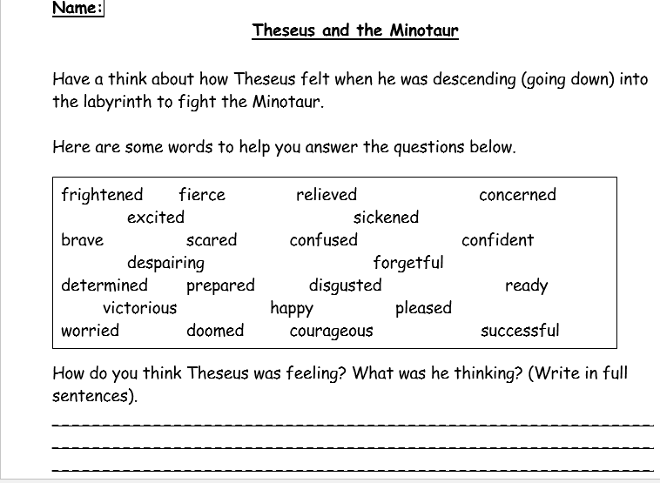
Reading – Theseus and the Minotaur
http://myths.e2bn.org/mythsandlegends/playstory563-theseus-and-the-minotaur.html
This link will take you to an eBook for the Theseus and Minotaur. You can choose to listen to this text being read to you, or you can read it yourself! ☺
After you have listened/read this story there is a worksheet for you to do on the website.

Slide 6
Spelling and word of the day
Spelling test – get an adult or a sibling to test you on these spellings:
Can’t
Shouldn’t
Wouldn’t
Their
There
They’re
Because
Accident
Accidentally
WORD OF THE DAY →
Dilapidated – an old house beyond repair

Slide 7
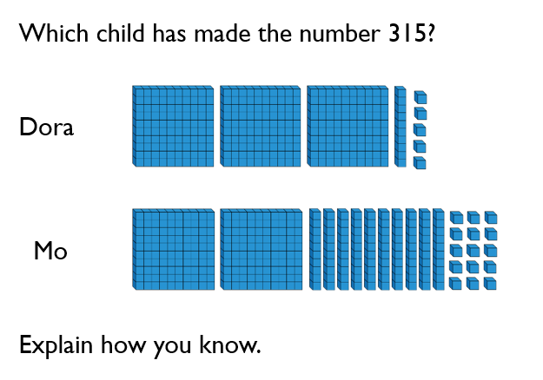
Maths
Activity 1:
White rose maths – related calculations
https://whiterosemaths.com/homelearning/year-3/week-1-number-multiplication-division/
Activity 2:

