Slide 1
Wednesday 27th January 2021 Week 4

Slide 2
Good morning!
Have a go at the following task:
Don’t say “went” say …… How many alternatives can you think of?

Slide 3
Arithmetic

Slide 6
Today we will focus on question 4 of year 5.
The question is asking us what the missing number is in the question 8,036-1000= ????+1000. When looking at the answer sheet, it tells us the missing number is 6,036 but how did we get this?
This question is about balancing calculations.
It is important to remember that = symbol means equals and doesn’t mean answer. This shows that each side of the calculation has to equal the same.

Slide 7
Working out 8,036-1000= ????+1000
We need to know what each side should total
We can do this by working out the calculation on the left first.
8,036 – 1000
This subtraction equals 7,036, so the calculation on the other side must equal the same.
7,036 = ???? + 1,000
So now we need to ask ourselves what do we add 1,000 to that will reach 7,036. To work this out we can do the inverse and subtract 1000 to see what we had before this would give us our answer of 6,036.
8,036 – 1000= 6,036 +1,000
After completing both sides of the calculation we should have 7,036 on each side.

Slide 8
To help you work out the missing number, work out the calculation on the opposite side first to tell you what it should equal.
Have a go at these questions using what you have just learnt.
50 + 100= ?? - 50
4 x ? = 10 + 10
Half of 200 = ??? + 80

Slide 9
Maths – Area of rectangles

Slide 10
Over the last couple of days we have looked at perimeter.
This measures the length around the edge of the shape.
Today we are going to move onto looking at area.
This is the space inside the shape.
When calculating the area of a rectangle or square we can follow a simple equation.

Slide 11
Looking at the shape we can see how many squares fill the inside of the shape - this is the area.
To do this we need to know how many rows there are. In this case there are 2 rows - this is also known as the length of the shape.
We also need to know how many squares are in each row. In this case there are 4 - this is also known as the width.
When we count how many squares there are altogether, there are 8.
Sometimes we won’t have squares to help us. When this happens we can simply multiply the length by the width to tell us the area. 2 x 4 = 8

Slide 12
Have a go at the next few questions.
Remember to work out both the number of squares in the length and the width before multiplying them together to get the area.

Slide 15
As mentioned before, sometimes we won’t have squared paper to help us. So we can multiply the length by the width.
Have a go at these questions now.
What do you notice about the units for area?

Slide 17
Challenge:
Remember to use a ruler when drawing a shape. Using squared paper may help you.
Hint: think carefully about what numbers you would multiply together to get 24.

Slide 20
Super spicy challenge:
I have created 3 rectangles that all have the area 120cm². All the sides are even numbers.
Find the size of the rectangles I could have created.
Find an example of a rectangle that I couldn’t have created.

Slide 21
If you would like some more support on this please watch the video below:
https://vimeo.com/480242752

Slide 22
English
- Sentence structure

Slide 23
Over the last couple of days we have looked at creating tension. Yesterday we looked at using descriptive language to help the reader imagine the scene. Today we are going to look at the sentence structure to help us create more tension.

Slide 24
The first thing we can do is use short, sharp sentences. The use of short sentences are perfect for building tension as they leave more to the imagination. Look at the sentences below and see which you think is most effective: Something was moving. A giant spider jumped across the dressing table, its spindly legs moving faster and faster as it went. Although the second sentence is very descriptive, it takes away all the tension by revealing too much too soon. The short sharp sentence helps to move the story on without giving too much away.

Slide 25
Building Suspense
The text uses some short, sharp sentences to shock the reader. In these short sentences, giving the reader no details at all is scary a bit like being in the dark.
Nothing moved. Cogston House was as silent as the grave. Perhaps the only thing worse than hearing her best friend desperately calling her name was being alone in this endless quiet. Alice’s eyes searched through the darkness, scouring the corridor which faded into more murky gloom. She could make out the hallway right in front of her, the door opposite, and beyond it, the enormous winding staircase. As she looked, blinking through the tears which had begun to stream hopelessly down her face, she was met with a sight at the top of the staircase which all but turned her to stone...
Something was moving.
Alice watched numbly. Her heart was in her mouth and her breath came in sharp, rattling gasps.
Descending the stairs one careful, agonising, creaking step at a time, a hunched silhouette shuffled out from the darkness...
Nothing moved. Cogston House was as silent as the grave. Perhaps the only thing worse than hearing her best friend desperately calling her name was being alone in this endless quiet. Alice’s eyes searched through the darkness, scouring the corridor which faded into more murky gloom. She could make out the hallway right in front of her, the door opposite, and beyond it, the enormous winding staircase. As she looked, blinking through the tears which had begun to stream hopelessly down her face, she was met with a sight at the top of the staircase which all but turned her to stone...
Something was moving.
Alice watched numbly. Her heart was in her mouth and her breath came in sharp, rattling gasps.
Descending the stairs one careful, agonising, creaking step at a time, a hunched silhouette shuffled out from the darkness...

Slide 26
Have a look at the paragraph below. Can you replace a sentence or two with short sentences to improve the tension?
He stumbled down the crooked cellar stairs; bouncing off each one until he finally hit the bottom. He looked around the room with great interest, as he picked himself back up. He had never been allowed to come down here by himself, so he thought he best make the most of the opportunity.
As he glared into every corner of the room, he noticed a small wooden door. He hobbled towards it with crimson flowing through his jeans. The dull pain from the fall seemed not to faze him as he went towards it.
As he did, the door nob turned slightly. This caused his heart to race faster and faster and it made his palms very sweaty. What could be opening the small wooden door?

Slide 27
As you can see, there is a lot of description but we can alter some of the sentences to make them shorter but more effective for building tension. Read the paragraph again and see what you think about what I have replaced. Is it the same as you?
He stumbled down the crooked cellar stairs; bouncing off each one until he finally hit the bottom. He stared around the room with great interest, as he picked himself back up. He had never been allowed to come down here by himself, so he thought he best make the most of the opportunity.
As he glared into every corner of the room, he noticed a something.
A door. He hobbled towards it with crimson flowing through his jeans. The dull pain from the fall seemed not to faze him.
As he did, the door nob turned slightly. His heart began to race. His palms became sweaty. His breathing became erratic. What was opening the door?

Slide 28
The use of short sentences in the edited paragraph create a better effect. The short pause after each sentence makes the reading more dramatic. It is important to remember not to use only short sentences though. Sometimes we need more detail to make the reader wait longer for the next piece of action.

Slide 29
Building Suspense
Adding extra information (subordinate and relative clauses) to sentences can also make the reader wait even longer.
Nothing moved. Cogston House was as silent as the grave. Perhaps the only thing worse than hearing her best friend desperately calling her name was being alone in this endless quiet. Alice’s eyes searched through the darkness, scouring the corridor which faded into more murky gloom. She could make out the hallway right in front of her, the door opposite, and beyond it, the enormous winding staircase. As she looked, blinking through the tears which had begun to stream hopelessly down her face, she was met with a sight at the top of the staircase which all but turned her to stone...
Something was moving.
Alice watched numbly. Her heart was in her mouth and her breath came in sharp, rattling gasps.
Descending the stairs one careful, agonising, creaking step at a time, a hunched silhouette shuffled out from the darkness...
Nothing moved. Cogston House was as silent as the grave. Perhaps the only thing worse than hearing her best friend desperately calling her name was being alone in this endless quiet. Alice’s eyes searched through the darkness, scouring the corridor which faded into more murky gloom. She could make out the hallway right in front of her, the door opposite, and beyond it, the enormous winding staircase. As she looked, blinking through the tears which had begun to stream hopelessly down her face, she was met with a sight at the top of the staircase which all but turned her to stone...
Something was moving.
Alice watched numbly. Her heart was in her mouth and her breath came in sharp, rattling gasps.
Descending the stairs one careful, agonising, creaking step at a time, a hunched silhouette shuffled out from the darkness...

Slide 30
We can also use a piece of punctuation called an ellipsis. This punctuation is used to give us a cliff hanger moment. It shows that something is coming up or if we want to leave the reader waiting. It looks like this … It is important to remember to start the sentence with what was taken out so that the text continue to make sense.

Slide 31
Building Suspense
There is a special piece of punctuation used when creating suspense.
Nothing moved. Cogston House was as silent as the grave. Perhaps the only thing worse than hearing her best friend desperately calling her name was being alone in this endless quiet. Alice’s eyes searched through the darkness, scouring the corridor which faded into more murky gloom. She could make out the hallway right in front of her, the door opposite, and beyond it, the enormous winding staircase. As she looked, blinking through the tears which had begun to stream hopelessly down her face, she was met with a sight at the top of the staircase which all but turned her to stone...
Something was moving.
Alice watched numbly. Her heart was in her mouth and her breath came in sharp, rattling gasps.
Descending the stairs one careful, agonising, creaking step at a time, a hunched silhouette shuffled out from the darkness...
Nothing moved. Cogston House was as silent as the grave. Perhaps the only thing worse than hearing her best friend desperately calling her name was being alone in this endless quiet. Alice’s eyes searched through the darkness, scouring the corridor which faded into more murky gloom. She could make out the hallway right in front of her, the door opposite, and beyond it, the enormous winding staircase. As she looked, blinking through the tears which had begun to stream hopelessly down her face, she was met with a sight at the top of the staircase which all but turned her to stone...
Something was moving.
Alice watched numbly. Her heart was in her mouth and her breath came in sharp, rattling gasps.
Descending the stairs one careful, agonising, creaking step at a time, a hunched silhouette shuffled out from the darkness...
Three dots together is called an ellipsis. Ellipses show that something is coming next (like a drumroll), or sometimes that the end of the sentence is missing.

Slide 32
Have a go at the ellipses sheets on the home learning page to expand your knowledge. Challenge: Write a paragraph looking at the image from Monday. Try to include: - Short sentences for effect - Sentences with detail(relative/subordinate clause) - Ellipses to create a cliff hanger moment

Slide 33
Guided reading

Slide 34
The garden of doom returns.
Today in guided reading we are going to be looking at pink questions (Polly prediction).
Read through the text from Monday or listen to my wonderful recording again below.
As you go through make notes about the story. What has happened so far? This will help you to make a prediction about the text.

Slide 35
When making a prediction it is important to think about what has already come before.
This will make it so that your prediction is relevant to the text.
Look at the two predictions on the next slide - which do you think is most likely to happen?

Slide 36
After being sucked into the game the boys will have to travel through the computer game ‘The garden of doom’ and beat the final boss before they can get back into their room. They will have to fight deadly plants and an evil gardener before they can finally go home. They will also need their mum to help them by turning the tv back on.
I think the boys will be abducted by aliens and taken to another planet where they will have to look after an evil garden for the aliens.

Slide 37
Now its your turn.
Have a go at deciding what will happen to the boys next.
Use your notes that you made when reading the text to help you justify your answer.

Slide 38
Spelling

Slide 39
Prefixes part 3:
Over the last couple of days we have looked at different prefixes.
Today we are going to look at the prefix tele-.
Think of as many words as you can that use this prefix.

Slide 40
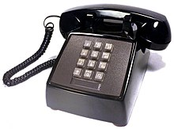
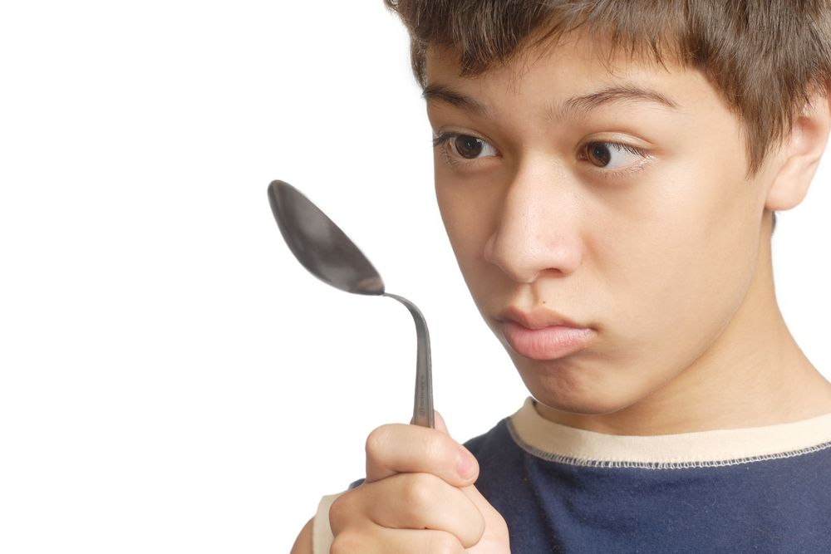
The prefix tele- means at a distance.
Look at the images below can you work out the words beginning with tele- that go with them.

Slide 41
Outdoor learning

Slide 42
This week in outdoor learning we are going to go for our nature walk around the village. We should have done this a couple of weeks ago but unfortunately the weather was against us.
We are going to find points of interest and take pictures of them. This will help us to write out instructions next week for people to follow the same route we have.

Slide 43
Why not have a go at home?
Take pictures of key landmarks around the village or your garden so that you can ask people to find them or so that they can help you to write a set of instructions about how to follow the route you took.

