Slide 1
Wednesday 20th January 2021 Week 3

Slide 2
Good morning!
Have a go at the following task:
How many times would you see 3 of the same numbers in a row in 24 hours on an ordinary 4 digit 24 hour digital clock?
1 1 : 1 4

Slide 3
Arithmetic

Slide 4
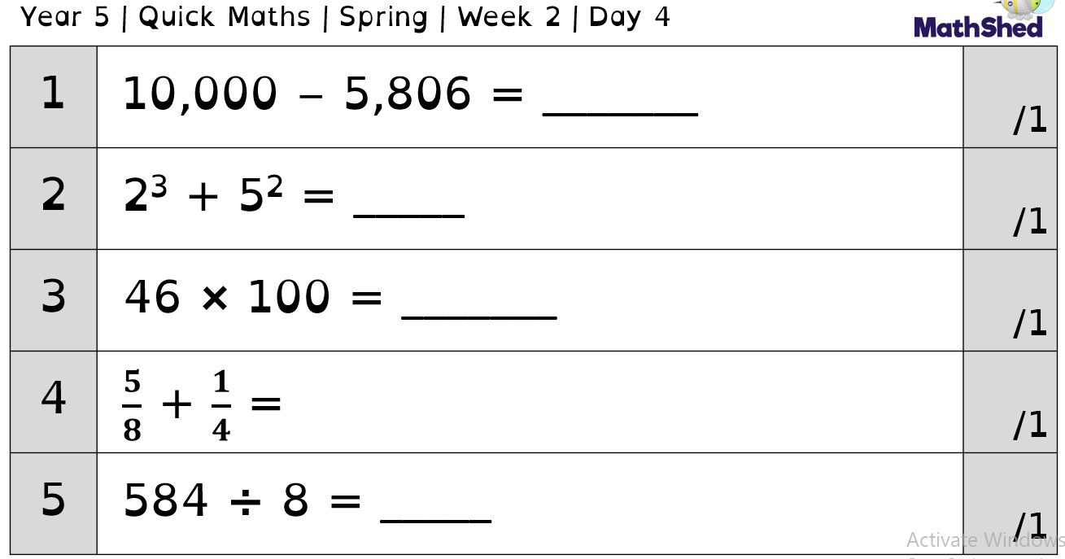
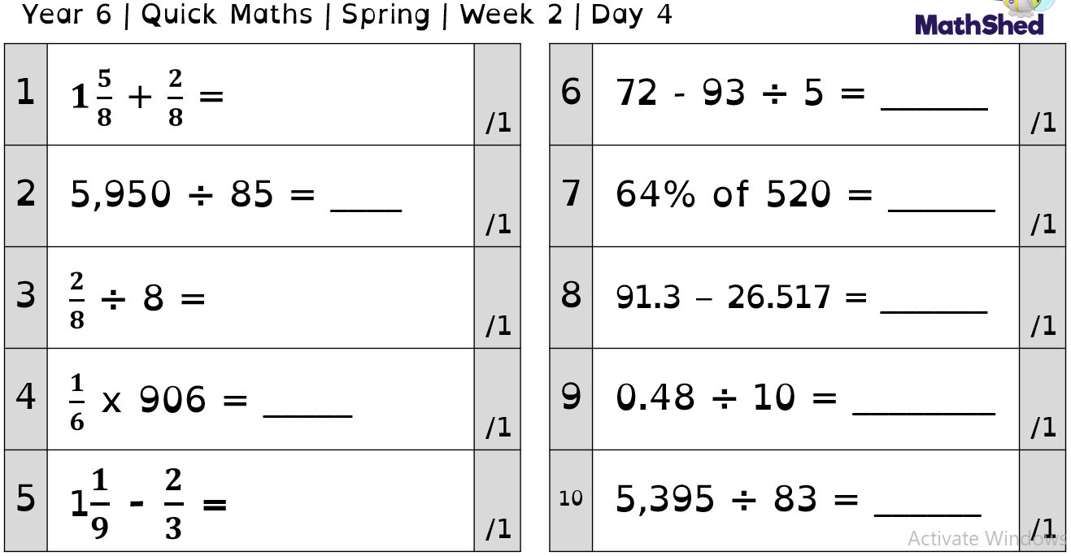

Slide 5
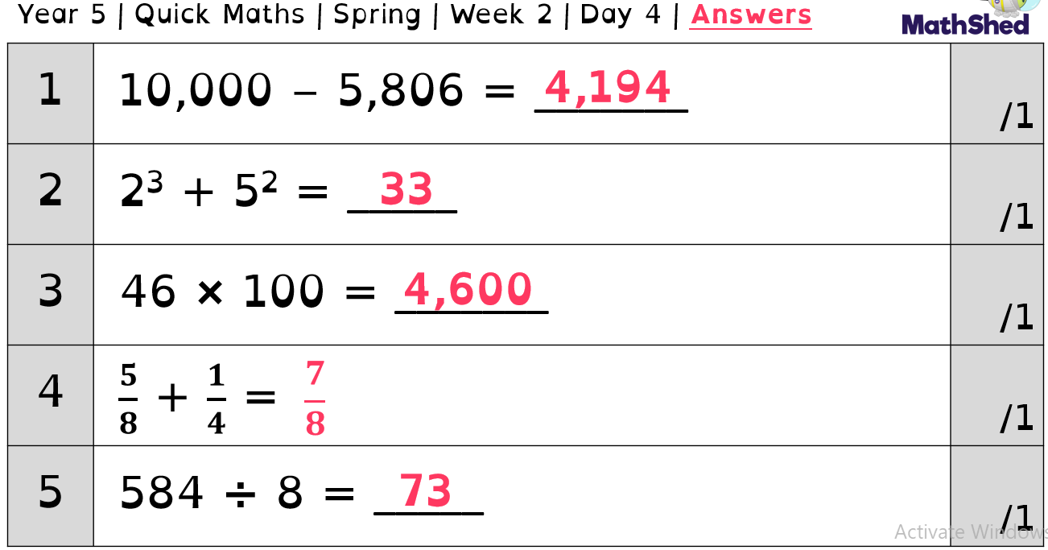
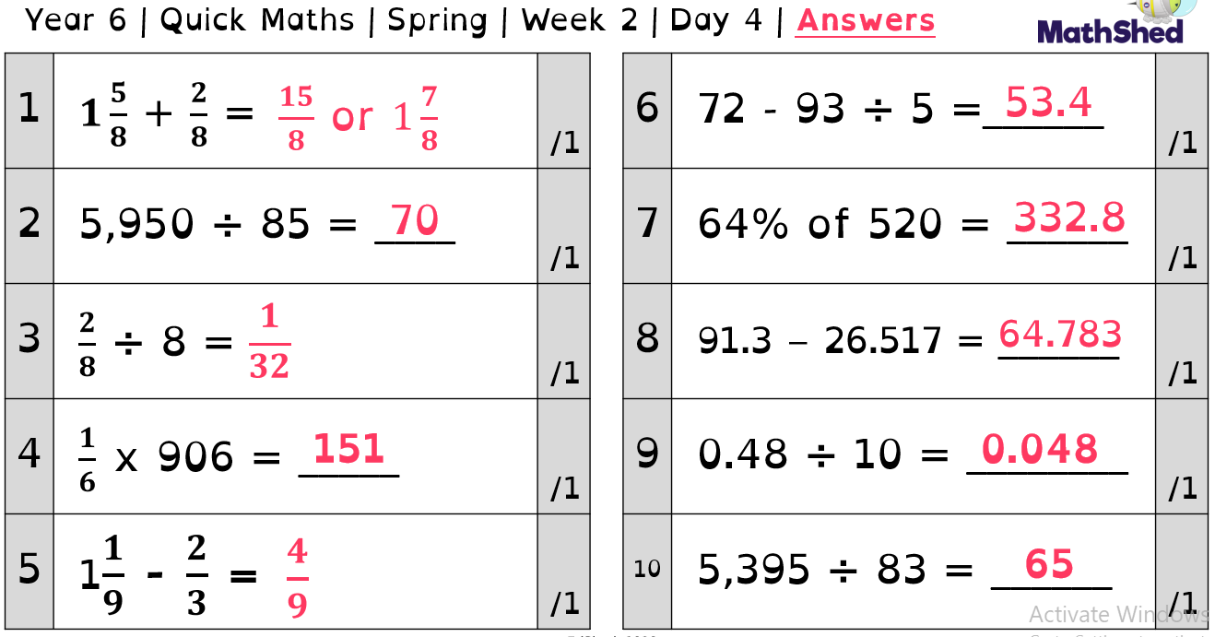

Slide 6
Maths – It’s time for time

Slide 7
Over the next couple of lessons we are going to be looking at converting time.
Read through the next few slides and have a go at the activities at the end.
Before you do that read the information below it will help you.
1 minute=60 seconds
1 hour = 60 minutes
1 day = 24 hours
1 week = 7 days

Slide 8
In 1 day..
I know that there are 24 hours in 1 day.
Source: me
8

Slide 9
How many hours are there in 1 week?
But how many hours are there in 1 week?
9

Slide 10
How many hours are there in 1 week?
That’s easy!
If there are 7 days in a week,
then 24 x 7 =
10

Slide 11
How many hours are there in 1 week?
1 day
24 hours
?
7 days
11

Slide 12
How many hours are there in 1 week?
24
12

Slide 13
How many hours are there in 1 week?
24
24
13

Slide 14
How many hours are there in 1 week?
24
24
24
14

Slide 15
How many hours are there in 1 week?
24
24
24
24
15

Slide 16
How many hours are there in 1 week?
24
24
24
24
24
16

Slide 17
How many hours are there in 1 week?
24
24
24
24
24
24
17

Slide 18
How many hours are there in 1 week?
24
24
24
24
24
24
24
24 x 7 = 168
18

Slide 19
How many hours are there in 1 week?
There are 168 hours in 1 week.
19

Slide 20
In 1 day..
I also know that there are 60 minutes in 1 hour.
20

Slide 21
In 1 day..
How many minutes are there in 1 day?
21

Slide 22
How many minutes are there in 1 day?
1 hour
60 minutes
?
24 hours
22

Slide 23
How many minutes are there in 1 day?
1 hour
60 minutes
?
24 hours
60 x 24 = 1440
23

Slide 24
Recap
There are 24 hours in 1 day.
24

Slide 25
Recap
There are 24 hours in 1 day.
There are 168 hours in 1 week.
25

Slide 26
Recap
There are 24 hours in 1 day.
There are 168 hours in 1 week.
There are 1440 minutes in 1 day.
26

Slide 27
In 1 day..
I know there are 60 seconds in 1 minute, but...
27

Slide 28
In 1 day..
How many seconds are there in 1 hour?
28

Slide 29
How many seconds are there in 1 hour?
1 minute
60 seconds
60 minutes
?
29

Slide 30
How many seconds are there in 1 hour?
1 minute
60 seconds
60 minutes
?
60 x 60 = 3600
30

Slide 31
There are 3600 seconds in 1 hour
There are 3600 seconds in 1 hour!
31

Slide 32
Converting
1 hour
60 minutes
?
52 hours
32

Slide 33
Converting
1 hour
60 minutes
?
52 hours
52 x 60 = 3120 min
33

Slide 34
Converting
1 hour
60 minutes
?
12 hours
34

Slide 35
Converting
1 hour
60 minutes
?
12 hours
12 x 60 = 720 min
35

Slide 36
Converting
1 hour
60 minutes
?
7200 minutes
36

Slide 37
Converting
1 hour
60 minutes
?
7200 minutes
7200 ÷ 60 = 120 hours
37

Slide 38
Converting
1 minute
60 seconds
?
1200 minutes
38

Slide 39
Independent Task
Complete the table below.
Seconds | Minutes | Hours
 |  | 24
 | 2880
129600 |  | 36
39

Slide 40
Independent task answers

Slide 41
Independent Task
Seconds | Minutes | Hours
 |  | 24
 | 2880
129600 |  | 36
41

Slide 42
Answers
Seconds | Minutes | Hours
 | ? | 24
 | 2880
129600 |  | 36
42

Slide 43
Answers
1 hour
60 minutes
?
24 hours
60 x 24 = 1440
43

Slide 44
Answers
Seconds | Minutes | Hours
 | 1440 | 24
 | 2880
129600 |  | 36
44

Slide 45
Answers
Seconds | Minutes | Hours
? | 1440 | 24
 | 2880
129600 |  | 36
45

Slide 46
Answers
1 minute
60 seconds
?
1440 minutes
1440 x 60 = 86400
46

Slide 47
Answers
Seconds | Minutes | Hours
86400 | 1440 | 24
 | 2880
129600 |  | 36
?
47

Slide 48
Answers
1 hour
60 minutes
?
2880 minutes
2880 ÷ 60 = 48
48

Slide 49
Answers
Seconds | Minutes | Hours
86400 | 1440 | 24
 | 2880
129600 |  | 36
?
48
49

Slide 50
Answers
1 minute
60 seconds
?
2880 minutes
2880 x 60 = 172,800
50

Slide 51
Answers
Seconds | Minutes | Hours
86400 | 1440 | 24
 | 2880
129600 |  | 36
172800
48
?
51

Slide 52
Answers
1 hour
60 minutes
36 hours
?
36 x 60 = 2160
52

Slide 53
Answers
Seconds | Minutes | Hours
86400 | 1440 | 24
 | 2880
129600 |  | 36
172800
48
2160
53

Slide 54
Now challenge yourself by having a go at the following problems.

Slide 55
Seconds, minutes and hours
There are …. seconds in 1 minute.
There are …. minutes in 1 hour.
There are …. hours in 1 day.
Source: me
55

Slide 56
How many hours are there in 14 days?
56

Slide 57
Word Problem 1
For Sports Day, Cala ran 800m.
She finished running the 800m in 300 seconds.
57

Slide 58
Word Problem 1
For Sports Day, Cala ran 800m.
She finished running the 800m in 300 seconds.
Her best record for an 800m sprint was 4.5 minutes.
58

Slide 59
Did she beat her record?
For Sports Day, Cala ran 800m.
She finished running the 800m in 300 seconds.
Her best record for an 800m sprint was 4.5 minutes.
59

Slide 60
Word Problem 2
Antoni is following his grandmother’s recipe.
60

Slide 61
Word Problem 2
Antoni is following his grandmother’s recipe.
It says the stew must cook for 2 hours and 10 minutes. So far he has been cooking it for 69 minutes. How much longer does the stew need to cook for?
61

Slide 62
Word Problem 2
The stew needs to cook for 2 hours and 10 minutes.
How many minutes is this in total?
62

Slide 63
Word Problem 3
Yasmin and Binh take different routes to get to Lanzarote.
63

Slide 64
Word Problem 3
Yasmin’s journey takes 3 hours and 34 minutes.
64

Slide 65
Word Problem 3
Binh’s journey takes 219 minutes.
65

Slide 66
Word Problem 3
Who’s journey took the quickest?
By how long?
3 h 34 min
219 min
66

Slide 67
Super spicy challenge
Back to the Future (117 min) | Frozen 2 (1 hour 43 min)
Frozen (1 hour 45 min) | Despicable Me (5700 sec)
School of Rock (6540 sec) | Finding Nemo (100 min)
i)Which is the shortest film?
ii) Which is the longest film?
iii) What is the difference in seconds between the longest and shortest film?
67

Slide 68
English
- Drafting

Slide 69
Today we are going to continue writing our non-chronological reports.
We will be focusing on the paragraph about appearances.
The video below will model how to write this paragraph:
https://classroom.thenational.academy/lessons/to-write-the-appearance-paragraph-of-a-non-chronological-report-c5j3jd?activity=video&step=1
Like yesterday, we are going to edit and improve our paragraph.

Slide 70
Think carefully about the GPS techniques you should be using in your work e.g.
Accurate punctuation
A range of conjunctions
Fronted adverbials
Expanded noun phrases
Brackets
Relative clauses
Although we often edit and improve our work in class, the following video may help you:
https://classroom.thenational.academy/lessons/to-edit-a-non-chronological-report-c9j3ac?activity=video&step=1
Remember, you may not be able to get all of these in this paragraph - you have the rest of your report to show your writing talents too!

Slide 71
Independent reading

Slide 72
You are going to continue with your independent reading today.
Once you have finished reading, create a poster for your book to encourage people to read it.
Remember to not give too much information away about the story.
Drop in little clues as to what happens.

Slide 73
Spelling

Slide 74
Homophones part 3: everything sounds the same
Today in spellings we are going to have a go at choosing the correct spelling. Read through the sentences on the next page and decide if it is the correct spelling of each word used.

Slide 75
Activity
I really love dessert, my favourite is sticky toffee pudding.
The man was stationery in the road staring into the sky, it was full the unusual objects.
Cheese and chocolate do not compliment each other very well.
I made loads of prophet by selling my old clothes, I can’t believe people actually wanted them.
In each sentence is the homophone correct? If not can you correct it.
Challenge: can you create a sentence that uses both versions of the homophone correctly for example.
Ice cream wasn’t the best dessert to eat in the desert; it melted very quickly.

Slide 76
Outdoor learning

Slide 77
This week in outdoor learning we are going to go to the nature area and give each other instructions.
We will have to make them very clear as the person we are giving the instructions to will be blind folded.
We are doing this so that when we write our instructions for the nature trail we will know how clear they will need to be.

Slide 78
Why not have a go at home.
Write down a set of instructions for getting around your house or garden and ask someone to blind fold you and read them to you. Try to get around your house using them.

