Slide 1
Tuesday 19th January 2021 Week 3

Slide 2
Good morning!
Have a go at the following task:
Try to get as close as you can to the target number using these six numbers:
75 3 4 8 2 5
Target Number: 181
You can't use the same number more than once.
Only add, subtract, multiply and divide are allowed.

Slide 3
Arithmetic

Slide 4
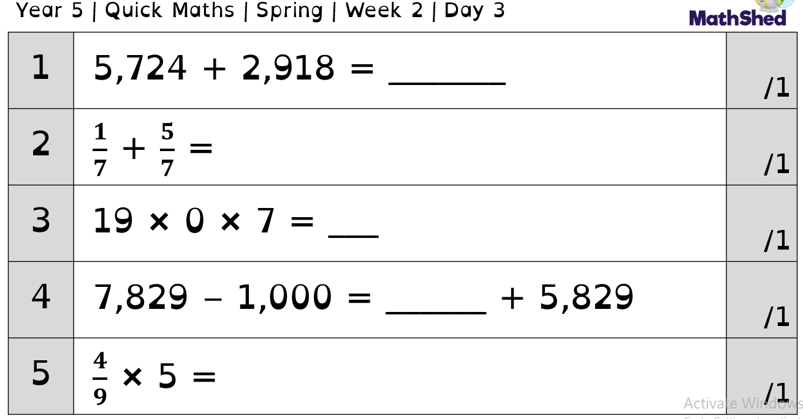
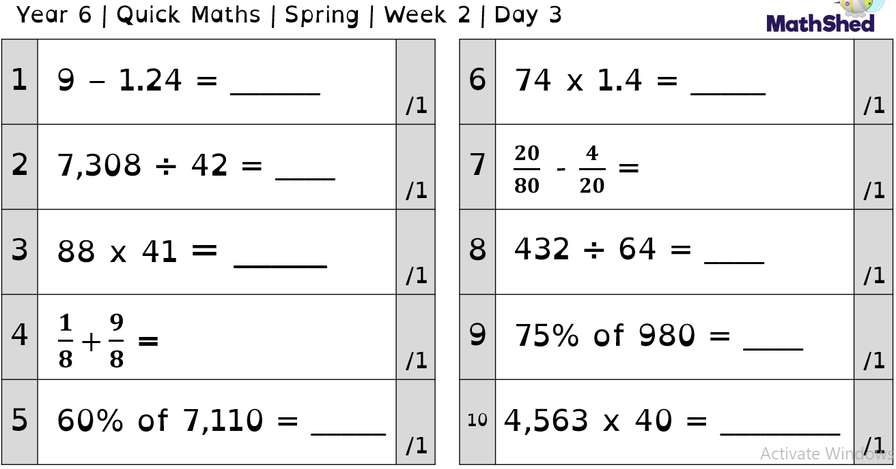

Slide 5
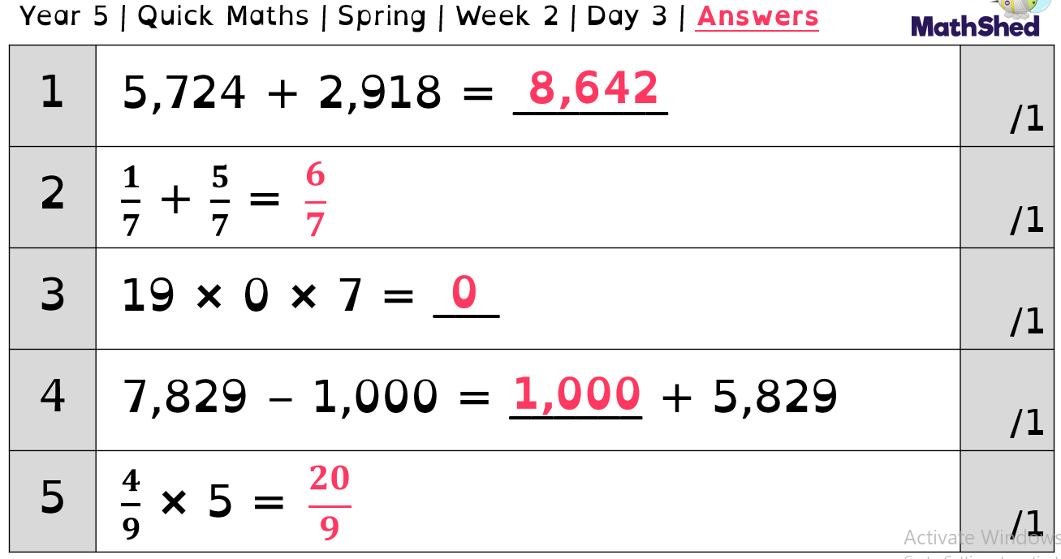
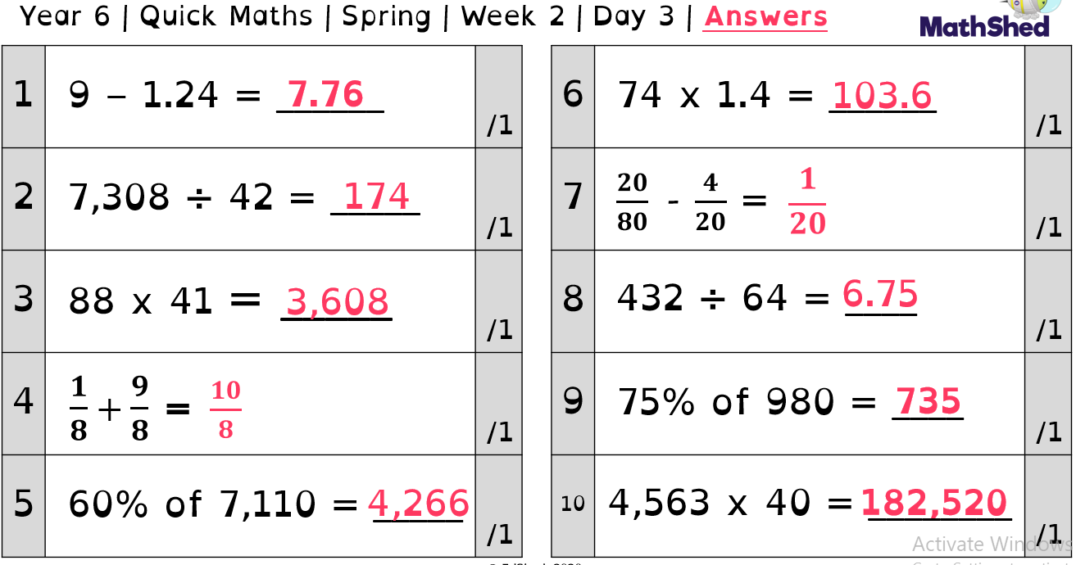

Slide 6
Maths -
Converting

Slide 7
Vocabulary
Converting – Change the form or character of something
Units – A quantity chosen as a standard e.g. a unit of measurement
Approximately - Almost, but not completely, accurate or exact

Slide 8
As well as metric units of measurement, we also use imperial measures with their own approximate conversions including:

Slide 9
To convert accurately, we need to decide how one number has changed (deciding whether we have multiplied or divided to scale the number) and do the same to the other side.
___ gallons
24 pints
How has pints been scaled up? (What has it been multiplied by?) How can we use this to work out gallons? (Multiply it by the same value)

Slide 10
___ feet
24 inches
6 feet
___ inches

Slide 11
Practice:
Convert the following:
2 inches = ?cm
7.5cm = ? inches
10 inches = ?cm
What would half an inch be in cm?

Slide 12
Practice 2:
Convert the following:
2 stone = ?lbs
140lbs = ? stone
5 stone = ?lbs
How can you use the second question to solve the third question?

Slide 13
Practice 3:
Convert the following:
3 gallons = ? pints
40 pints = ? gallons
100 gallons = ? pints
What is half a gallon in pints?

Slide 14
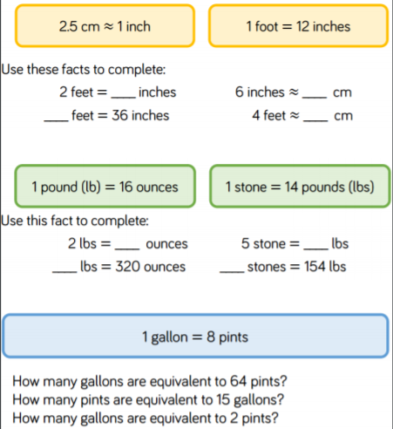
Independent activity.
Have a go at these questions:

Slide 15
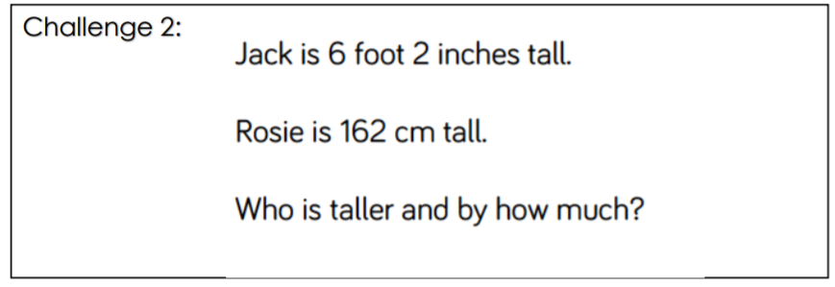
You may want to have a go at the following challenges:

Slide 16
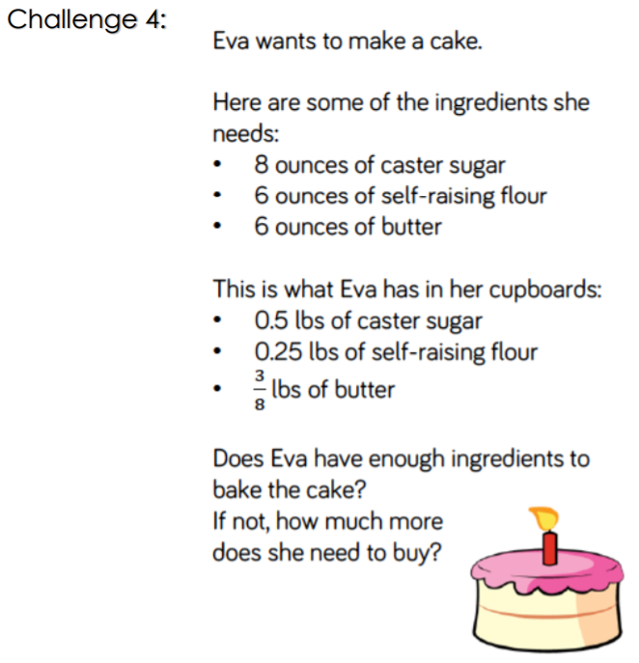
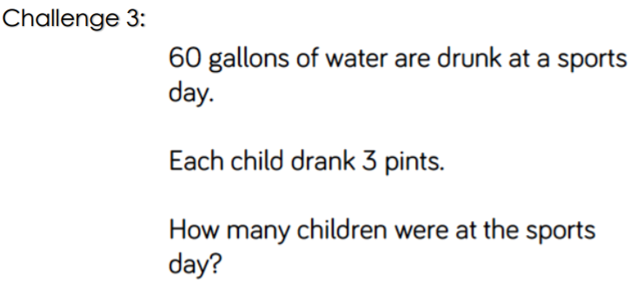

Slide 17
English
- Drafting an introduction

Slide 18
Next, we are going to start writing our non-chronological report about a big cat you might spot whilst on safari.
Each day this week we will write a paragraph of information and then edit it to ensure it contains the GPS skills needed, uses good quality vocabulary and is interesting for the reader.
The following video will walk you through writing an effective introduction. Keep pausing it whilst you write your own sentences.
https://classroom.thenational.academy/lessons/to-write-the-opening-paragraph-of-a-non-chronological-report-6grp2e?activity=video&step=1
Now, we are going to edit this paragraph... Look at the next slide.

Slide 19
Think carefully about the GPS techniques you should be using in your work e.g.
Accurate punctuation
A range of conjunctions
Fronted adverbials
Expanded noun phrases
Brackets
Relative clauses
Although we often edit and improve our work in class, the following video may help you.
https://classroom.thenational.academy/lessons/to-edit-a-non-chronological-report-c9j3ac?activity=video&step=1
Remember, you may not be able to get all of these in your introduction - you have the rest of your report to show your writing talents too!

Slide 20
Guided reading

Slide 21
Today we are going to continue our work on non-fiction texts.
Have a look at the text from yesterday again. Once you have re-read it have a go at the question sheets attached to the same file.
These focus on comprehension skills.
Can you label each type of question by highlighting it the correct colour? For example, if it is a green question(fact retrieval) highlight the question green.
What sort of question is the most common in non-fiction texts?

Slide 22
Spelling

Slide 23
Homophones part 2
Today we are going to specifically be looking at a group of homophones.
With each homophone I would like you to write the word and draw a picture/write a sentence to show the meaning.

Slide 24
Our focus homophones are:
desert
dessert
stationary
stationery
prophet
profit
complement
compliment

Slide 25
Science

Slide 27
Aim
I can demonstrate understanding of the scientific meaning of adaptation.
Success Criteria
I can understand that adaptations are mutations.
I can identify adaptive traits.

Slide 28
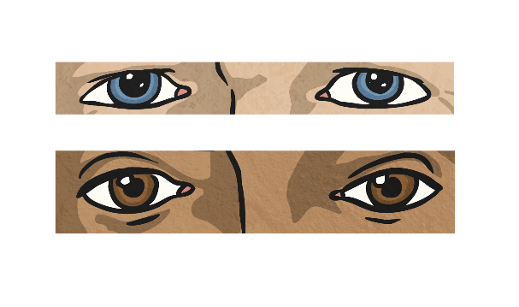
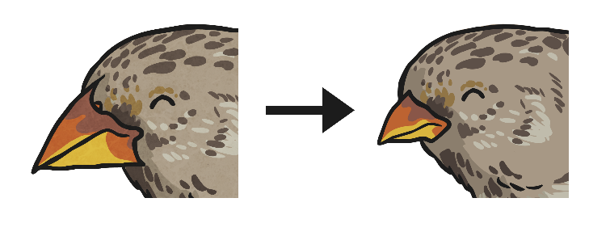
Variation
What does variation mean?
What causes variation?
Inheritance
Adaptation
These are characteristics that offspring inherit from their parents.
These are characteristics that are influenced by the environment the living thing lives in.

Slide 29
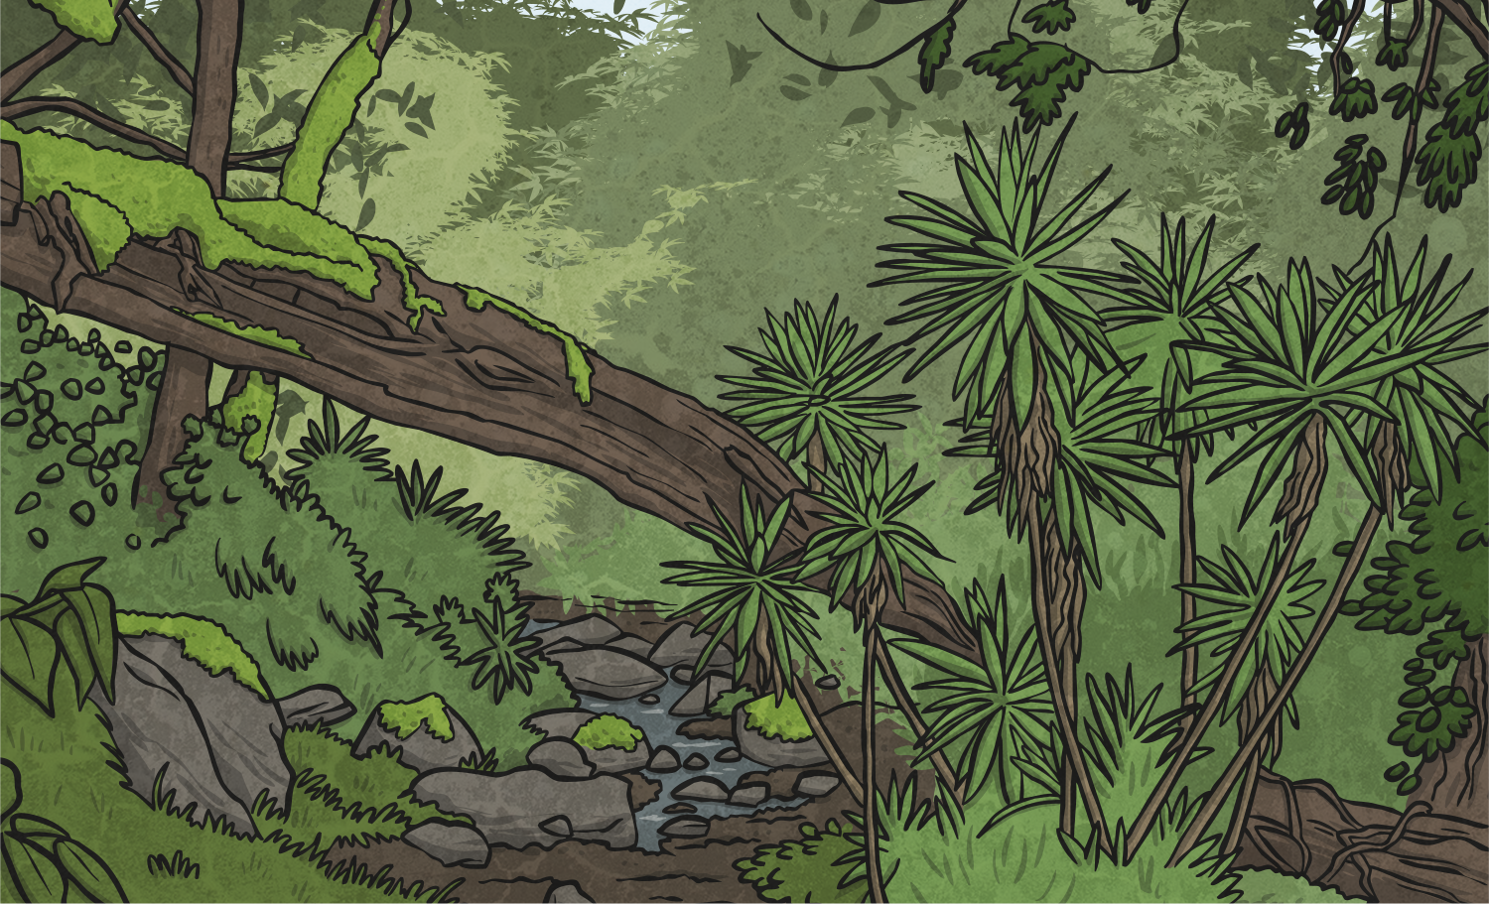
Environment and Habitats
What is an environment?
What is a habitat?

Slide 30
Environment and Habitats
Sometimes the words ‘environment’ and ‘habitat’ are used as though they have the same meaning. However, there are important differences:
A habitat refers to a specific area or place in which animals and plants can live.
An environment contains many habitats and includes areas where there are both living and non-living things.
So a bird may live in the woods, its habitat, but its environment could include a stream and a mountain, which are habitats in their own right.
What different types of habitats are there?

Slide 31
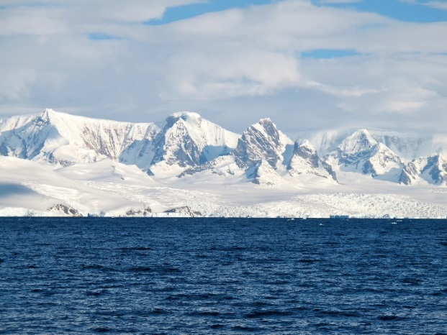
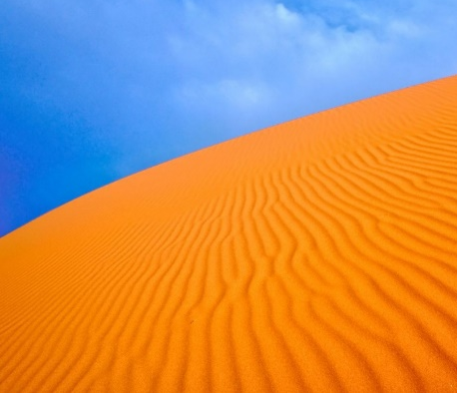
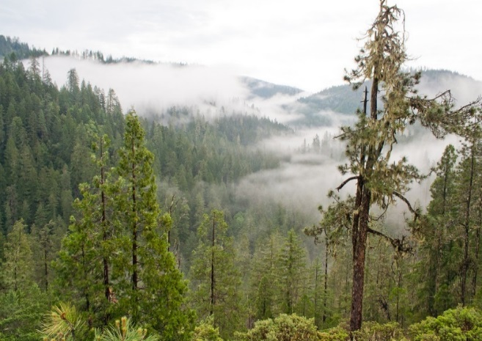
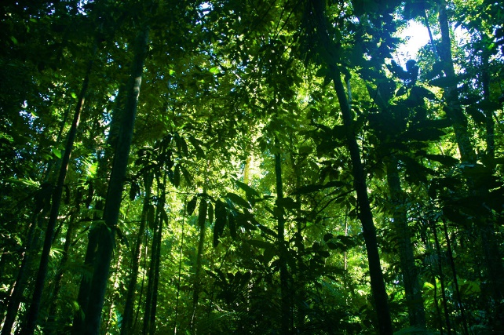
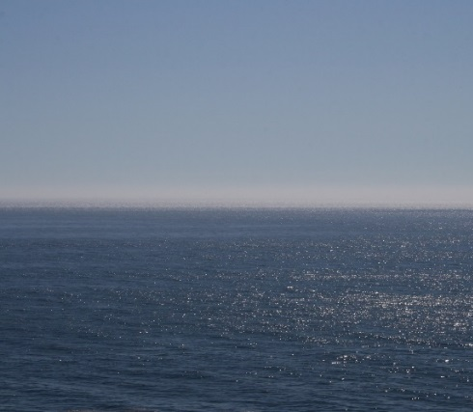
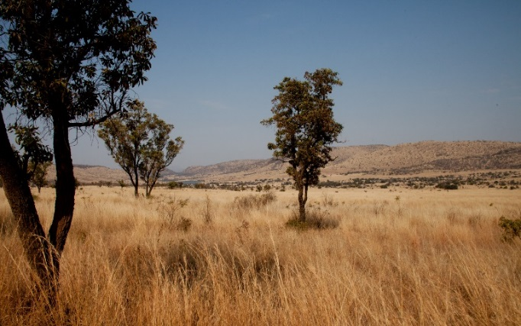
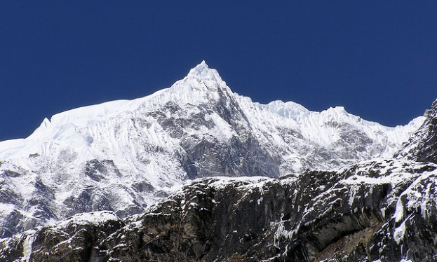
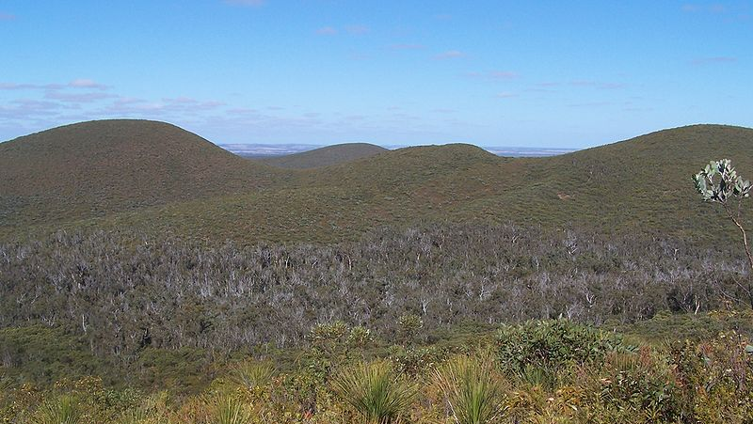
Polar regions
Deserts
Coniferous forests
Tropical rainforests
Oceans
Grasslands
Mountains
Remember: an environment is more than one habitat.
Heath
Photo courtesy of UnofficialSquaw.com, Moyan Brenn, Al_HikesAZ, tauntingpanda, Stephan Edgar, davidpitts and doug88888 (@flickr.com) Gnangarra (commons.wikimedia.org)- granted under creative commons licence – attribution

Slide 32
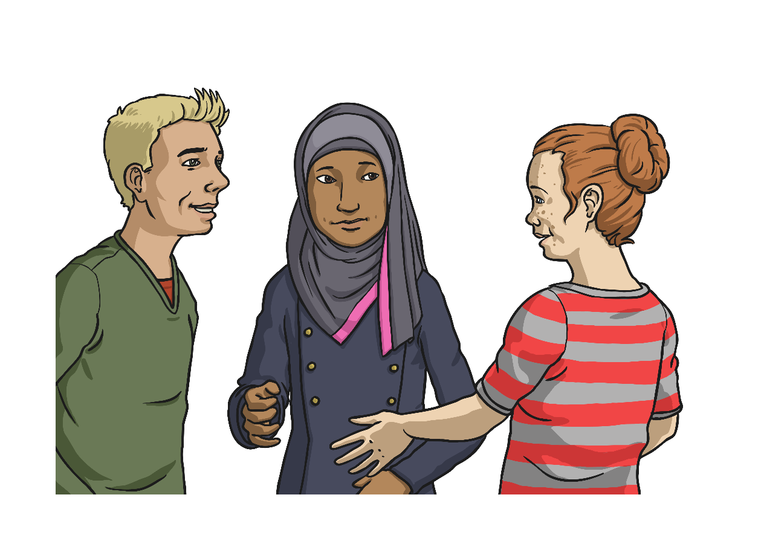
What Does Adapted Mean?
‘Adapted’ means to adjust to new conditions – like a new home or school.
‘Adapted’ is when you turn a book into a TV programme or a film!!
‘Adapted’ means making something suitable for a new purpose - like cutting off the legs of jeans to make them into shorts.
What do you think? Discuss with someone.
Correct Answer: All three of them! But none of these is the scientific meaning.

Slide 33
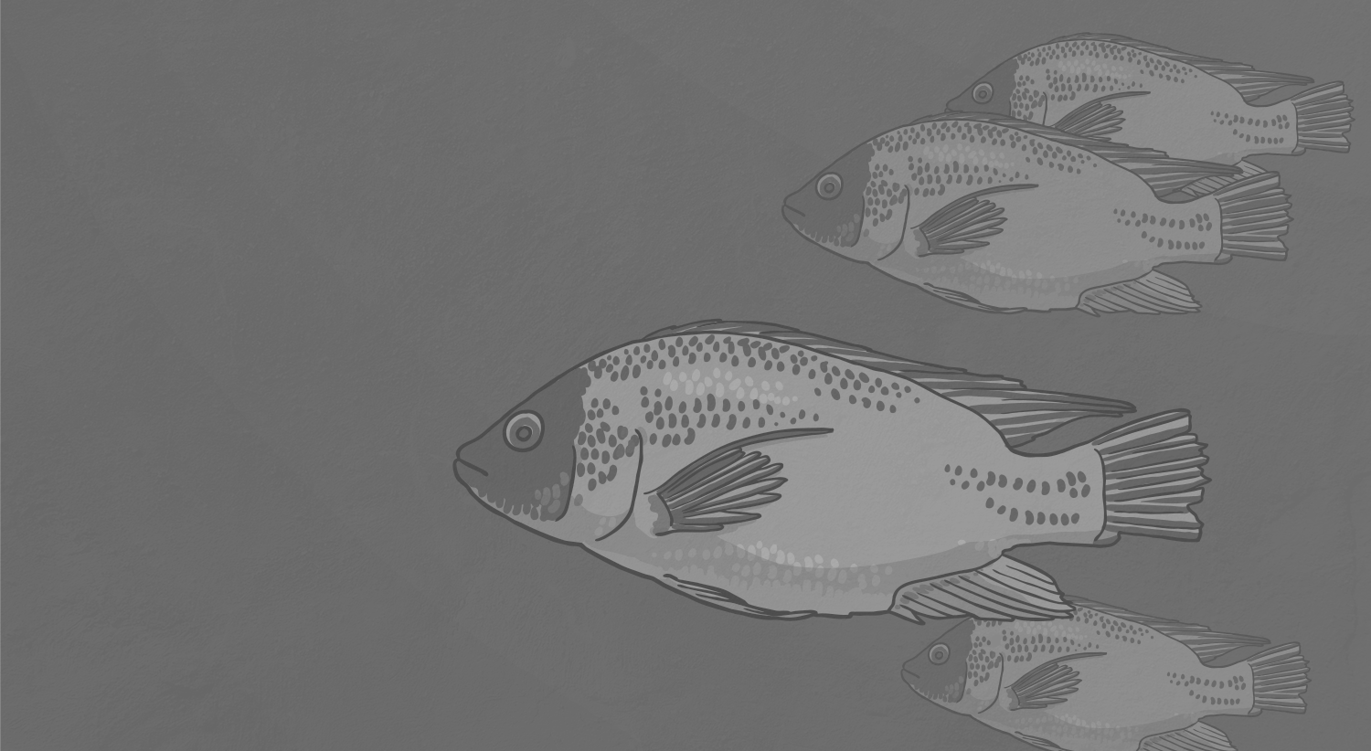
Adaptation Scientific Definition
When you see a fish swimming in its habitat, it is noticeable that it is suited to it.
Can you think of two ways that fish are suited to living in the water?
Examples: It has gills to breathe in oxygen in the water.
It has fins that allow it to move through water easily.
It has a special bladder called a swim bladder which allows it to remain buoyant.

Slide 34
Adaptation Scientific Definition
So it’s easy to think that the fish has adapted (changed) – to suit its habitat or environment. But this is incorrect! No living thing changes deliberately to adapt to an environment.
Think about it - if you wanted to change and live in the sea would you be able to choose to grow fins? If you were in the water long enough would you start to develop gills? The answer for both is no!
Even though it may seem hard to believe, this fish has
developed all of these features accidently, not intentionally or deliberately.

Slide 35
Adaptation Scientific Definition
The adaptations, each of which have occurred over time (which is called evolution) make it easier for the fish to live in water and survive.
We only see the fish as it is now and not the other fish who started off similar to it but whose adaptations made it harder, rather than easier, to live in the water. These fish have become extinct as a result.
The successful adaptations allowed the fish to survive in the water better. Hence the fact that this fish is still alive now.
Adaptation is not a part of a living thing, it is a process. The parts, such as gills, are called the ‘adaptive traits’.

Slide 36
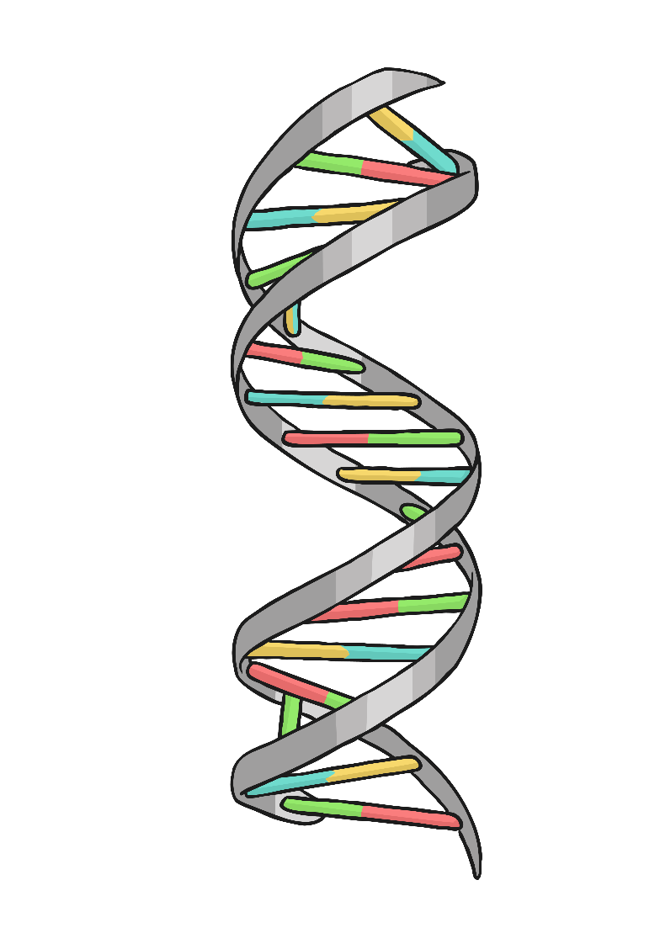
Accidental Adaptations
So how do these random, accidental adaptations occur? The usual cause is random mutations.
We need to go back to our DNA.
Each cell has a copy of the DNA. Random mutations occur when the cell becomes damaged and fails to repair itself completely. Sometimes this failure affects the DNA in the cell.
In this situation, the DNA stays slightly different. When the cell with the mutated DNA replicates, it will do so with the mutation.

Slide 37
Accidental Adaptations
Mutations are not in themselves good or bad. Some mutations have no effect at all! However, other mutations can cause us to lose or gain functions.
One example of this is the ability of humans to drink milk after infanthood.
All other mammals stop drinking milk after they are weaned. As they develop they become lactose intolerant (the body stops being able to digest milk).
A mutation in humans has allowed us to carry on drinking milk even after we are weaned as babies. Further mutation means we can drink the milk of other mammals – such as cows, sheep and goats. Again no other mammal does this!

Slide 38
Adaptive Traits
Adaptive traits enable a living thing to survive better in its habitat or environment. As it lives longer, it means that it has a greater chance of reproducing and so the adaptive trait gets passed on.
Your task is to identify adaptive traits in living things.

Slide 39
Complete the table by matching the living thing with its habitat and adaptive trait/s.
Choose the hot, hotter or spicy task from the following pages.
Can you add any of your own adaptive traits?
C: Add your own living thing, its habitat and any adaptive traits to the table.

Slide 40
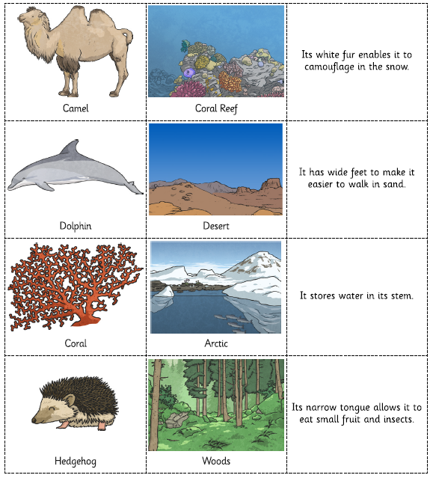
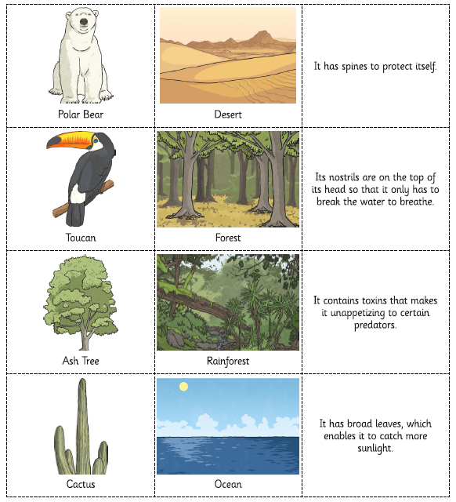
Hot

Slide 41
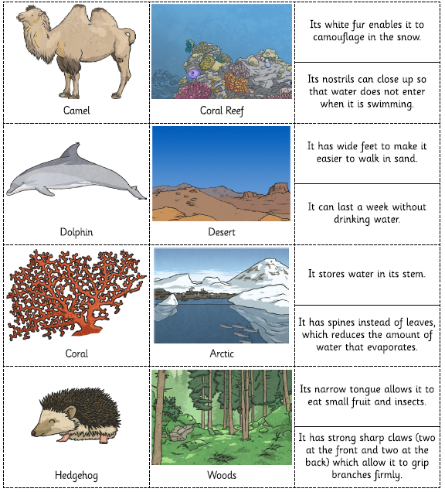
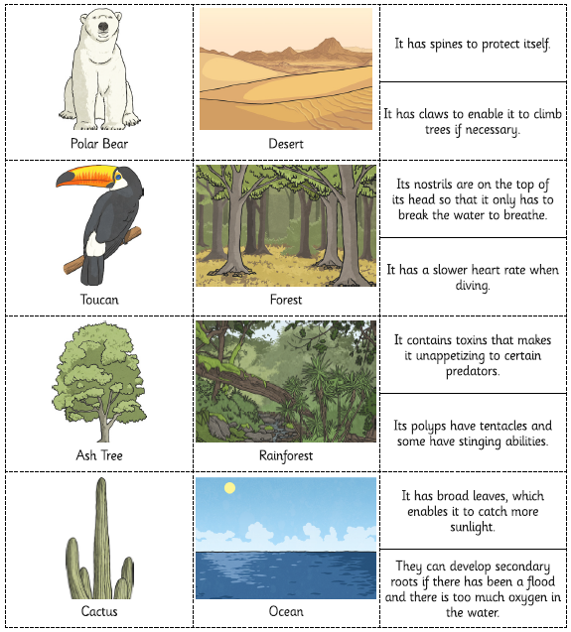
Hotter

Slide 42
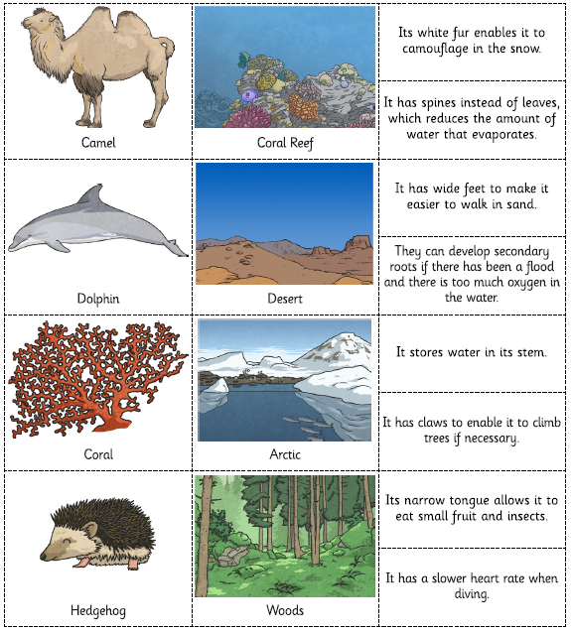
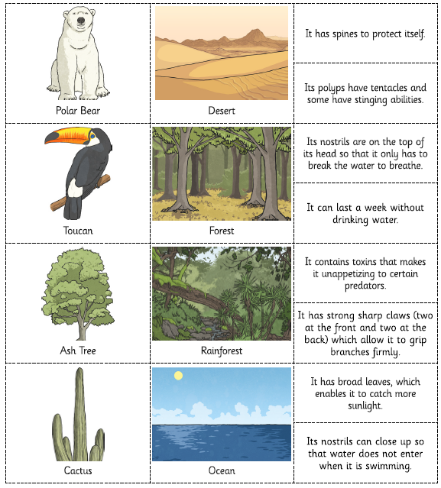
Spicy

Slide 43
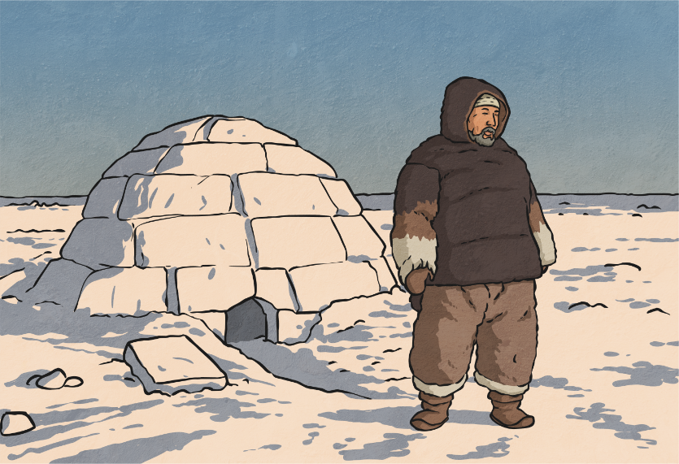
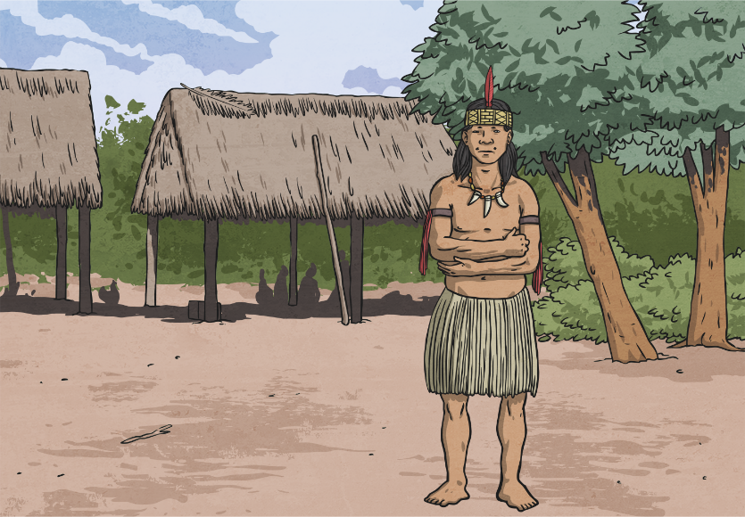
Humans
What habitats do humans live in?
Are there any habitats they are not able to live in?
Can you identify adaptive traits that humans have which enable them to live in such a range of different habitats and environments?

Slide 44
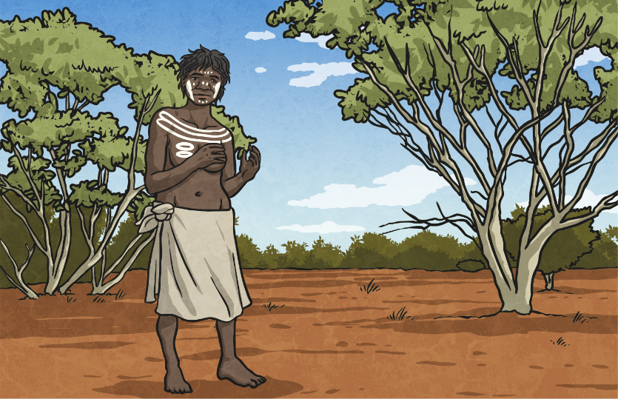
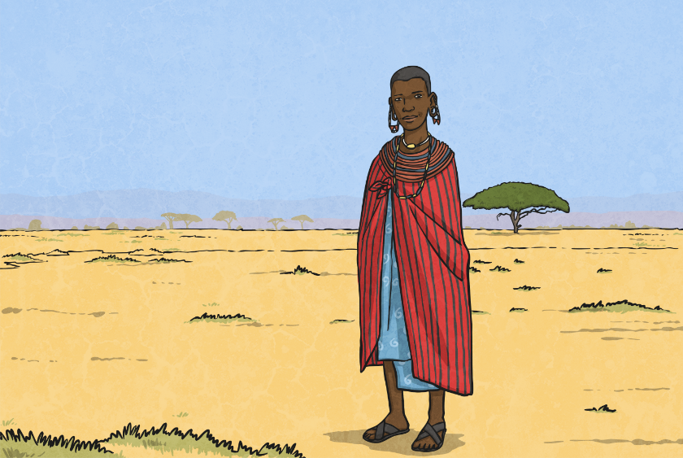
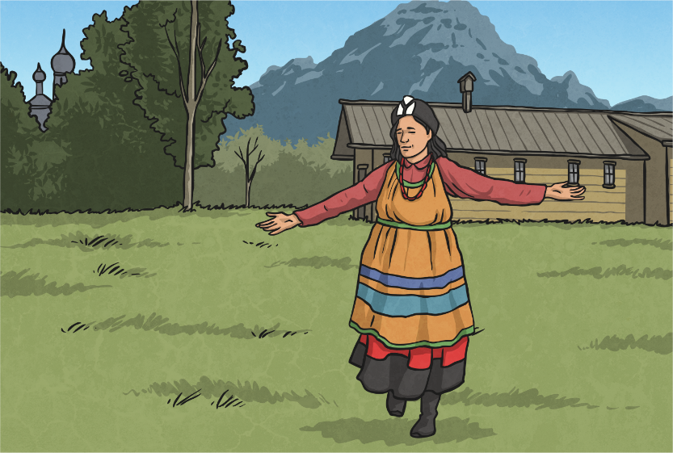
What habitats do humans live in?
Are there any habitats they are not able to live in?
Can you identify adaptive traits that humans have which enable them to live in such a range of different habitats and environments?

