Slide 1
Good morning year 6 I hope you are well. Remember I am here to help if you have any questions about the work I have set. I hope you are all well and feeling safe. Thank you to everyone who has sent me there work so far. I am looking forward to seeing what you do today.
Tuesday 12th January 2021

Slide 2
Good morning!
Have a go at the following task:
Try to make the longest word you can using these letters:
Try to make the most words you can:
Have you considered the spelling rules and patterns we have discussed and practiced this year?
E R T A O S L M I B

Slide 3
Arithmetic

Slide 4
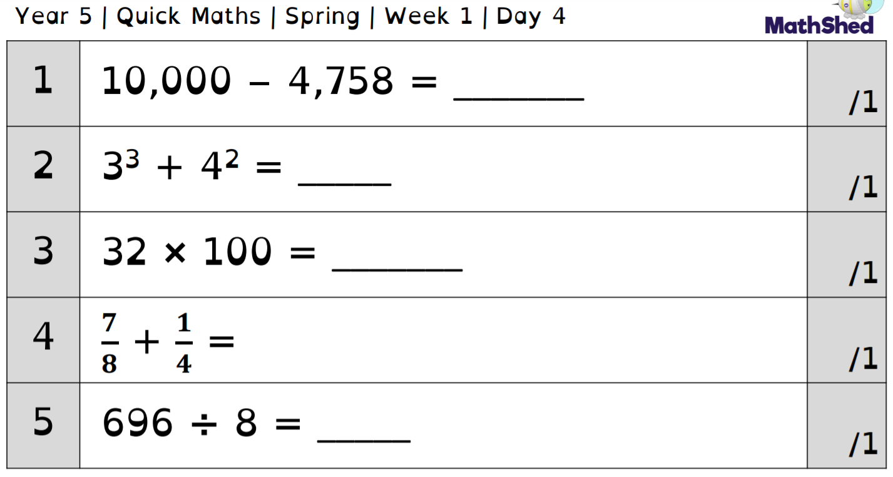
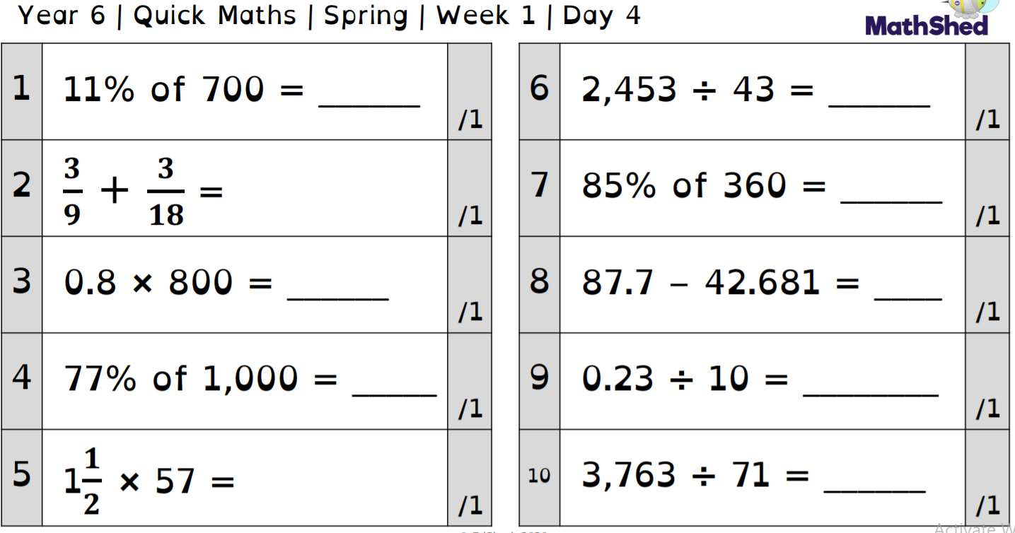

Slide 5
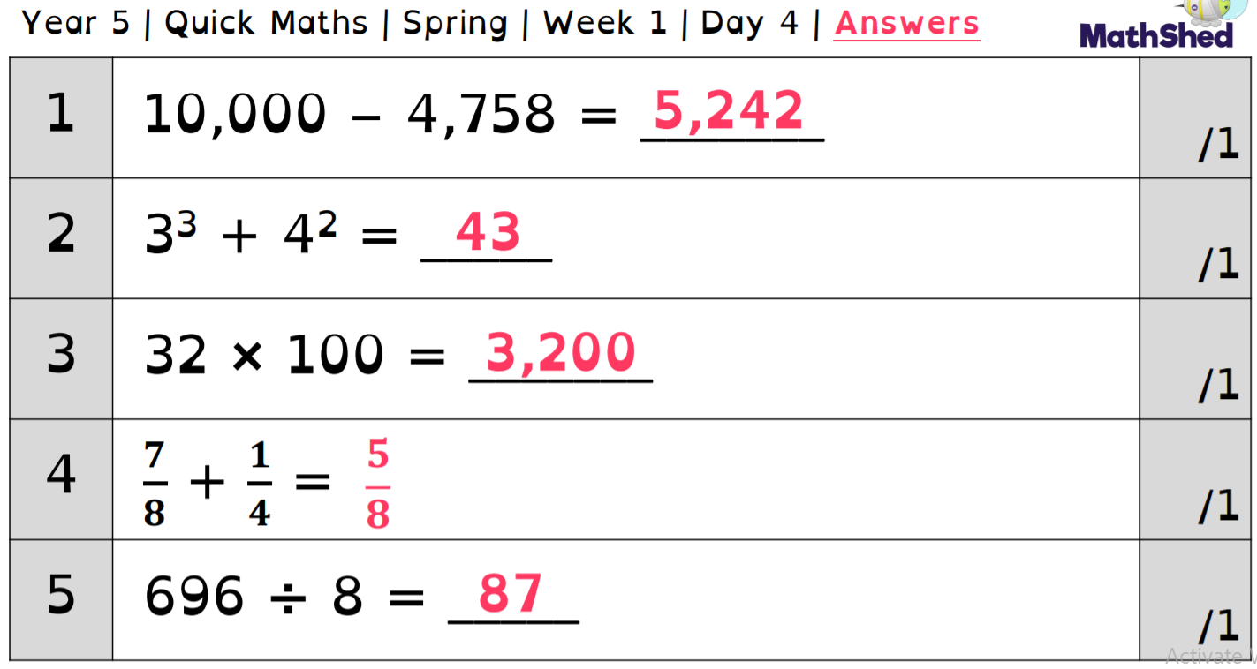
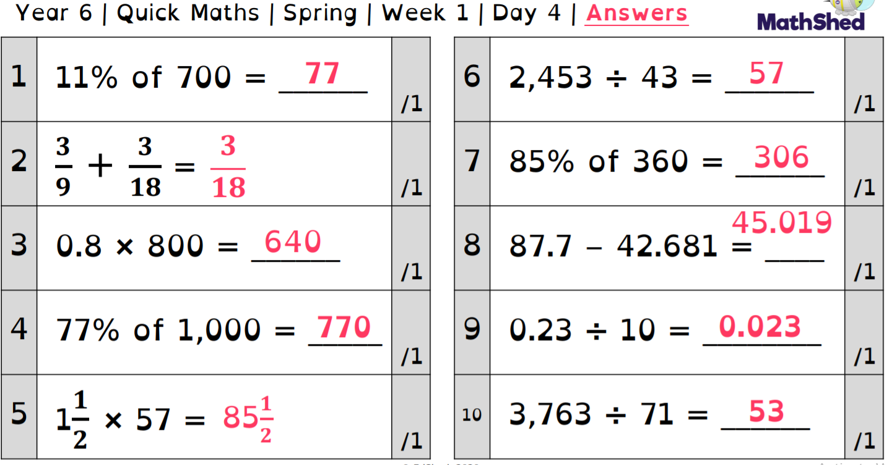

Slide 6
Maths -
Metric measures

Slide 7
Maths LI: I can convert metric measures
Today we are going to continue our work on converting measures.

Slide 8
Vocabulary
Converting – Change the form or character of something
Units – A quantity chosen as a standard e.g. a unit of measurement
Measurement – The size, length or amount of something
Mass - Weight

Slide 9
Key Facts Recap
How many metres are there in one kilometre?
1 km = ? m
How many grams are there in one kilogram?
1kg = ? g
What does kilo mean?

Slide 10
Kilo means a thousand so kilogram means a thousand grams and kilometre means a thousand metres.

Slide 11
Key Facts Recap
How many millilitres are there in one litre?
1 l = ? ml

Slide 12
1kg = 1000g
1000g = 1kg
1km = 1000m
1000m = 1kg
1l = 1000ml
1000ml = 1l

Slide 13
÷ 1000
1000ml
1000g
1000m
1l
1kg
1km
x 1000

Slide 14
Convert the following into metres:
3km
7km
10km
13km
5.5km
Remember 1km = 1000m

Slide 15
Convert the following into litres:
4000ml
8000ml
12000ml
17000ml
6500ml
Remember 1000ml = 1l

Slide 16
Practice:
Convert the following measurements into grams
2kg
9kg
3.5kg
6.75kg
What mistake are people likely to make on the final question?
1000g = 1kg

Slide 17
Practice 2:
Convert the following measurements into kilometres
4000m
7600m
2345m
500m
What’s the same and what’s different between 1.5km and 1.500km?
1000m = 1km

Slide 18
Practice 3:
Convert the following measurements into millilitres
5l
8l
8.25l
1.23l
Why are the units of measurement at the end important?
1l = 1000ml

Slide 19
Super spicy
Convert the following measurements
?kg to 3240g
98001g to kg
6380ml to l
0.324l to ml
Sarah has converted her drink into ml from litres as she thinks it will be easier to share between her and 4 friends. She had 1.5litres to start with. How much does each friend get?
Hot
Convert the following measurements
2kg to g
4000g to kg
3000ml to l
7l to ml
Hotter
Convert the following measurements
2.54kg to g
7450g to kg
5330ml to l
7.23l to ml
343.?ml to ?.???2l
If you have finished these have a go at one of the challenges available.

Slide 20
If you need some more support follow the link below.
https://classroom.thenational.academy/lessons/converting-between-units-of-metric-mass-6ww38d

Slide 21
English
- Relative clauses

Slide 22
Today we are going to practice using relative clauses.
Watch the following video to remind you what they are, how they are used and the punctuation involved. You will have the opportunity to write some of your own during this video.
https://classroom.thenational.academy/lessons/to-develop-knowledge-of-relative-clauses-6mu6ae?step=1&activity=video
Next, write some sentences/a paragraph about your favourite animal (preferably a big cat), including as many relative clauses as possible!
For example: Tigers, which are the largest of the big cats, live in many places around the world such as India. Think carefully about what other GPS techniques should you be using in your work.

Slide 23
Guided reading

Slide 24
We are going to continue with the text from yesterday, specifically looking at comprehension questions.
We will be looking at green questions and yellow questions today.
Can you remember what a green question focuses on? What can we do to help us find the answers?
Can you remember what a yellow questions focuses on? What will need to include to help us answer these questions?

Slide 25
Remember green questions focus on fact retrieval, this means we can scan through the text and find the information easily.
We may need to find key words in the text from the question to help us.
Yellow questions focus on inference, we will need to interpret the information we have to guide our answer. With yellow questions its always a good idea to find some evidence to support your answer.

Slide 26
Here is a reminder of the story. Re-read it before answering the questions.

Slide 29
Comprehension questions (green).
What sort of berries does the character want to pick?
What month is the story set?
What city is the story set in?
How old is the main character?
How did the character move to get to the bush?
‘The character cut their elbow.’ is this statement true?

Slide 30
Comprehension questions (yellow).
Why do you think the lady eyes the main character in the way she did?
How do you know the character wants to eat the berries?
What impression do you get of London? Use evidence from the text to support your answer.

Slide 31
Spelling

Slide 32
-cian spelling
Can you think of any words that end in -cian?
Give the rules you think apply to this ending.

Slide 33
-cian spelling
Where words end in c ( music - musician)
Common in occupations (Technician)

Slide 34
We generally find that words ending in –cian are associated with someone's occupation. How many can you think of are there any words that end in the suffix –cian that don’t follow that rule?

Slide 35
Science

Slide 37
Aim
I can explain the scientific concept of inheritance.
Success Criteria
I can identify inherited characteristic that are passed on from parent to offspring.
I can explain how inherited characteristics can lead to variation.

Slide 38
This half term we are going to be learning about evolution and inheritance.
Evolution is a theory created made famous by a scientist called Charles Darwin.
In a spider diagram look write down what you already know about evolution and inheritance.

Slide 39
Key Vocabulary
Write one or two concise sentences to explain the meaning of the words. In the box to the side.
Use a dictionary to help you with this.
Evolution…
Parent…
Fossil….
Variation….
Offspring…..
Inheritance…..
Environment….

Slide 40
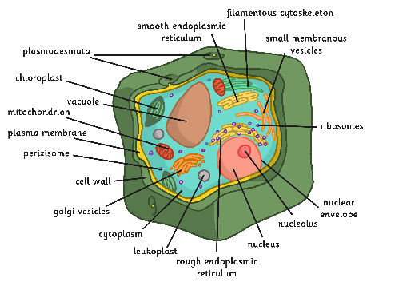
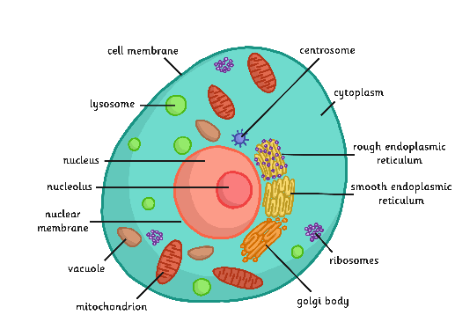
Cells, Chromosomes, DNA and Genes
While you will not be examining these in detail, it is helpful to know about the building blocks of life for this unit.
Cells are the building blocks of all living things. All living things are made up of cells. Amoebas have one cell. Humans have trillions of cells!
Cells

Slide 41
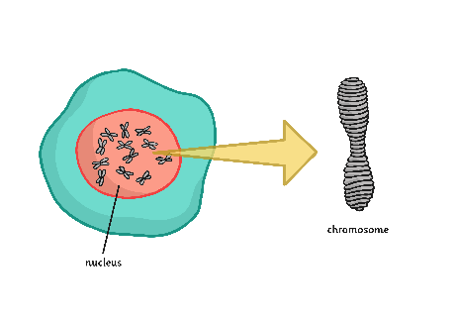
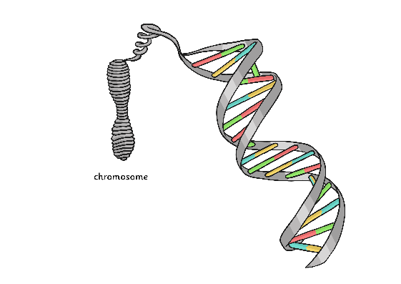
The nucleus of a cell contains chromosomes, which are made up of DNA.
Chromosomes
DNA carries the characteristics that we inherit. It is located in two places in the cell: the nucleus and the mitochondria. DNA can replicate and make copies of itself. When cells divide, each cell needs to have an exact copy of the DNA in the old cell.
DNA
Genes are short sections of DNA that contain specific information. This is often called the genetic code. All the genes in the whole cell are called the genome.
Genes

Slide 42
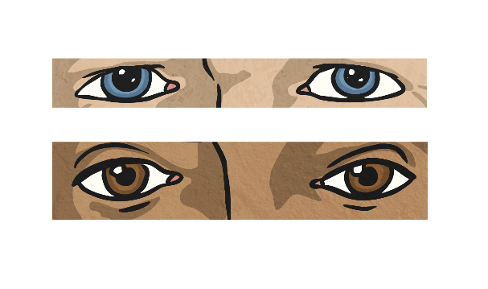
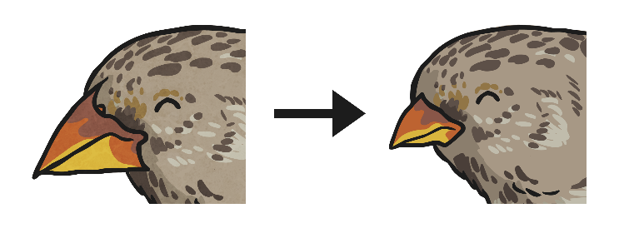
Variation
What does variation mean?
What causes variation?
Inheritance
Adaptation
Over many generations, a species will adapt to its environment because the animals with the most successful characteristics are more likely to survive and pass on these characteristics to their offspring.
These are characteristics that are passed on to offspring from their parents.

Slide 43
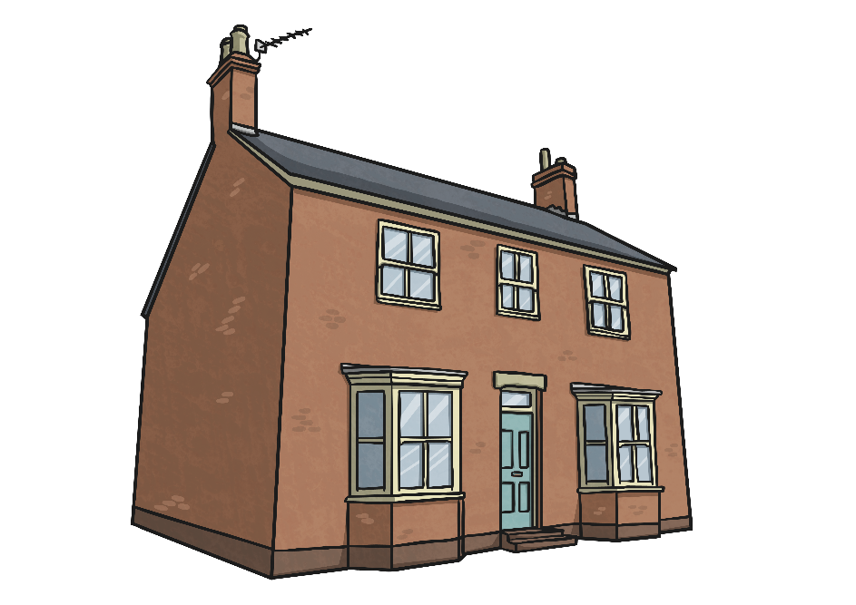
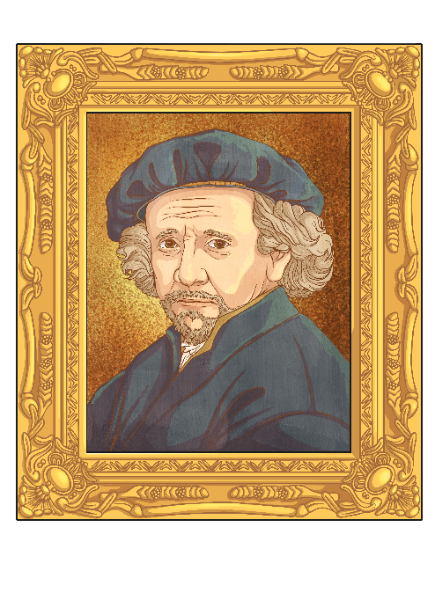
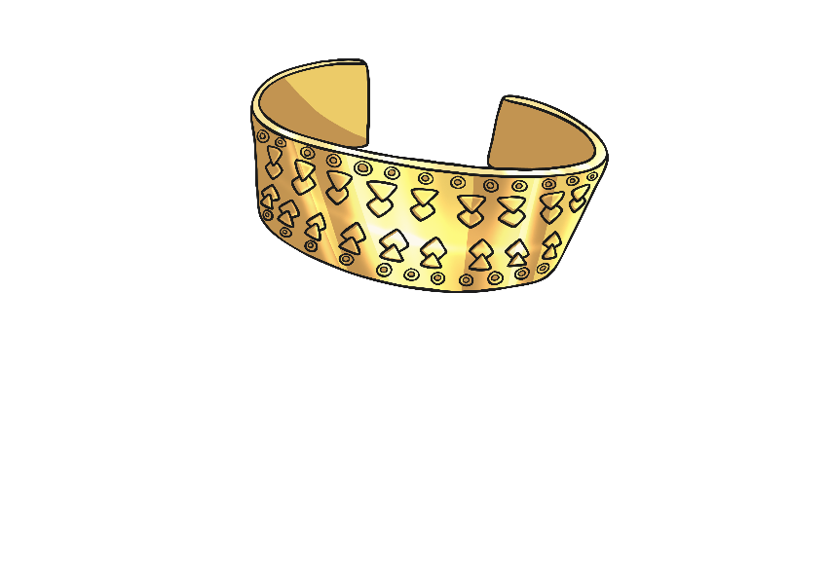
Inheritance
When we talk about inheritance, we often mean things that are passed on to us when one of our relatives or friends has died. Inherited items are sometimes houses or important objects.

Slide 44
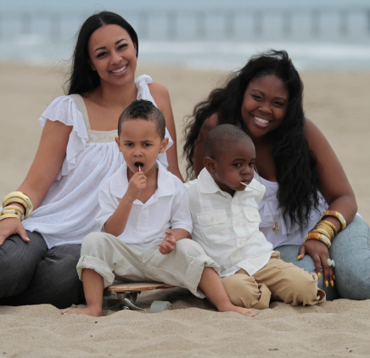
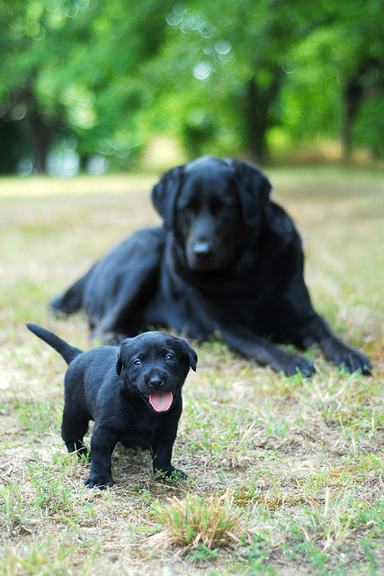
Inheritance
In science, inheritance refers to the genes that are passed on from parents to offspring. When we refer to inherited characteristics we tend to focus on physical characteristics as these are easy to spot but inherited characteristics include abilities such as taste and smell.
Photo courtesy of Parker Knight, blogdnd and jolly_janner (@flickr.com) - granted under creative commons licence – attribution

Slide 45
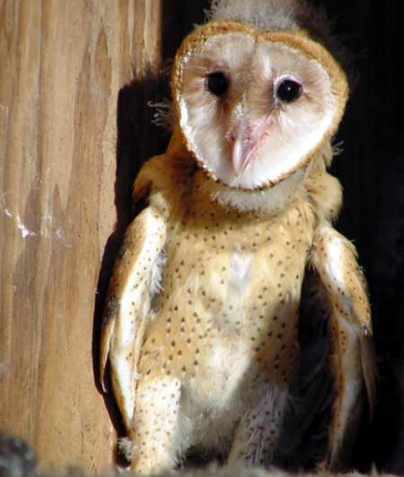
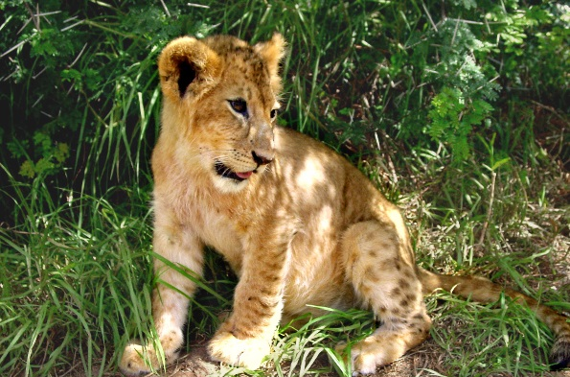
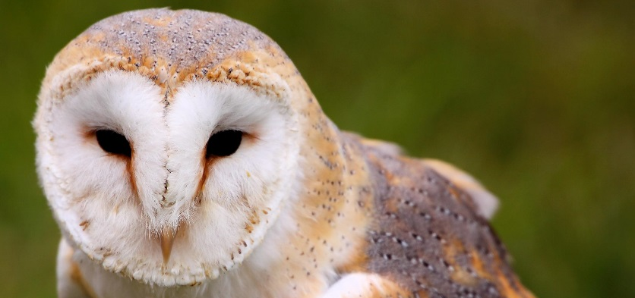
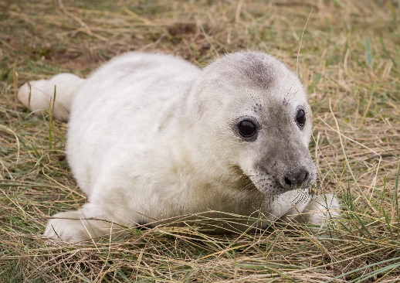
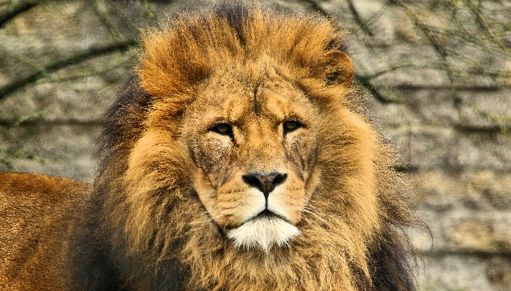
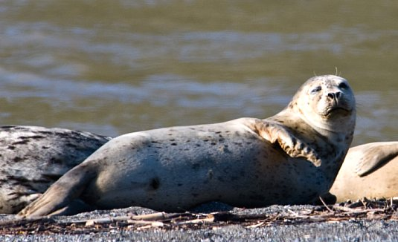
Parents and Offspring
Match the parent with its offspring.
How did you match the parents and offspring?
What are the inherited characteristics that you could see?
Photo courtesy of Courtney McCutchen, Steve Skater, Airwolfhound, Dan (catching up) and Tony Fischer (@flickr.com) - granted under creative commons licence – attribution

Slide 46
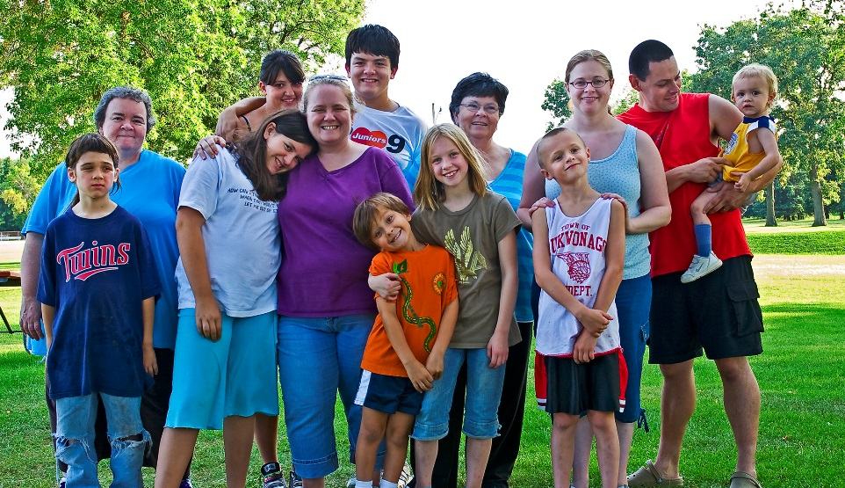
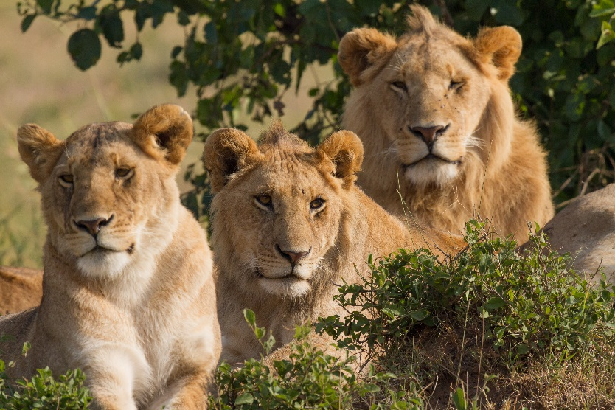
Parents and Offspring
MISCONCEPTION ALERT!
While offspring does mean child, it does not mean that you are only offspring when you are children! The inherited characteristics you gain from your parents are part of your DNA for life.
Even when you are an adult you are your parents’ child!
Photo courtesy of Randen Pederson and Benh LIEU SONG (@flickr.com) - granted under creative commons licence – attribution

Slide 47
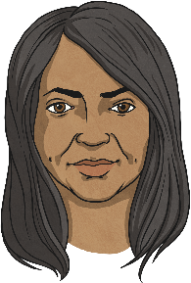
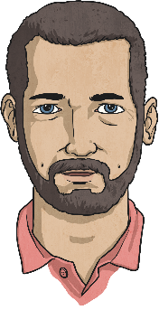
Inheritance and Variation
How can inherited characteristics (similarities between parent and offspring) result in variation (differences)?
Well the majority of living things are the result of sexual reproduction so they have two parents. You inherit the characteristics from both parents but the way they combine makes the offspring unique.
The inherited characteristics can combine in different ways, which is the reason why siblings inherit the same characteristics but are not identical to each other.
Even identical twins that share the exact same combination of DNA are not 100% the same! This is due to the fact that genes develop separately when the twins are embryos or during later development.

Slide 48
Inherited Characteristics
We often talk about inheriting characteristics from our parents. However, it is not always the case that these are passed on through DNA. Some are learnt as we grow up.
In the spaces below think of some characteristics that have been inherited and some that have been acquired(learnt). For example your eye colour is an inherited characteristic but being able to play the piano is acquired.
Inherited Characteristics
Acquired Characteristics

Slide 49
Inheritance in context: crossbreed dogs

Slide 50
Match the two dog breeds and their crossbreed offspring
Cut and stick the parents and offspring together in your book.
Underneath each match, describe the characteristics the offspring has from each parent
for example a Dalmation has spots on its fur is there an offspring that has the same?

