Slide 1
Friday 22nd January 2021 Week 3

Slide 2
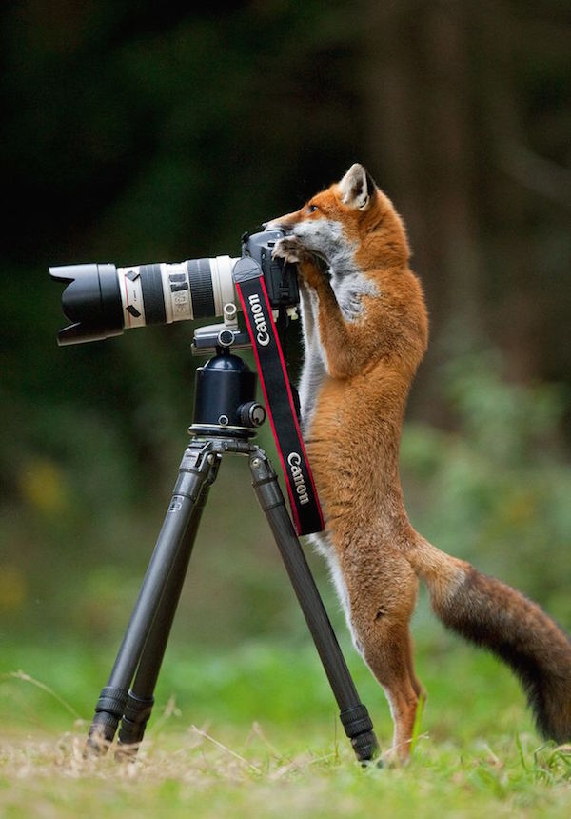
Good morning!
Have a go at the following task:
Write a caption or story based on the picture.

Slide 3
Mathletics

Slide 4
Today we are going to be working on Mathletics and edshed.
Complete the tasks set for you on converting measures and then play live to compete against your friends.
You could also spend some time on TT Rockstars. Is there anyone you want to challenge?

Slide 5
English
Drafting

Slide 6
Today we are going to finish drafting our non-chronological reports.
Which paragraphs do you have left to write?
As before, remember to edit and improve at the end of each paragraph.

Slide 7
Independent reading

Slide 8
Once you have finished reading independently I would like you to have a go at describing the main character, you may want to draw them as well. Think about the descriptions you have had in the book.
If you have been reading a non-fiction book have a go at drawing what you have read about.
Remember to annotate(label) the work with key information.

Slide 9
Spelling

Slide 10
Homophones part 5: End game
Today we are going to be testing our knowledge of the homophones we have been learning. fill the gaps in the sentences on the next slide with the correct homophone. Try to use your memory to spell them.

Slide 11
The _______ was full of unusual and deadly creatures.
The car sat ___________ at the end of the cliff, one false move and it would be the end.
I gave my teacher a _________, I had really enjoyed their lesson.
I love ice cream, it’s my favourite _________.
Moses is a _________ sent by God.
I made loads of _______ from selling my home-made cookies.
I bought myself a new __________ set from the shop, it has unicorns on it.
Bacon and eggs taste great together, they really __________ each other.

Slide 12
Topic/science
- Art

Slide 13
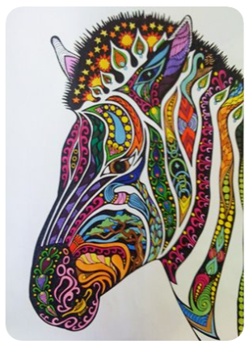
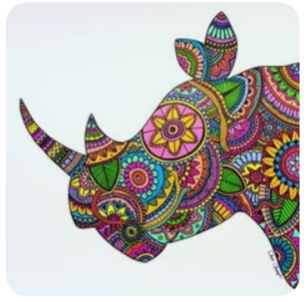
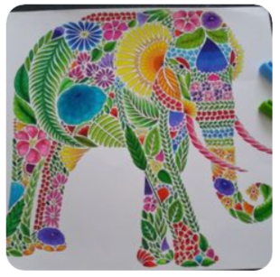
Zen animal art
Fill it with patterns and colours!
Draw the outline of your selected safari animal

Slide 14
If you are struggling to draw the animals outline why not find one from the internet to print out.
Think about the colours that you have chosen for you animal. Can you use colours that match the creatures environment?
For example if you chose a whale you could use different shades of blue to match the ocean where it lives.

