Slide 1
Good morning year 6 I hope you are well. Remember I am here to help if you have any questions about the work I have set.
Friday 15th January 2021

Slide 2
Good morning! To wake up your brain, have a go at the following task:
The security door to Mrs Jones’ office has a code of 5422.
The door can, in fact be opened by any combination of these numbers (e.g. 2425).
How many different combinations are there to open the door?

Slide 3
Mathletics/EdSHed

Slide 4
Today we are going to be working on Mathletics and edshed.
Complete the tasks set for you and then go on play live to compete against your friends. Maybe you could face time your friends so you can talk to them at the same time.
You could also spend some time on TT Rockstars. Is there anyone you want to challenge?

Slide 5
English
Gathering information

Slide 6
Today we are going to research our chosen big cat. Remember our topic is African Safari, so consider which animals you could choose.
The video below has some ideas surrounding tigers - you could use this as a starting point and edit them for your own cat.
https://classroom.thenational.academy/lessons/to-learn-about-tigers-and-their-appearance-c5j3cc?activity=video&step=1
Use a range of sources to gather information. Record your information in note form, ready to write up next week.

Slide 7
Independent reading

Slide 8
Today you are going to carry on reading the book you chose the other day.
Once you have read for a bit of time I would like you to create a comic strip depicting what has happened in the story so far. If you have chosen a non-fiction piece can you create an information poster that shows what you have read.

Slide 9
Spelling

Slide 10
This week we have been learning about the sound shun and its suffixes that go with it.
-tion
-sion
-cian
On the next page is a sheet for you to complete. Fill it in with the correct spellings.

Slide 11
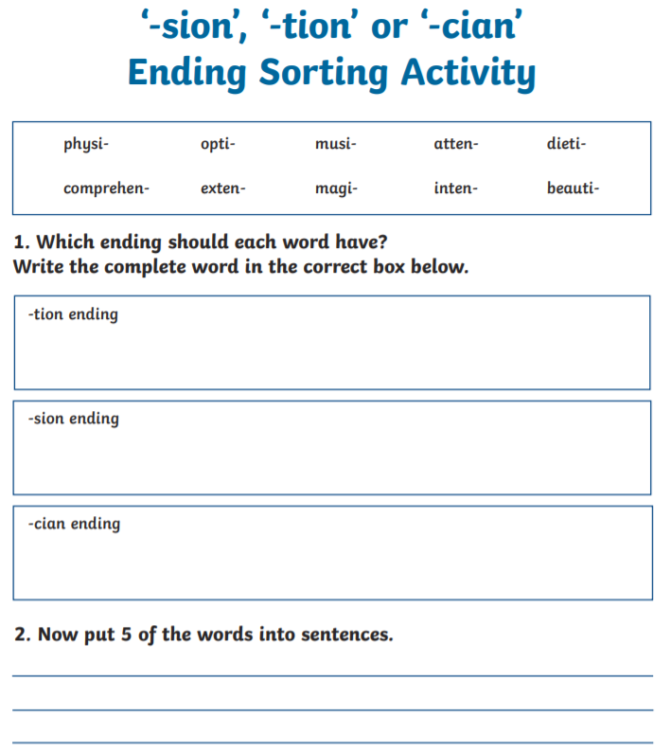

Slide 12
Topic
- Geography

Slide 13
This week in topic we are going to be looking at Shackleton’s journey and what he planned on doing.
First we need to know who Ernest Shackleton was.
He was an extraordinary man and one of the most famous explorers to ever live.

Slide 14
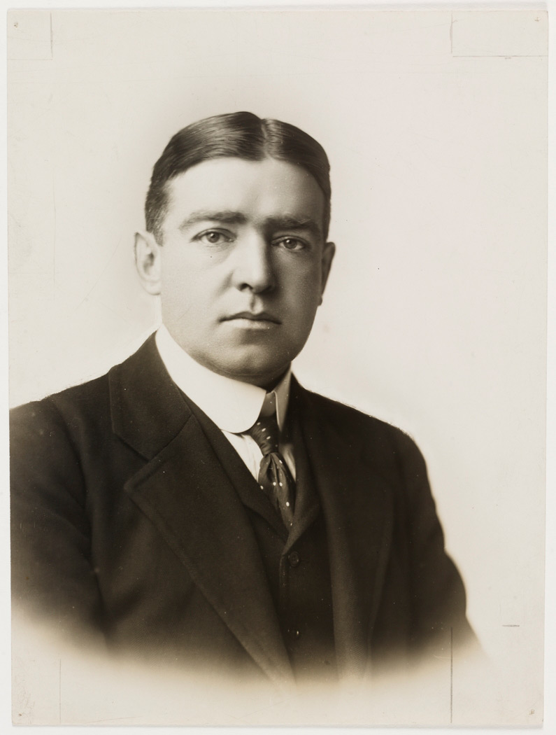
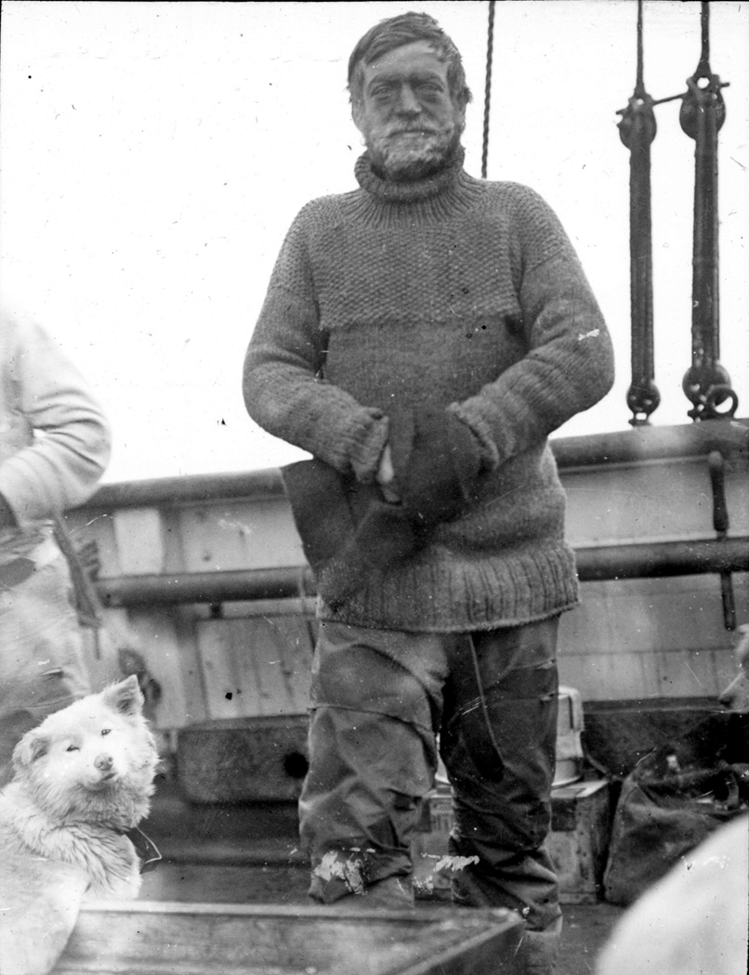
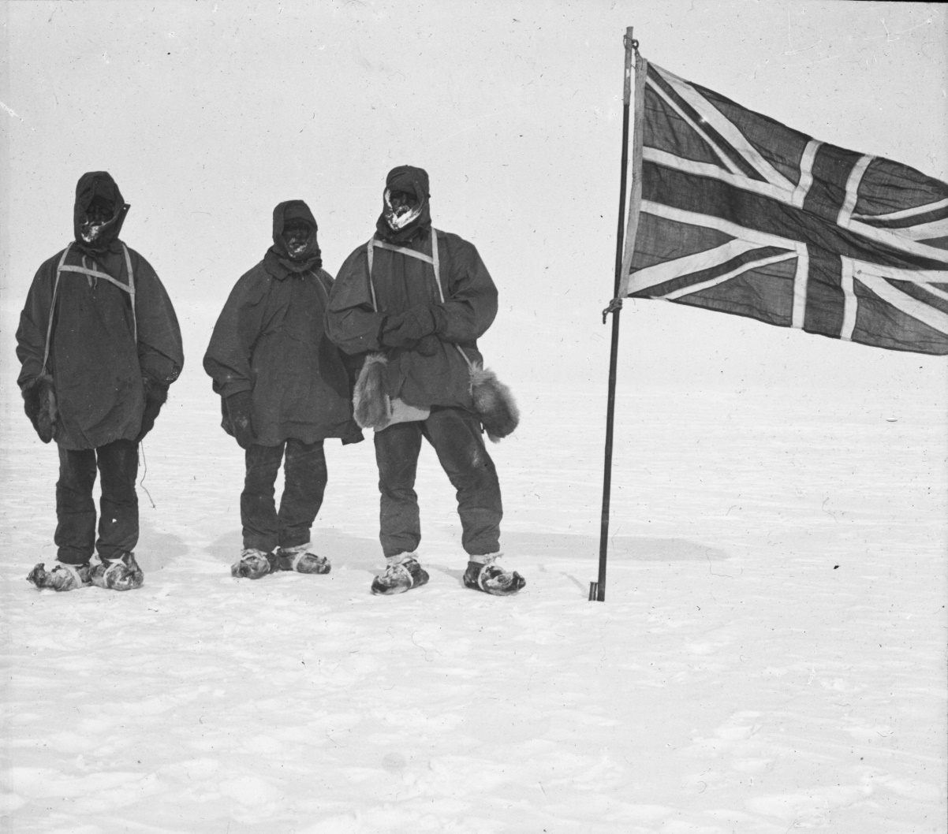
Ernest Shackleton was an Edwardian gentleman and Antarctic explorer from a hundred years ago

Slide 15
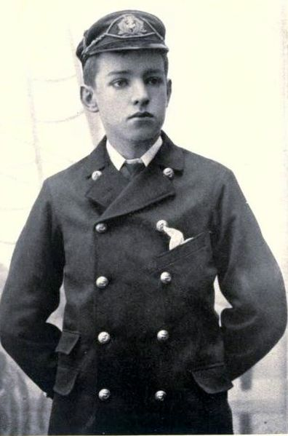
He was born in Ireland in 1874 to an English family, one of 10 children. His family moved to London in 1884. He wasn’t keen on school and went to sea at the age of 16.

Slide 16
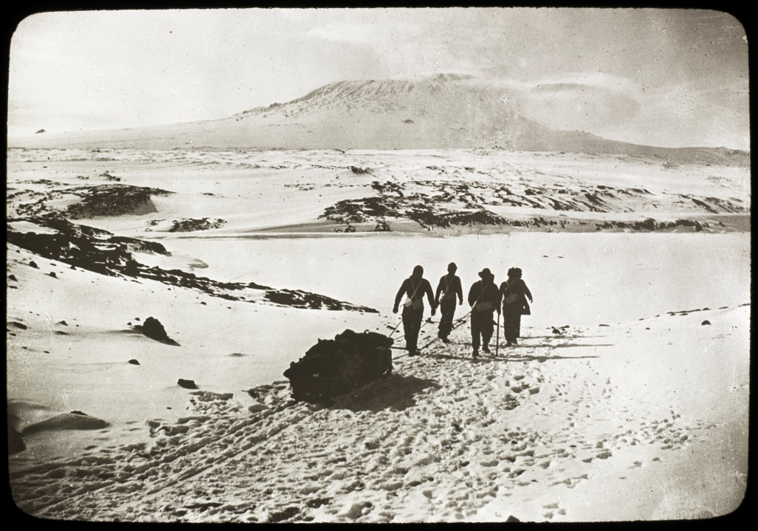
He became a certified master mariner able to command a ship. In 1901 he went to Antarctica for the first time with Captain Scott and came within 530 miles of the South Pole. In 1907 he led his own expedition and came within 97 miles of the South Pole.
Heading to Mount Erebus on the way to the South Pole

Slide 17
By 1914 he had been made Sir Ernest Shackleton. The South Pole had been reached by Roald Amundsen and Robert Scott in 1911/1912, so Shackleton organized a trans-Antarctic expedition to cross Antarctica from one side to the other via the South Pole.
An advert said to have been placed in a London newspaper by Shackleton for his Endurance expedition
Picture copyright Paul Ward

Slide 18
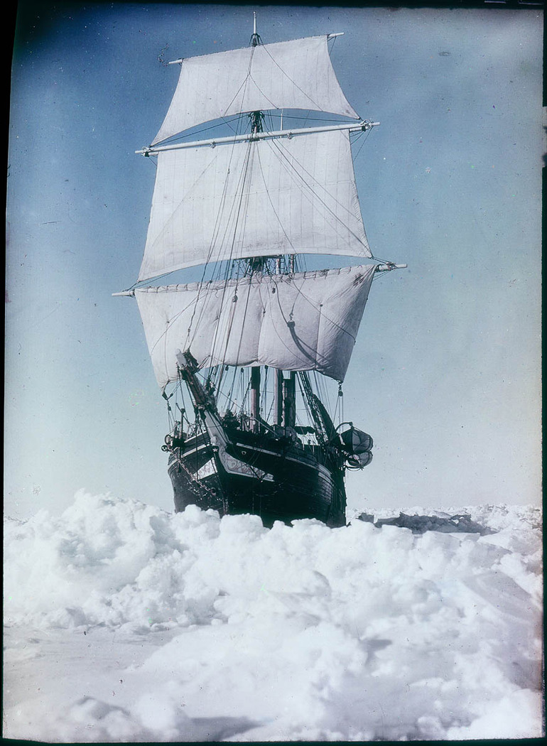
The ship to be used was called the Endurance, this is sometimes called the Endurance expedition, though was properly called: The Imperial Trans-Antarctic Expedition The Endurance set off from England just as the 1st World War was about to happen. Shackleton volunteered his ship and crew for the war effort but was told in a telegram to “Proceed”. It sailed in August 1914. 28 men including Shackleton were to reach the Antarctic.

Slide 19
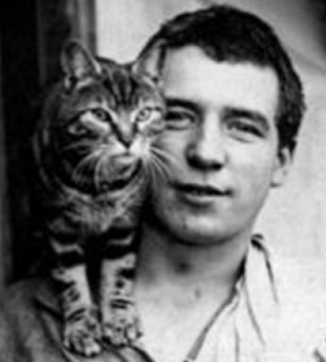
The journey started as expected, except a stowaway was found three days out of port after leaving South America for Antarctica. It was too late for Shackleton to turn back and so he offered the stowaway, 19 year old Perce Blackborow, a position of steward with the condition "If anyone has to be eaten, then you will be the first!". Blackborow accepted.
Stowaway Perce Blackborow with Mrs. Chippy, the ships cat

Slide 20
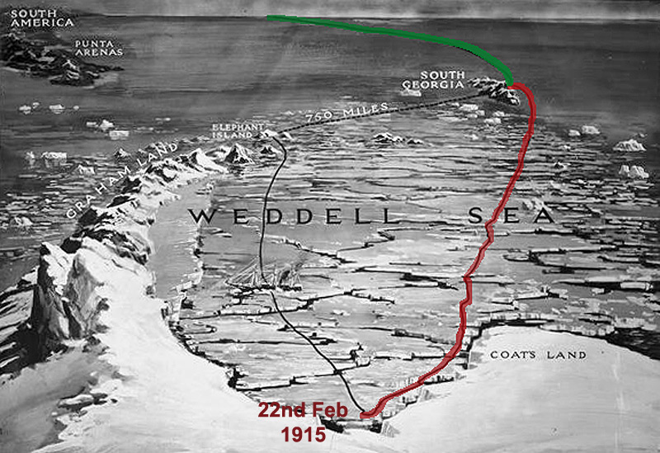
Some whalers he met at South Georgia on the way to Antarctica told Shackleton that it was a particularly bad year for sea-ice in the Weddell Sea. Do you think that Shackleton and his men would make it?
Shackleton’s journey from South Georgia to Antarctica

Slide 21
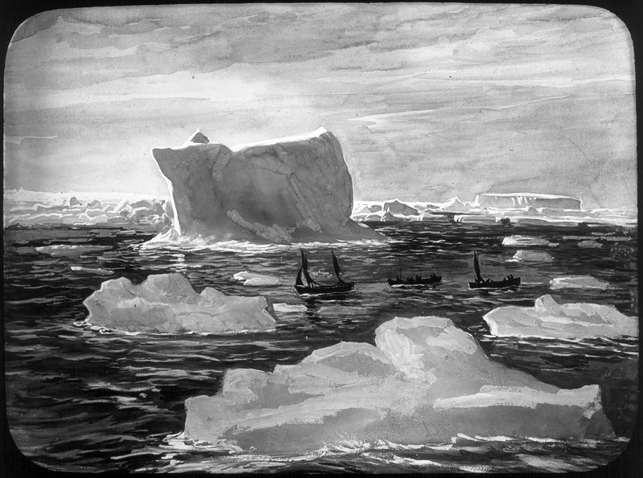
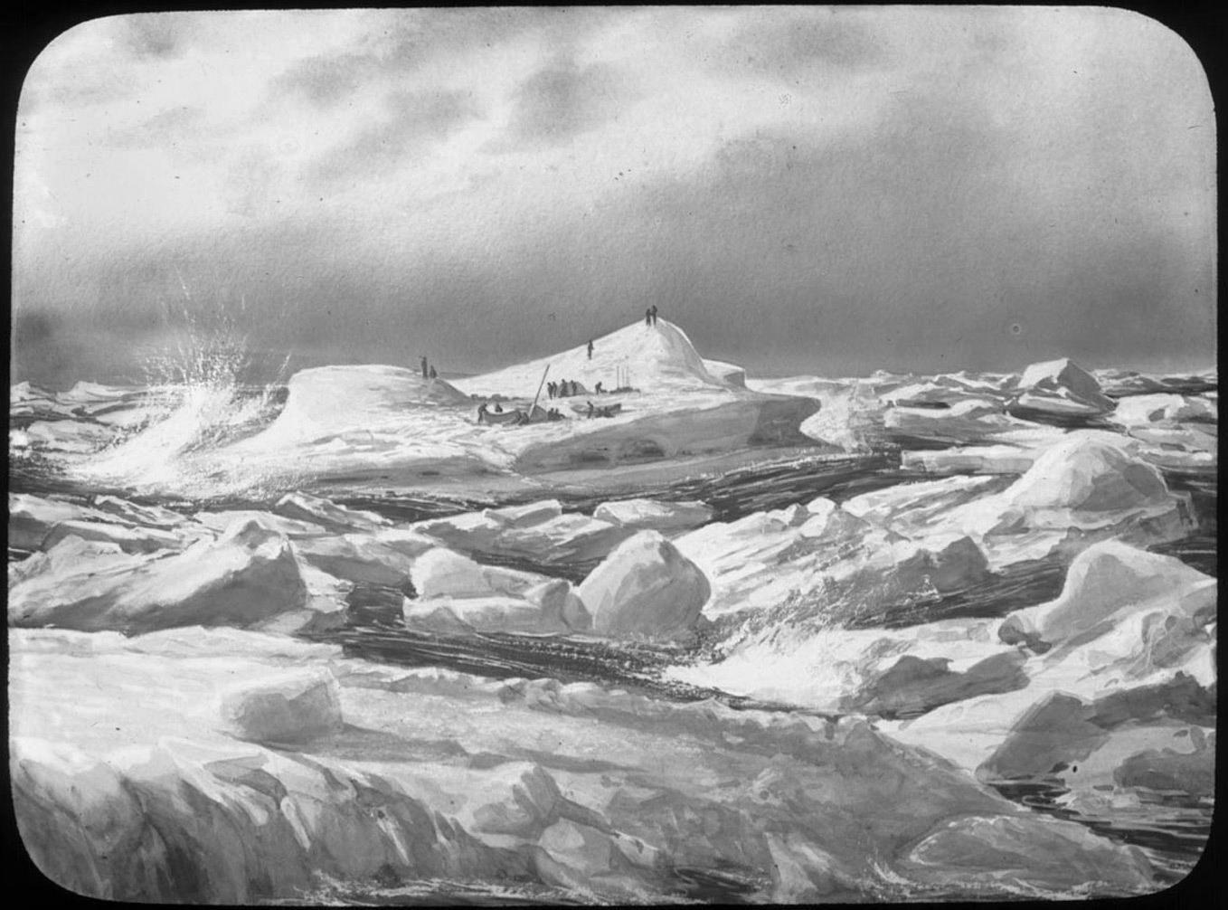
For five days, the men rowed and sailed the boats across the sea dotted with ice-bergs and pack-ice. For some of them this was the hardest part of the journey, wet and cold all the time, virtually no food or drinking water, little sleep and many cases of frost bite. At times they had to bail the boats out to prevent the stormy sea from sinking them and row for their lives.

Slide 22
Answer the following questions on what we have learnt about Shackleton so far.
1.‘Ernest Shackleton loved school.’ Is this statement true? Give evidence to show your answer.
2.How close did he get to the South pole when he lead the expedition?
3.Read the job advert again, do you think anyone would want to apply? Why do you think people did apply? Think about what we said about young men going to war, this will help you.
4. Why do you think that Ernest told the stowaway that if they needed to eat someone he would be the first?

Slide 23
Your activities.
Write a new job advert trying to persuade people to come on the expedition. Think about the language you are going to use to do this.
Remember to make the expedition sound exciting.
Use phrases like:
Once in a lifetime opportunity
Get to see the world
You’ll never get another chance like it.

Slide 24
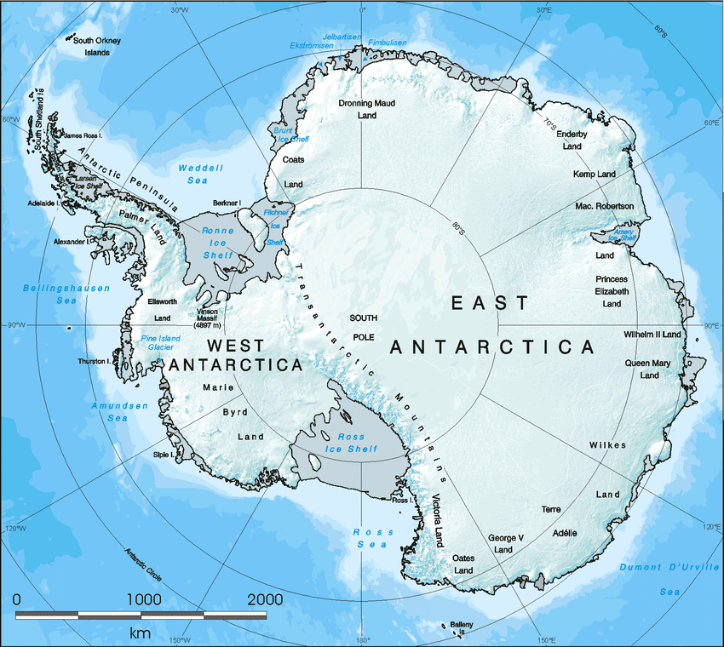
Activity 2
On the map to the side have a go at plotting the route you think Shackleton wanted to take across Antarctica. Remember he wanted to go all the way across passing through the South Pole.
Look at the picture of the map on the previous slide, it gives you a clue as to where he wanted to start.

Slide 25
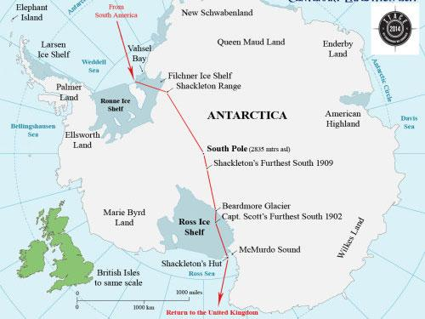
This is the actual journey that he planned does yours match what he wanted to do? Why do you think he went the way he did? Give reasons for your answer.

